Slide 1
Emerging Topics for 2024 & Beyond
John Chino, ARM-P, ARM-E, CSRM

Slide 2
Thought for the Day
Warren Buffett
“The important thing is to know what you know and know what you don’t know.”

Slide 3
Table of Contents
What did I get Right and Wrong in 2023 (which I predicted in 2022)
What is an Emerging Risk?
Risks as defined as Emerging by Certain Sources
The Top 10 (10-2)
Number 1!
It’s not all bad…

Slide 4
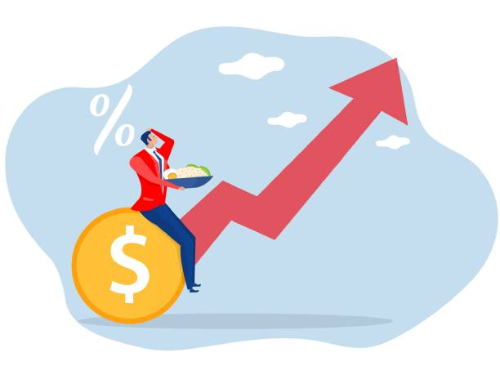
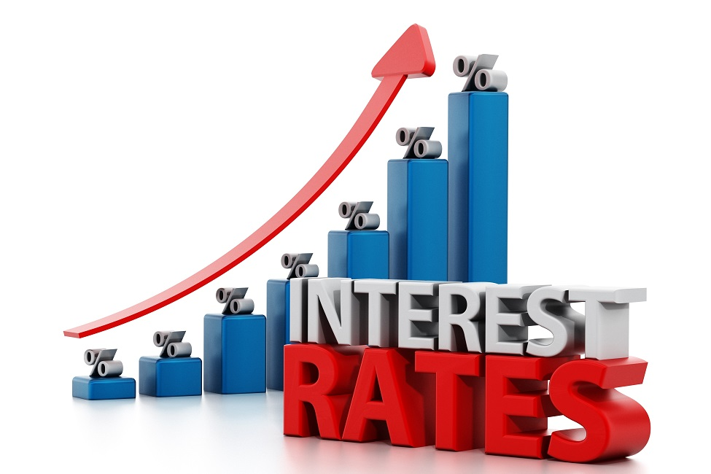
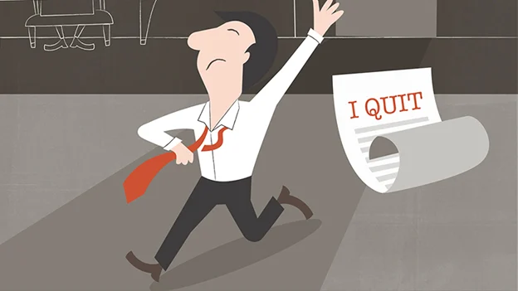
2023 Trends
What did I get right?
Hyper-Inflation
Investment Income
The Great Resignation

Slide 5
2023 Trends ? What did I get right?
I correctly predicted “hyper-inflation” as a trend; and it’s been a game changer resulting in pressure on rates for just about every line of insurance and especially Property.
I reassessed the hard market and called out a major “red flag” which proved to be prescient for disastrous property renewals.- That red flag was and continues to be investment income (high interest rates) which while mostly beneficial was disastrous for the Property Reinsurance Industry
The Great Resignation creates multiple hazards and this is especially keen in Law Enforcement where detention centers are being run at 50% of recommended staff deployment numbers and in many cases significantly less.

Slide 6
Temporary Trend: Hyper Inflation & the cost to rebuild
Architect’s Budget and the Actual Bids
The Pandemic has ravaged work crews and work sites
Logistics and supply chain issues have created huge cost increases for building materials especially wood products
Inflation fueled by fiscal stimulus
Many public agencies and school districts have shelved construction plans or reduced project sizes.
And your contractor is going to have a hard time meeting your insurance requirements!!

Slide 7
Wait a second, maybe it is a Crisis?

Slide 8
2023 Trends
Market Dynamics – Where we are now?
Pressure on Underwriting
Prudent Underwriting Decisions
Underwriting Results
Pressure on Investments
Interest Rates
Investment Income

Slide 9
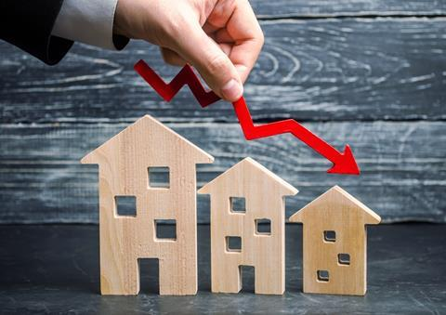
2023 Trends
What did I get wrong?
Property Renewals
Property Capacity Crunch
War in Ukraine Impact

Slide 10
2023 Trends ? What did I get wrong?
I reassessed the hard market and called out a major “red flag” which proved to be prescient for disastrous property renewals but I didn’t make the link to property nor did I come close to emphasizing how disastrous this would be.
I identified the interest rate hike but failed to emphasize its significant impact to the property capacity crunch. In fact, I should have started my list of emerging risks with Property Renewals as Number 1! It overshadowed everything else in the market and was a “budget buster”.
On the other hand, I overstated the significance of Cyber as the loss experience and market actually flattening primarily due to the war in Ukraine.

Slide 11
What’s an Emerging Trend?
Either new trends or current issues that are changing
Emerging Trends As Cited By
World Economic Forum
Swiss Re Institute
My own observations as to the Public & Scholastic Sectors
Notes:
John
Emerging Trends are either new trends or current issues that are changing.
We shall review Emerging Trends as cited by:
World Economic Forum
Swiss Re Institute
My own observations as to the Public & Scholastic Sectors

Slide 12
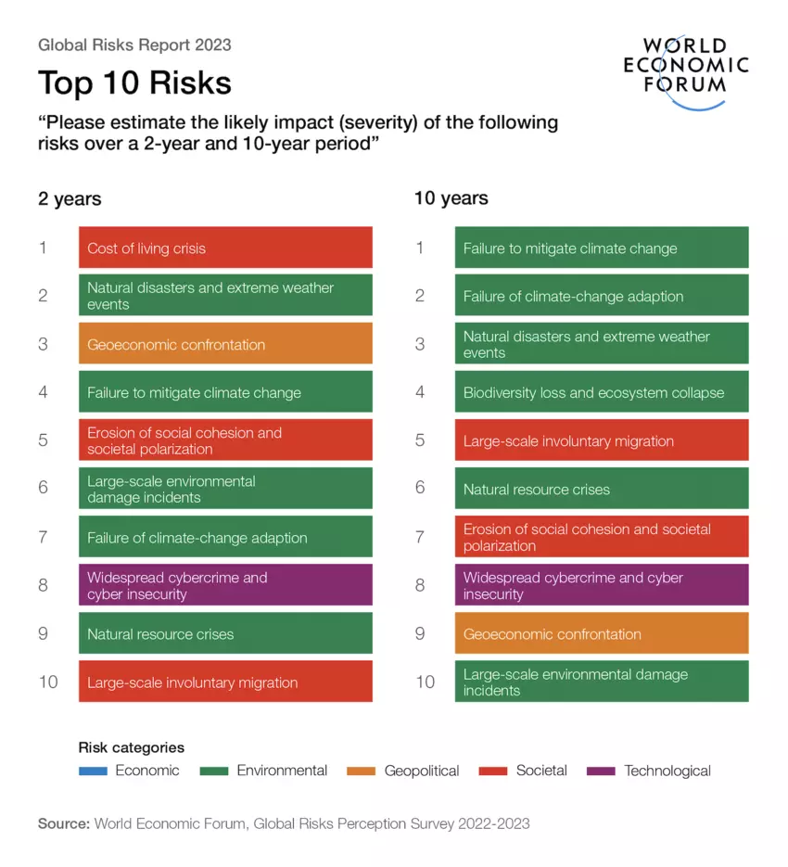

Slide 13
Swiss Re – Emerging Trends 2023-2025+
AI Getting Hacked 2025+
Bird Flu 2023-2025
Global Debt Stress – 2023-2025
Nuclear Radiation – 2023-2025
Toxic Chemicals – 2023-2025
Climate Change/The Artic – 2023-2025
Weight Loss Injections 2023-2025
Hooked On line - 2025+

Slide 14
JC: Insurance, Scholastic & Public Agency Related Emerging Trends
Emerging means changing or new…
10 Sexual Abuse & Molestation (SAM)
9) Workers’ Compensation Severity
8) Mental Illness & Homelessness
7) Where are all the new hires?
6) Law Enforcement
5) Climate Change & Risk Mitigation
4) Cyber
3) Rising Inflation & the Debt Crisis
2) Property and the worst market in 2 generations (or more).

Slide 15
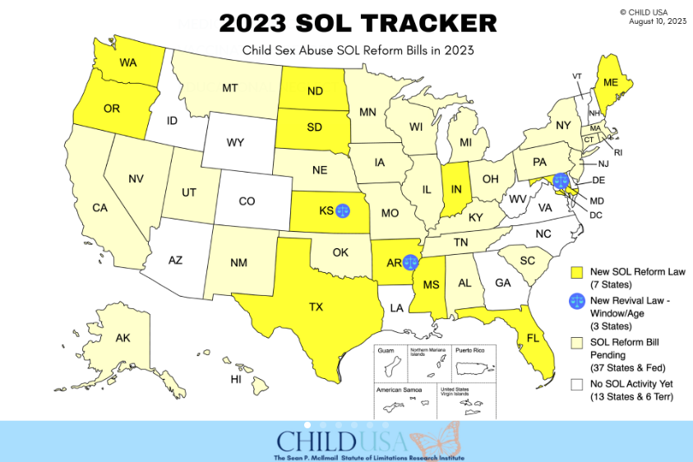
Reviver Legislation and Sex Abuse – 2023
#10
Source: Child USA https://childusa.org/2020sol/

Slide 16
Top 10 Emerging Risks
#10
Sexual Abuse & Molestation
Insurance Industry Response
Retreat entirely
Claims Made Coverage
Lower Limits, Higher Deductibles & Raise Prices
“Sunset Clauses”
Knowledge equals an exclusion
Aggregate Limits
Per Victim Attachment
Mandatory Loss Control

Slide 17
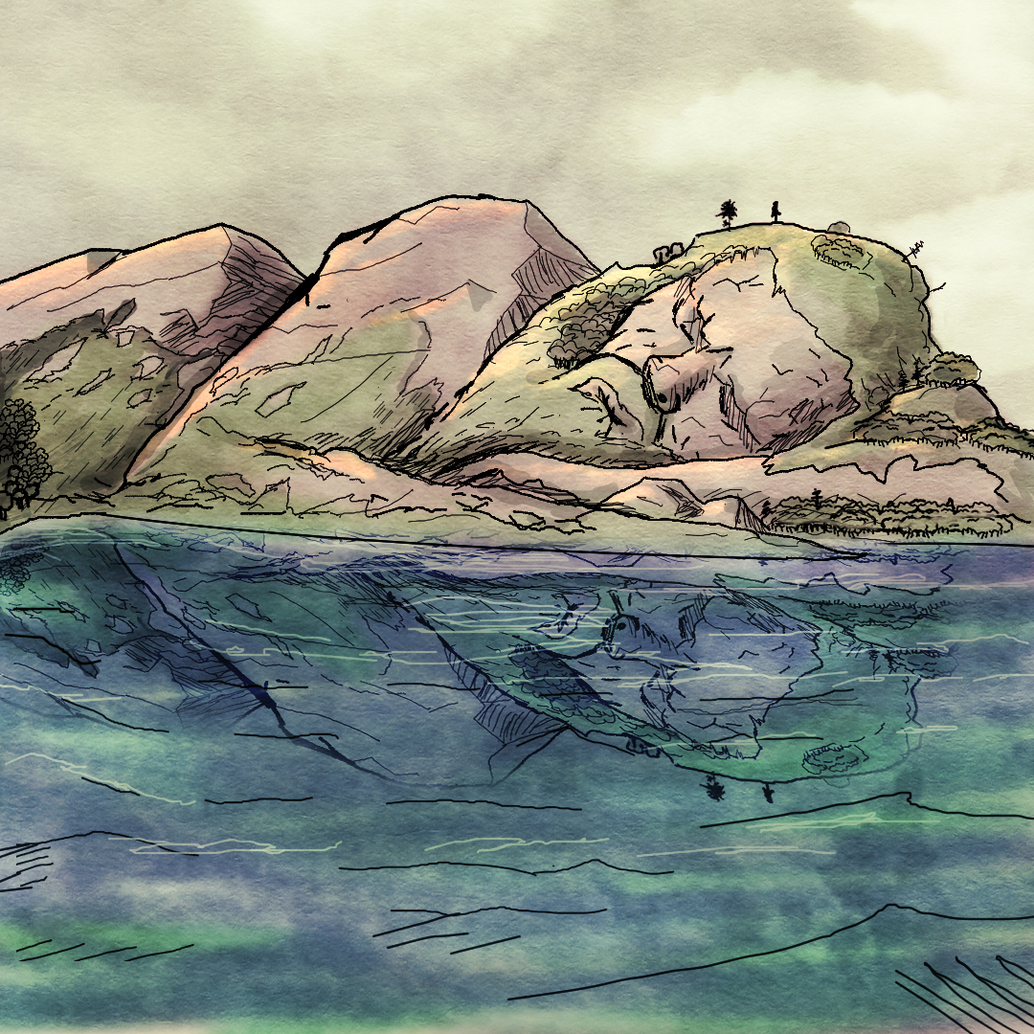
Top 10 Emerging Risks
#9
Workers’ Compensation Severity
Frequency is great but severity is growing…exponentially
The Costs of large death and permanent total disability claims
Safety National reports a 30% increase in claims with incurred over $10M
NCCI and WCIRB do not track this information and so their news is always good
Cost Drivers

Slide 18
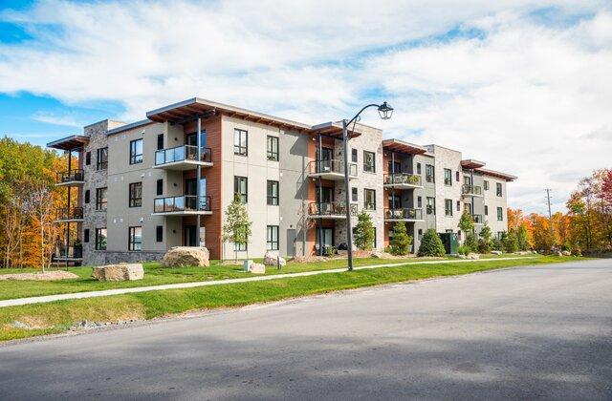
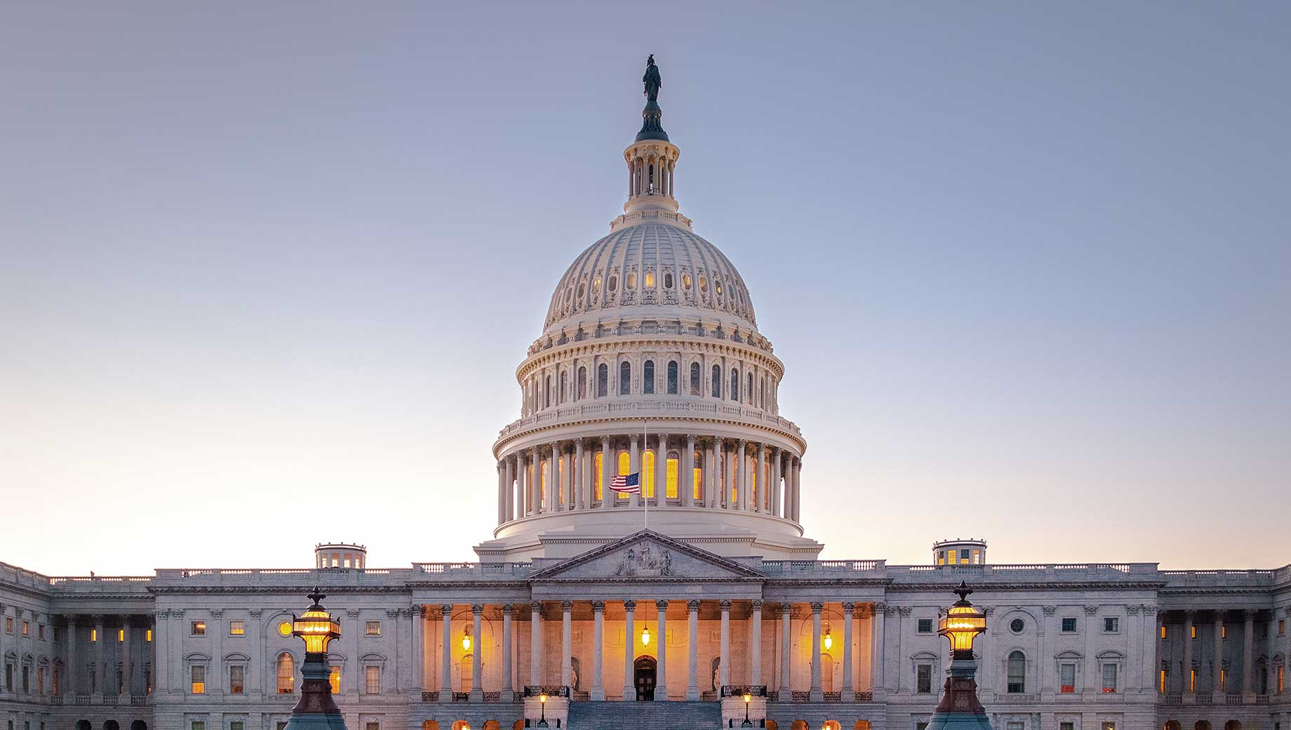
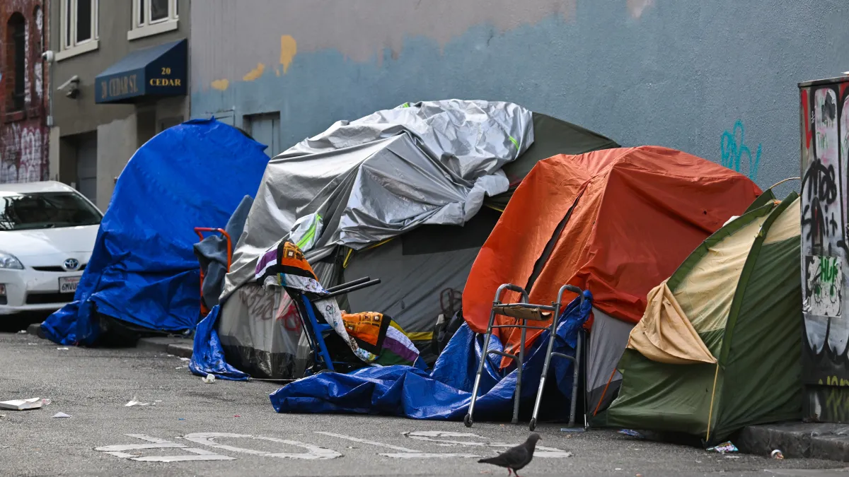
Top 10 Emerging Risks
#8
Mental Health & Homelessness
Community Assistance Recovery and Empowerment (CARE)
Lack of affordable housing
Governments are struggling with it
Homelessness rose 16%
California passed the CARE ACT in 2022

Slide 19
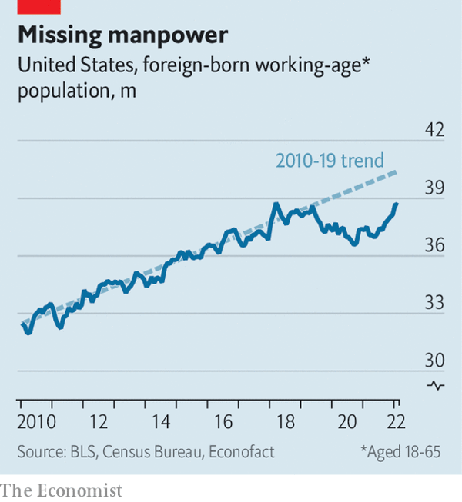
#7

Slide 20
Top 10 Emerging Risks
#6
Law Enforcement
Law Enforcement “fixes” that Insurers find abhorrent
Colorado Senate Bill 217
Eliminates Qualified Immunity
Officers to face up to $25k in personal damages
Colorado House Bill 1250
Deadly force as a “last resort”
New Mexico HB4
Allows New Mexicans to launch lawsuits against governmental entities in State Court if they believe their civil rights have been violated.
Eliminates Qualified Immunity

Slide 21
Top 10 Emerging Risks
#6
Law Enforcement
Insurers are not keen on Law Enforcement risk
Staffing is a crisis in some cities
Public perception
Continuing media coverage
Changes in law
Colorado
New Mexico
Who’s next?
Qualified Immunity

Slide 22
Climate Change and Increasing Losses for the Industry
#5

Slide 23
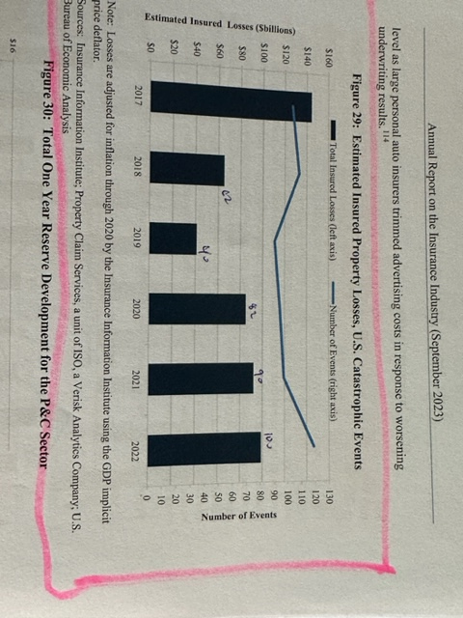
2020 & 2021…

Slide 24
Top 10 Emerging Risks
#5
Climate Change & Risk Mitigation
Better laws
Shared Risk Financing
Impact of Hurricane Andrew
More Secure Buildings
Technology!

Slide 25
Top 10 Emerging Risks
#4
Cyber
The Ukraine War was actually good for Cyber Insurers
US Government is concerned about the threat
Federal Agencies are coordinating responses

Slide 26
Rising Inflation and The Debt Crisis
#3
The last time we conquered inflation was referred to as the Great Moderation and it took from the 1980’s to 2007. The cure was the Central Bank and the focus on supply-side reforms.
The response to the pandemic was a flooding of money from governments to the public which ushered in the return of inflation.
Inflation impedes the economic growth and hurts governments and can result in recession which is likely. This prevents governments from investing in technologies, health care and other services.
In a severe recession the result might place stress on the ability of governments to pay debt as well as corporations.

Slide 27
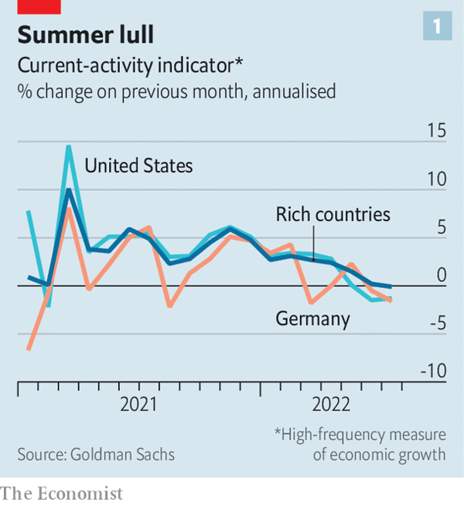
#3

Slide 28
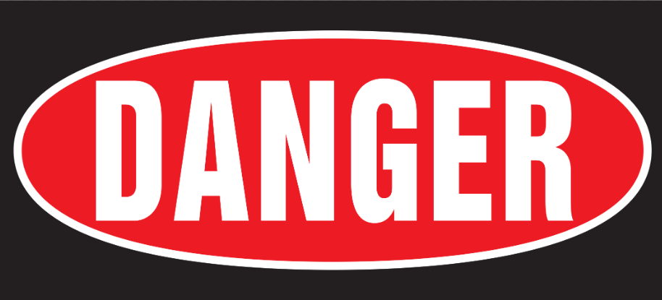
Top 10 Emerging Risks
Public Entity Community of Practice
Developing Public Entity Insurance Professionals
#2
Property and the worst market in 2 generations (or more)
Marketplace
Realities
Controllable
Variables
Industry CAT
Capacity
Adequate Valuations
Warning – Severe Market Conditions Ahead
Inflation and Loss Cost Trends
Communication
Set Expectations
CAT & Un-Modelled “Secondary Peril” Losses
Program Structure

Slide 29
Top 10 Emerging Risks
#2
Property and the worst market in 2 generations (or more)
Marketplace Conditions Cause & Effect
Key Market Drivers 2023
Reinsurance Protection
Inflation and Valuation
Increase in Frequency and Severity of Losses

Slide 30
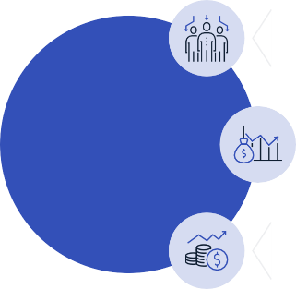
Top 10 Emerging Risks
#2
Property and the worst market in 2 generations (or more)
UGLY: Property Trends and Renewal Expectations
Reduced Capacity: Fewer Companies with less $$
Property Insurance:
Capacity Crunch
Increased Deductibles and Reduced Limits: Pushes more risk onto the Pool
2023 Property Renewals
Increased Rates: Reinsurance became very Expensive

Slide 31
The Elephant in the Room
The Post Covid World is different and the difference is being seen in insurance and the Public Sector in a myriad of ways that are new, emerging and yet eerily familiar.
High Interest Rates
Hyper Inflation
Banking Stress
Debt Crisis
A War in Europe and now the Middle East as well
A “runaway” condition in respect of the cost of liability claims but especially for SAM, Law Enforcement, EPLI and Auto.
Property Capacity Crunch

Slide 32
Is there a different approach?
It isn’t the strongest that survive it’s the most adaptable….
Adapting to the “new normal” requires modifications to how we do business
Claims-Made: once a “four-letter” word but now essential for certain coverages
Captives: can provide pools with benefits and flexibility
Group Captives have been an option for pools for many years going back to the formation of the NLC-Mutual
What can you do if you're not eligible to be in a group captive?

Slide 33
Is there a different approach?
Use everything at your disposal…no one silver bullet
Avoid soft market thinking
Data, data, and more data
Expand your markets
Have a plan… and an alternative
Challenge the status quo

