Slide 1
Insurance Policy Basics
How to Read an Insurance Policy
Scott K. Thomason, Senior Vice President
Regional Practice Leader, Gallagher Public Sector
October 2023

Slide 2
Insurance Policy Basics Overview
Purpose of Insurance
Types of Insurance Policies
Fundamentals of Contract Law
Insurance Contract Provisions
Insurance Laws & Regulation
Insurance Policy Structure
Reading the Policy

Slide 3
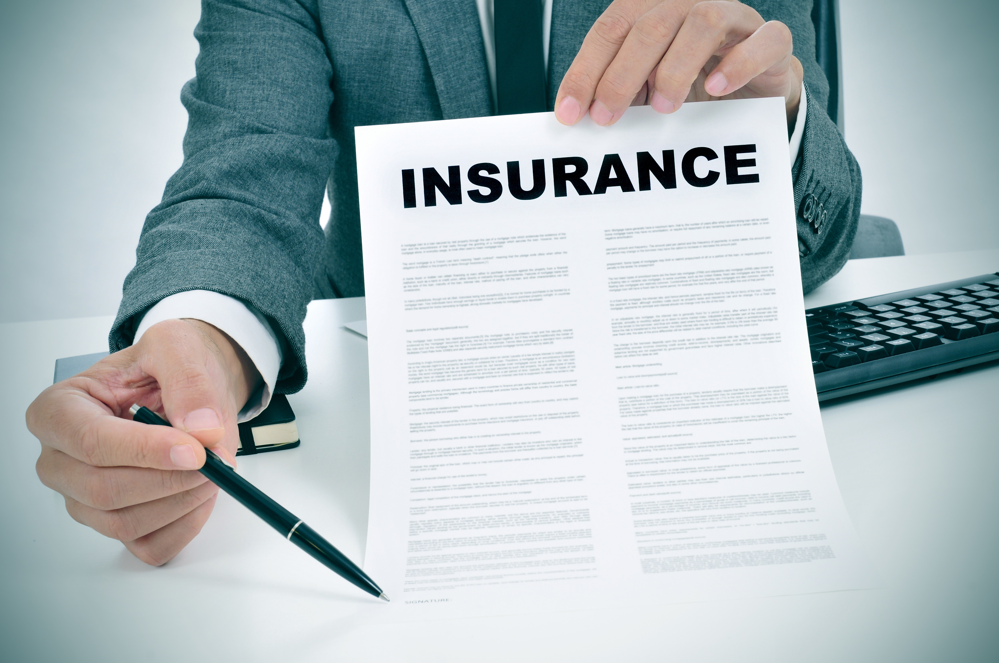
Purpose of Insurance
What is Insurance?
A contract in which one party agrees to indemnify another against a predefined category of risks in exchange for a premium. Depending on the contract, the insurer may promise to financially protect the insured from the loss, damage, or liability stemming from some event.
What is the purpose of buying insurance?
To make you whole again
To take a known loss for an unknown loss
To spread out risk
To sleep better at night
Insurance procurement is part of ART
What is the ART of Risk Management?
Avoid – risk avoidance
Reduce – risk control, safety, contractual risk
Transfer – via contract or via insurance

Slide 4
Types of Insurance Policies
Property & Casualty
Commercial Package
Automobile
Commercial Property
Professional Liability
Workers Comp
Life & Health
Health
Group Accident
Disability
Life
Dental
Government Plans
Social Security
Unemployment
NFIP(Flood)
Federal Crop
Reinsurance
Facultative
Treaty
Proportional
Non-Proportional
Risk Attaching

Slide 5
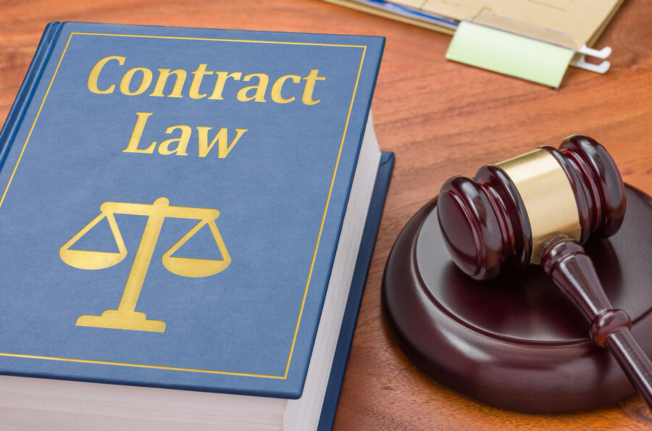
Fundamentals of Contract Law
The basis of all contract law is a simple promise!
Three elements to a valid contract
Offer
Acceptance
Consideration
To be an enforceable contract, it must:
Have a legal purpose
Does not violate public policy
All parties are able to consent

Slide 6
Insurance Contracts
Insurance has some very distinctive characteristics
Principle of Indemnity
Insurable Interest
Subrogation
Unilateral Contract
Aleatory Contract
Contract of Adhesion
Doctrine of Utmost Good Faith

Slide 7
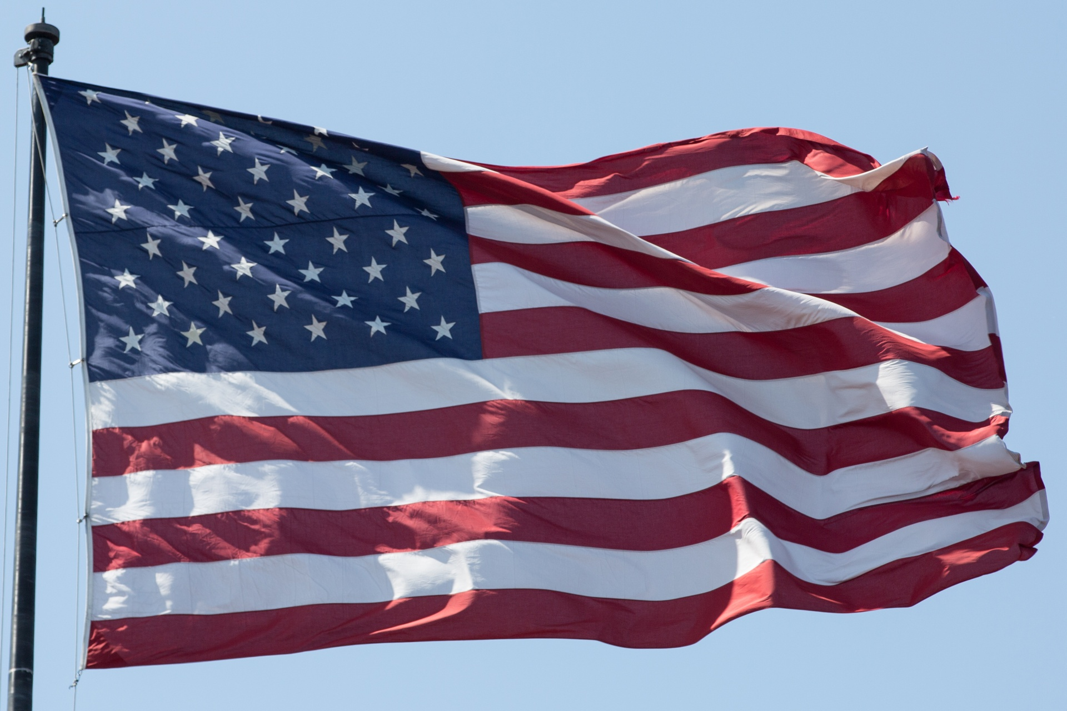
Insurance Laws & Regulation
The Property & Casualty insurance industry is one of the most highly regulated businesses in the United States. It receives a lot of oversight due to the important social and economic function insurance provides to individuals and businesses.
Insurance Laws and Related Laws
Federal Statutes (TRIA, NFIP, USL&H)
State Statutory Laws (Insurance Regulation, WC Benefits)
State Tort Caps / Immunity Protection
PLUS common laws
Regulation by Departments of Insurance
Licensing and Enforcement 4. Legal and Compliance
Financial Monitoring 5. Advertising Oversight
Insurance Fraud 6. Information Gathering
Admitted versus Non-Admitted Policies

Slide 8
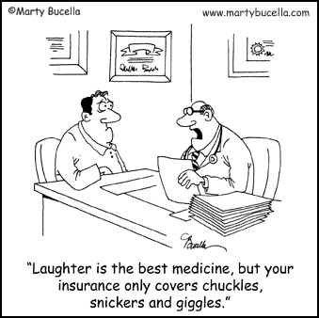
Insurance Policy Structure
Are all insurance policies the same?
Types of Insurance Policy Forms
Standardized
ISO – Insurance Services office
AAIS – American Association of Insurance Services
Non Standard Carrier Forms
Manu Scripted (Endorsements)
- Broker
- Carrier

Slide 9
Reading the Insurance Policy
Every Insurance Policy has FIVE parts:
Declaration Pages
Insuring Agreements (The main policy form)
Conditions
Definitions
Exclusions
Most commercial policies have a sixth part:
Endorsements

Slide 10
Policy: Declarations Pages
The “Dec Page” is usually the first page or set of pages of the policy and it summarizes key information such as:
Insurance Company
Named Insured
Coverage
Forms Checklist
Policy Number
Expiration Date
Placing Agency
Deductibles
Premium
Limits of Liability
Insured Address
Effective Date

Slide 11
Policy: Insuring Agreement
The main policy form that grants coverage
Details the heart of the coverage provided
Additional agreements (coverage sections) can be embedded
Includes Conditions, Definitions, and Exclusions
Sample Agreement wording from ISO Commercial Property CP 00 10 10 12
A. Coverage
We will pay for direct physical loss of or damage to Covered Property at the premises described in the Declarations caused by or resulting from any Covered Cause of Loss.
1. Covered Property……
Sample Agreement wording from ISO Commercial Property CP 00 10 10 12
SECTION I - COVERED AUTOS
Item Two of the Declarations shows the "autos" that are covered "autos" for each of your coverages. The following numerical symbols describe the "autos" that may be covered "autos". The symbols entered next to a coverage on the Declarations designate the only "autos" that are covered "autos".
A. Description Of Covered Auto Designation Symbols……

Slide 12
Conditions & Definitions
Policy Conditions
Policy Definitions
Duties in the event of a loss
Loss payment
Liberalization clause
Other insurance clause
Audit provisions
“Auto”
“Bodily Injury”
“Employee”
“Occurrence”
“Claim”
“Accident”
Loss Conditions
This section spells out both the insured and insurer’s rights and responsibilities under the policy
Key words and phrases are often assigned “definitions” in the policy

Slide 13
Exclusions & Endorsements
Policy Exclusions
Endorsements
Removes morale hazards
Not all policies have endorsements but most all commercial policies do
Clarifies coverage
Standard endorsements exist
Eliminates overlapping coverage
Removes uninsurable risks
Every exclusion serves a purpose
Removes coverages that are not contemplated in the premium
REDUCES COVERAGE
Takes away coverage
Carves out …..
Restricts coverage
Each line of business has needs to customize the coverage
Grants coverage

