Slide 1
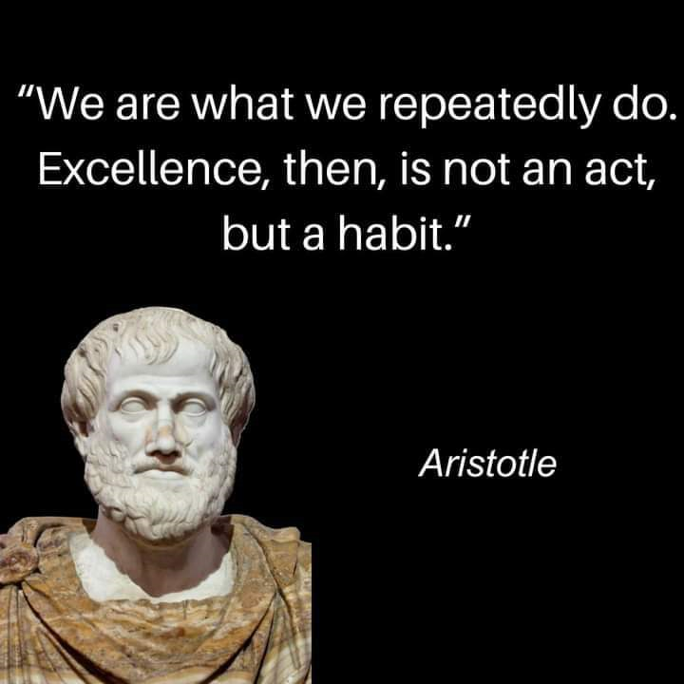
7 Habits
of Highly Effective Risk Managers

Slide 2
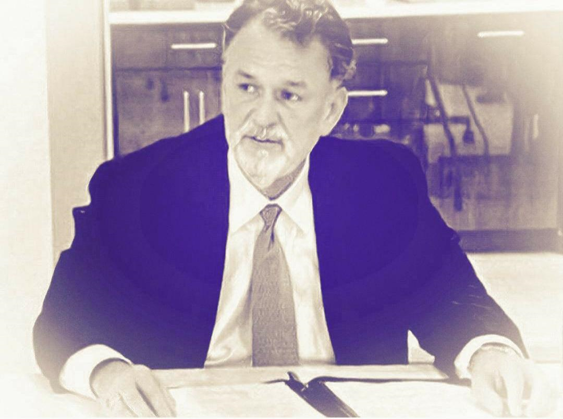
7 Habits
of Highly Effective Risk Managers
Your Instructor:
Michael G. Fann, ARM-P, MBA
President/ Chief Encouragement Officer
Public Entity Partners
Franklin, Tennessee
What must we do daily to protect…
our People
the Public
our Property

Slide 3
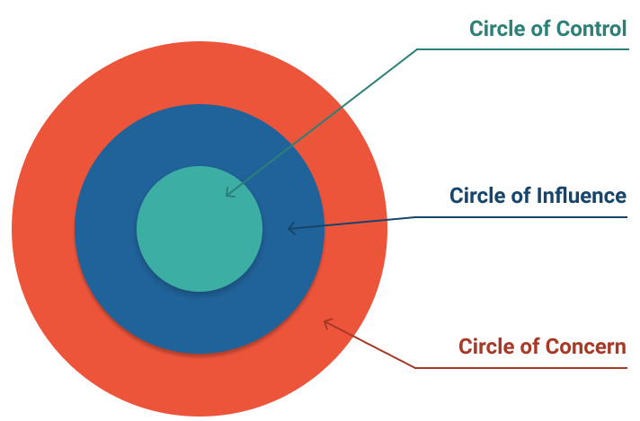
7 Habits of Highly Effective Risk Managers
Moving from Dependence to Independence
Habit 1 – Be Proactive
Take responsibility for one’s reaction to one’s own experiences
Take the initiative to respond positively; seeking solutions
Improve the situation
[know what you want, but take what you can get]
“Between stimulus and response lies your ability to choose”
Focus your responses within your “circle of influence”

Slide 4
7 Habits of Highly Effective Risk Managers
Moving from Dependence to Independence
Habit 2 – Begin with the End in Mind
Know where you are going
Immerse yourself into your Vision and Mission
Define and understand where you currently are
[To thine own self be true. – from Shakespeare’s Hamlet]
“You are the programmer”
[All things are created twice. First in your mind…]
Do not just act… think first. Get your mind right, then act.

Slide 5
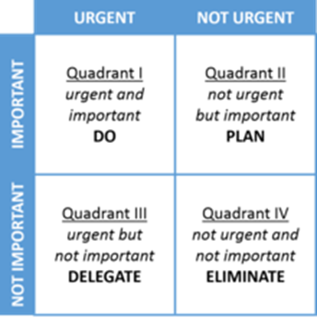
7 Habits of Highly Effective Risk Managers
Moving from Dependence to Independence
Habit 3 – Put First Things First
What’s important should never be at the mercy of what is urgent
Take the initiative to respond positively; seeking solutions
“Write the program, become the leader”
Urgent & Important - DO
Not Urgent, but Important - PLAN
Urgent, but not Important - DELEGATE
Not Urgent and not Important - ELIMINATE

Slide 6
7 Habits of Highly Effective Risk Managers
Moving from Independence to Interdependence
Habit 4 – Think Win-Win
What results will be mutually beneficial?
Seek agreement in your relationships
Value and respect the viewpoints, goals & needs of others
“Win-Win” isn’t about being nice nor a quick fix.
[“It is a character-based code seeking collaboration.”]

Slide 7
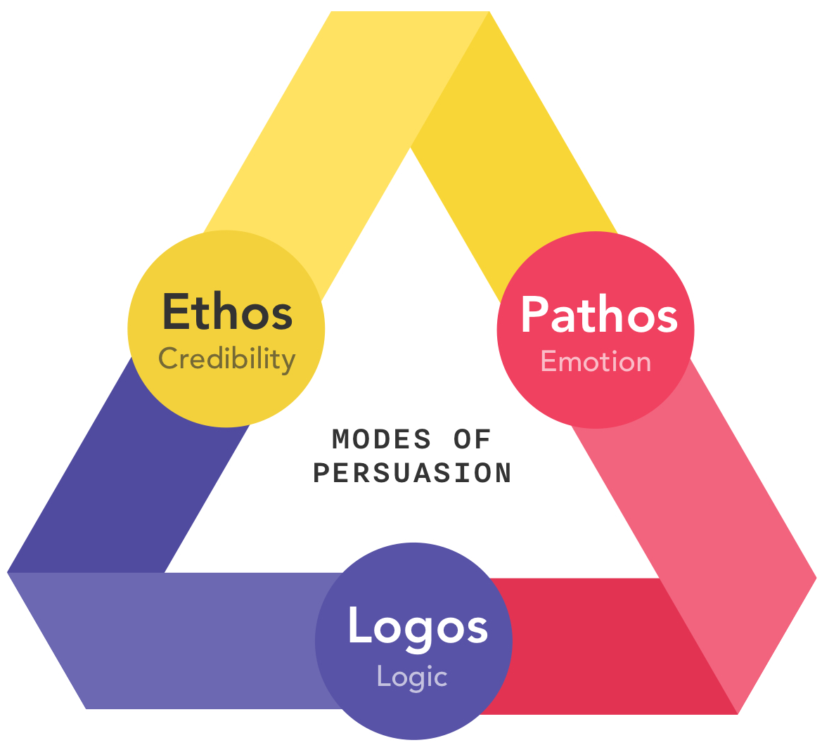
7 Habits of Highly Effective Risk Managers
Moving from Independence to Interdependence
Habit 5 – Seek First to Understand,
then to be Understood
Empathetically listen to genuinely understand
Keep an open mind
Create a positive problem-solving atmosphere
Ancient Greek philosophy of Three Modes of Persuasion
[Ethos – one’s personal credibility… the trust that one inspires]
[Pathos – empathy… emotional trust]
[Logos – logic and reasoning]

Slide 8
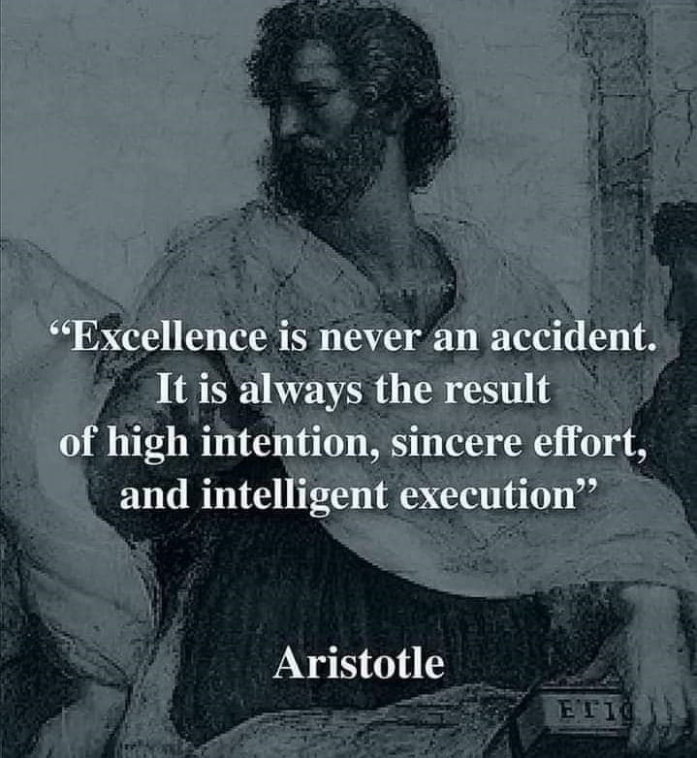
7 Habits of Highly Effective Risk Managers
Moving from Independence to Interdependence
Habit 6 – Synergize
There is safety in a multitude of counselors
Combine the strengths of people through positive teamwork
Achieve goals that no one could have achieved alone

Slide 9
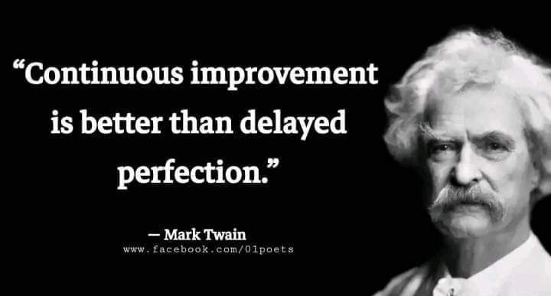
7 Habits of Highly Effective Risk Managers
Moving to Continual Improvement
Habit 7 – Sharpen the Saw
Constantly review the data
Balance and renew one’s approaches, resources & passion
The person you will be in 5 years is largely determined by what you input into your brain (reading, listening, watching), and the people you associate with.
Create a deeper understanding of people, accident causation, and core solutions
Create your organization’s “Upward Spiral” of growth, change and constant improvement

Slide 10
7 Habits of Highly Effective Risk Managers
Moving from Dependence to Independence to Interdependence
to Continual Improvement
7 Habits
Habit 1: Be Proactive
(Do something instead of nothing)
Habit 2: Begin With the End in Mind
(Get your mind right, Know the Goal, create a Plan)
Habit 3: Put First Things First
(Balance the Important and the Urgent)
Habit 4: Think Win-Win
(Everyone Can Win – seek collaboration)
Habit 5: Seek First to Understand, Then to Be Understood
(Listen Before You Talk)
Habit 6: Synergize
(Together Is Better – safety in a multitude of counselors)
Habit 7: Sharpen the Saw
(Balance Feels Best)

