Slide 1
Education and All Things Risk
Dorothy Gjerdrum
Senior Managing Director
Gallagher Public Sector & K-12 Education Practice

Slide 2
Agenda
K-12 and Higher Education:
Mission, context and leadership
Operations and decision making
Unique exposures
Lists of key risks
A deeper dive into SAM

Slide 3
Mission and Context
Higher Education
Young adults and youth
Lots of variations – public/private, 2/4-year, research, religious
K-12 Education
All grades through 12
Public, charter – created by state law
Private, independent – affiliated with an organization or specific mission
What’s the mission of your school?

Slide 4
A Key Element of Context: Stakeholders
Higher Education
Internal – leadership, staff, faculty, students, alumni, the board, contractors
External – contractors, peer institutions, parents, regulatory bodies, banks, local governments, insurers
K-12 Education
Internal – leadership, staff, faculty, students, the board, contractors
External – parents, contractors, other schools, regulatory bodies, banks, local governments, insurers
Definition from ISO 31000:
People and organizations who affect, can be affected by, or perceive themselves as affected by your organization’s decisions and activities

Slide 5
Leadership
Higher Education
Board of Trustees
Chancellor, President
Hierarchy and silos
K-12 Education
Governing Board
Superintendent
Principles and administrators
Leadership support is key to risk management success

Slide 6
Operations
Higher Education
Young adults living on their own for the first time – or older students
Faculty diversity, research, free speech
Athletics
Broad community engagement
Travel abroad
Summer camps
K-12 Education
In loco parentis
Transportation
Food service
Before- and after-care
Sports, clubs
Travel abroad, field trips
Multi-purpose use of buildings
Anything missing?

Slide 7
Decision Making
Key considerations for managing risk:
One decision maker versus consensus building
Authority versus accountability
Stakeholder interest and engagement
Important to engage allies and opponents

Slide 8
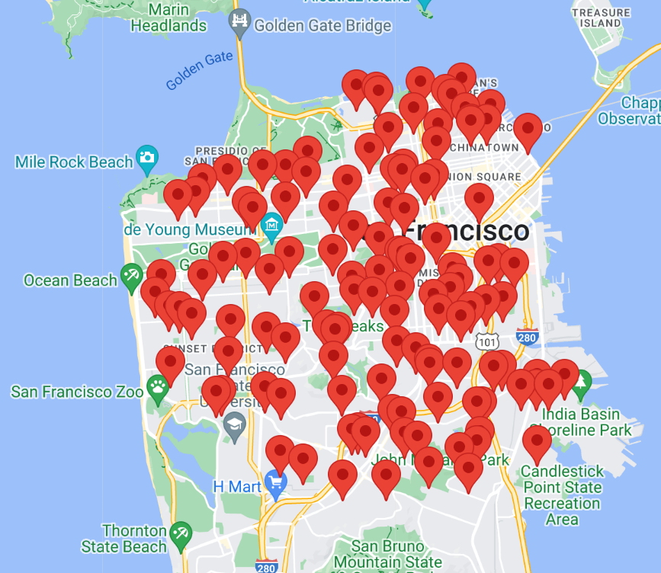
Ordinary Exposures – With a Twist
All schools have “ordinary exposures” that are experienced by many organizations, with some special twists:
Property – locations are concentrated, aging infrastructure, difficult to maintain updated values, buildings are unoccupied for periods of time, vandalism and fire

Slide 9
Ordinary Exposures – With a Twist
All schools have “ordinary exposures” that are experienced by many organizations, with some special twists:
Cyber – schools (including higher education) and government agencies are frequent targets (in top five), MFA compliance is difficult (impossible?)

Slide 10
Ordinary Exposures – With a Twist
Transportation
School bus driver shortage
Special ed transportation
Field trips
MVR checks
Volunteers using cars
Coaches

Slide 11
Unique Exposures
Sexual abuse and molestation (SAM)
Traumatic brain injury (TBI)
Failure to educate and special education
Civil rights litigation (ADA, IDEA, Title IX)
Unique workers’ comp exposures
Workplace violence & school shootings
Employment practices (unions, tenure)
Interested in emerging risks?
Attend John Chino’s session on Friday!

Slide 12
Lists of Top Risks – How Can They Help?
School-specific (K-12 or Higher Ed) and a compilation of nationwide experience – compare them to your top risks
Most include recommendations for treating risks – are you doing enough?
Watch for trends! What can we learn from other operations?

Slide 13
Top Ten Risks – Online Chubb Article
Student Life
Accidents
Student health
Mental health
Study abroad
Academic Operations
Hiring and promotion
Cyber & data security
Special events
Financial crime
Reputational damage
Clinical trials
These have a higher education focus
Risks facing educational institutions when returning to school | Chubb
https://www.chubb.com/au-en/articles/business/schools-in-session-understanding-education-related-risks.html

Slide 14
Top Ten Risks – United Educators, 2022
For Higher Education
Enrollment
Data security
Recruitment and hiring
Operational pressures
Student mental health
External pressures
Regulatory and legal compliance
Facilities and deferred maintenance
Public safety
Title IX
extension://efaidnbmnnnibpcajpcglclefindmkaj/https://www.ue.org/4902a8/globalassets/risk-management/reports/2022-top-risks-report-he.pdf

Slide 15
Top Ten Risks – United Educators, 2022
For K-12 Independent Schools
Enrollment
Recruitment and hiring
Operational pressures
Data security
Sexual misconduct
External pressures
Student mental health
Public safety
Diversity, equity and inclusion (DEI)
Facilities and deferred maintenance
extension://efaidnbmnnnibpcajpcglclefindmkaj/https://www.ue.org/4902cc/globalassets/risk-management/reports/2022-top-risks-report-k12.pdf

Slide 16
Charter Schools Top Ten Risks
Premises medical claims/GL
Employment practices
Vehicle accidents
Workers’ comp
Stolen laptops/equipment
Drop-off/pickup
Playground & athletics
Field trips/foreign travel
Special education
Crisis event and student violence
Gallagher’s Education Practice, Charter School Symposium

Slide 17
Top Six Risks – Philadelphia Insurance Co.
Harassment and bullying
Title IX expansion
Active shooter
Property damage
Employment practices
5 Critical Risks Schools Face Today — And How to Mitigate Them : Risk & Insurance (riskandinsurance.com)

Slide 18
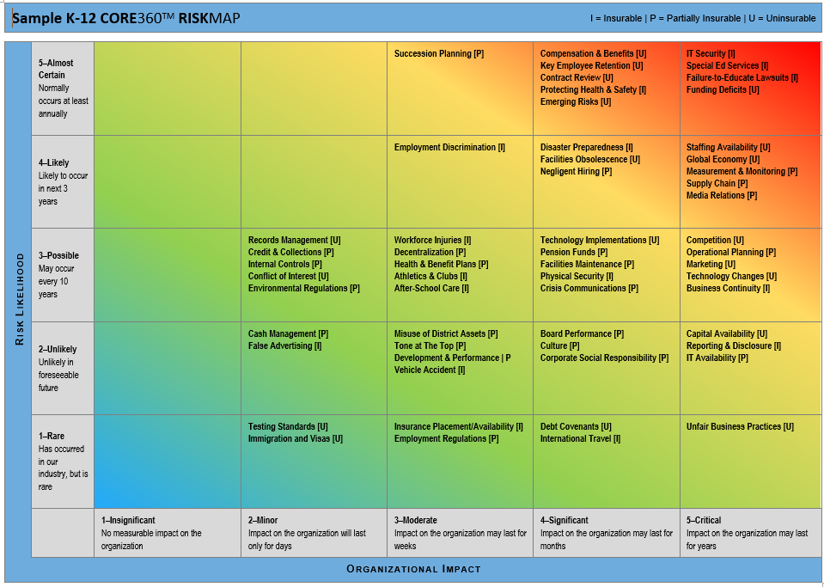
Strategic Risk Assessment
Key risks in 9 risk categories – customized by type of entity
5x5 rating scale
Easily deployed to any number of stakeholders
Each risk identified as Insurable, Partially Insurable or Uninsurable
Reach out if you’d like a demo or sample output

Slide 19
Report from the SAM Symposium
November of 2022
Transforming the Trend:
SAM Overview

Slide 20
Ground Rules
Children are not statistics
This risk affects all of us
And please – take care of yourself, too
Language:
CSA, SAM or SML
National Sexual Assault Hotline 1.800.656.4673
Rape, Abuse and Incest National Network · rainn.org

Slide 21
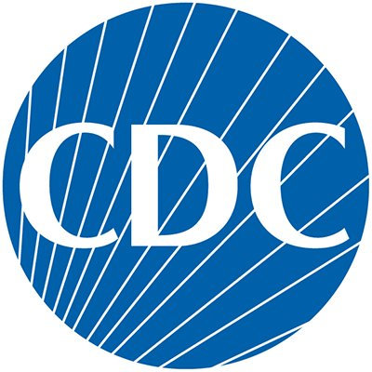
Overview of SAM
Defining Child Sexual Abuse
What is child sex abuse? The child:
does not fully comprehend
does not consent to or is unable to give informed consent to, or
is not developmentally prepared for and cannot give consent to
*From the Centers for Disease Control and Prevention (CDC)

Slide 22
Overview of SAM
Why Does This Risk Need Attention?
1 in 4
Girls
1 in 13
Boys
CDC Statistics based upon reported incidents
$9B
Impact
7x
Disabilities
91%
Known

Slide 23
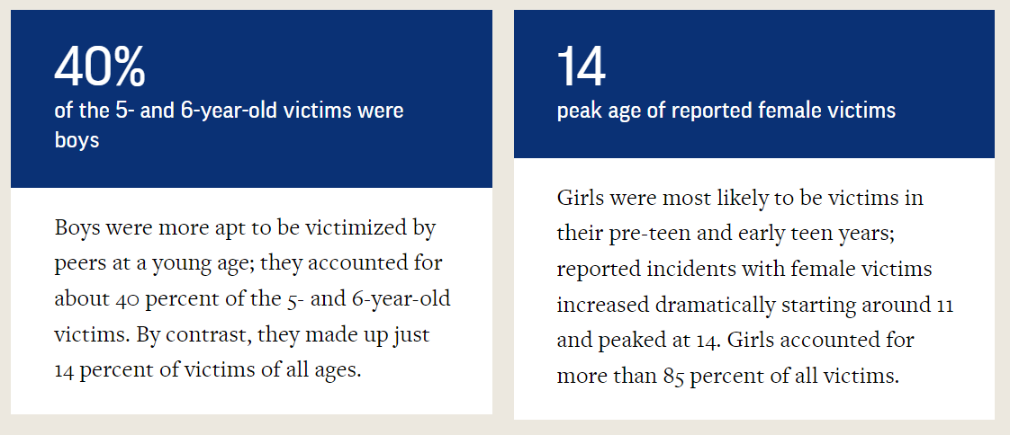
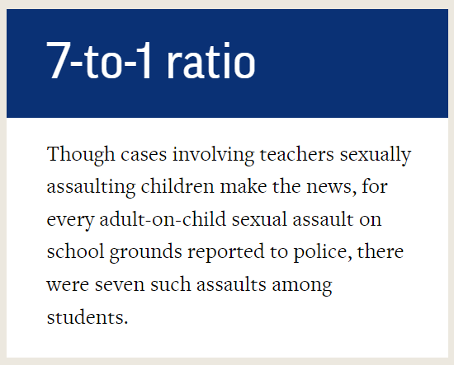
Overview of SAM

Slide 24
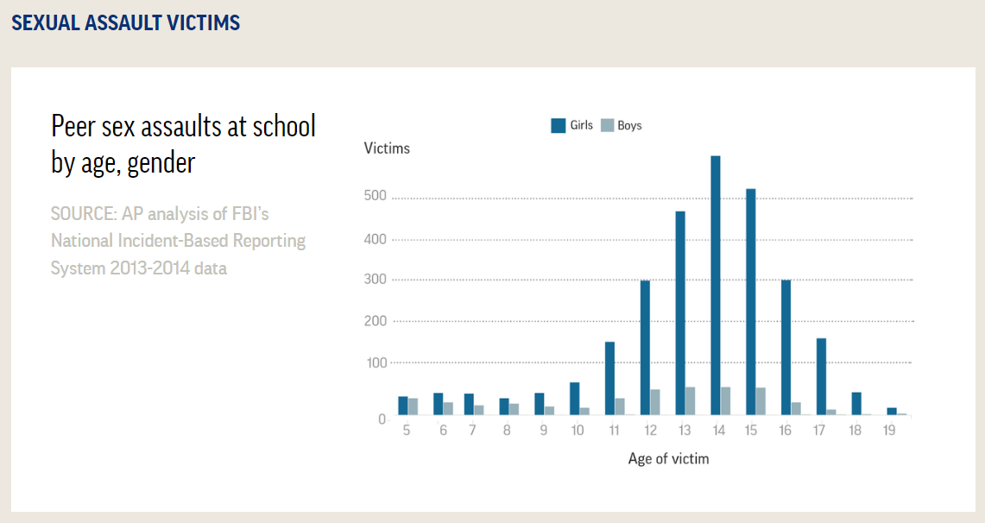
Overview of SAM

Slide 25
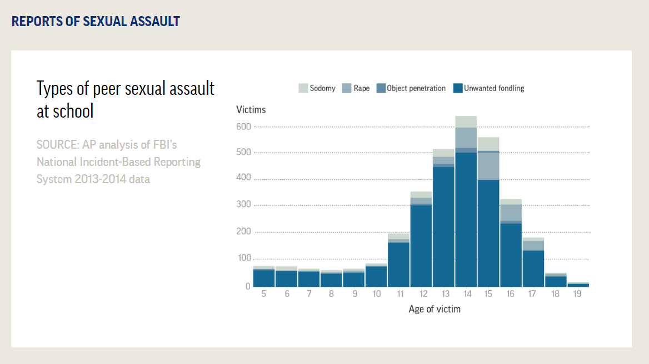
Overview of SAM

Slide 26
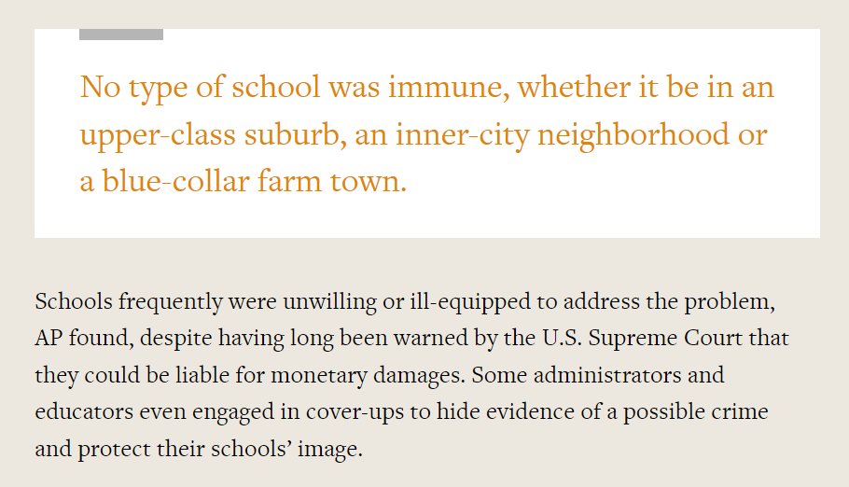
“It Won’t Happen Here…”

Slide 27
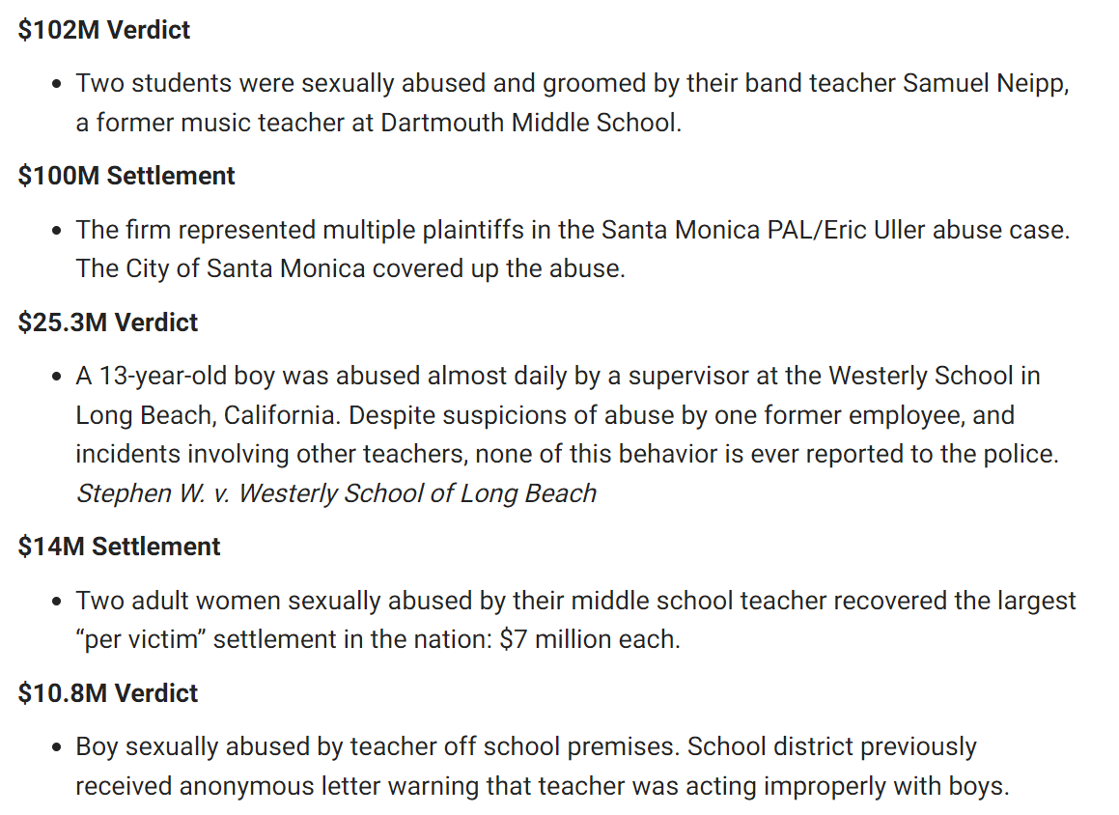
High $$ Verdicts and Settlements
California Cases

Slide 28
Long-Term Consequences
Experiencing child sexual abuse can affect how a person thinks, acts, and feels over a lifetime. This can result in short- and long-term physical, mental, and behavioral health consequences.
Examples of physical health consequences:
Sexually transmitted infections (STIs)
Physical injuries
Chronic conditions later in life, such as heart disease, obesity, and cancer
Examples of mental health consequences:
Depression
Post-traumatic stress disorder (PTSD) symptoms
Examples of behavioral consequences:
Substance use/misuse, including opioid misuse
Risky sexual behaviors, meaning sex with multiple partners or behaviors that could result in pregnancy or STIs
Increased risk for perpetration of sexual violence
Increased risk for suicide or suicide attempts
Fast Facts: Preventing Child Sexual Abuse |Violence Prevention|Injury Center|CDC

Slide 29
Transforming the Trend: SAM Symposium
https://www.ajg.com/us/transforming-the-trend-symposium-resources/
K-12 schools & school pools, youth-serving nonprofits, higher education
Keynote speakers, panel discussion, cohort work
Key findings
Post-symposium actions:
Symposium Report
Strategic Action Plan and ongoing work:
Resources
Awareness and Support
Data

Slide 30
Transforming the Trend: Sam Symposium
Key Findings
We need to raise awareness among leaders; we lack a sense of urgency
“Most instances of sexual misconduct are the result of a long-term process, in which boundaries are breached gradually and lines of appropriate behavior are blurred. What may begin as an expression of care and compassion for a child can devolve over time into boundary violations or abuse when there is a lack of clear guidelines, effective training, appropriate coaching or corrective behavior.”
“Leadership is tasked with making the right decisions, even when they are tough decisions. Let’s make a conscious decision to respect the inherent value of our children and commit to training and prevention! When presented with the data, it will be hard not to choose sexual abuse awareness.”
Angela Crotty, Chief School Business Official, Midlothian School District, IL
Transforming the Trend Symposium Report,
Gallagher, 2023

Slide 31
Transforming the Trend: Sam Symposium
Key Findings
We need to raise awareness among leaders; we lack a sense of urgency
A few of the barriers to change that we need to address:
Lack of recognition of SAM as a prevalent risk that needs ongoing treatment
Not understanding the need to change the culture of silence – and change behaviors
Lack of reliable data and strategic, big-picture thinking
Lack of resources and capacity
A reliance on insurance as the primary solution and assuming that insurance will continue to be available
Passing the trash
Transforming the Trend Symposium Report,
Gallagher, 2023

Slide 32
Transforming the Trend: Sam Symposium
Key Findings
We need to develop a broader understanding & approach to manage this risk
Training & Awareness
Policies & Procedures
Incidents & Claims
Arbitration, Mediation, Litigation Management
Insurance Coverage & Risk Financing
Ethical Behavior
Community & Parent Engagement
Best Practices
Continual Improvement
The Legal Environment; Legislative Action

Slide 33
Transforming the Trend: Sam Symposium
Key Findings
Policies and processes need to be survivor-centric
Barriers to change that we need to address:
Claims management processes that prioritize “brand protection” over the safety of children
The mistaken belief that no reported claims means that there is no SAM behavior occurring
Policies and procedures that punish people rather than regarding incidents as opportunities for correction and training
A lack of listening and empathy, punishing reporters, mishandling allegations
Proprietary and Confidential

Slide 34
Thank You for Your Engagement!
Review:
Consider your mission, context, leadership and stakeholders as you build your risk management program
Does your program address all exposures?
Review the lists of key risks; what needs more attention?
Which of the SAM action items can you address?
Resources:
Lists specific to your operations
Interested in a broader approach? Consider a Strategic Risk Assessment (contact Dorothy)
SAM resources on Transforming the Trend web page

