Slide 1
Succession Planning for Next Gen
Mark ‘The RxProfessor’ Pew
Provost and Founding Partner
WorkCompCollege.com
mpew@WorkCompCollege.com

Slide 2
Learning Objectives
Identify needs for strategic and proactive, not reactive, succession planning
Outline tips for recruitment, retention and growth of your talent base
Recognize how change management is important to the transition of people and processes

Slide 3
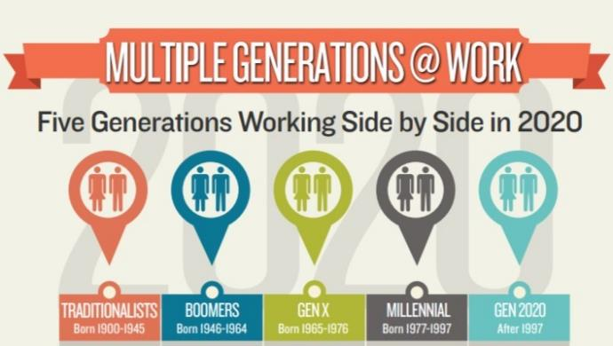
A Multi-Generational Workforce
Old Teach Young
Time management
Financial stability
Loyalty
Young Teach Old
Technology
Open minded
Entrepreneurial Spirit
Source: www.mentorworks.ca/blog/business-strategy/multigenerational-workforce

Slide 4
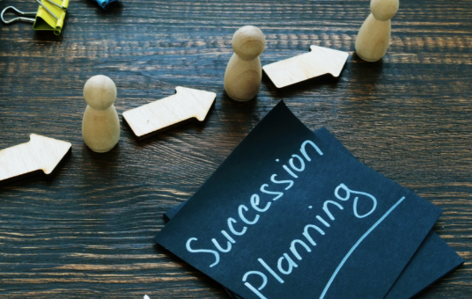
Succession Planning
Institutional and intuitional knowledge
People to people and/or Generative AI
Diversity
Look beyond the “usual”
Mission
Define the Why (with How, What, When, Where)
Now
Don’t wait until they leave

Slide 5
Recruitment / Retention
Creativity
Is a college degree required?
Professional development
Invest in people
Meritocracy
Cultivate competency
Balance
Leadership by example

Slide 6
Change Management
D x V x F > R
Dissatisfaction
with status quo
The D, V, and F
must be realized
in order to overcome
Resistance
(the status quo)
Vision
of a desirable
future state
Taking a
consequential
First step
Source: www.mindtools.com/az5rlba/beckhard-and-harris-change-equation

Slide 7
Change Management
D x V x F > R
Dissatisfaction
with status quo
The D, V, and F
must be realized
in order to overcome
Resistance
(the status quo)
Vision
of a desirable
future state
Taking a
consequential
First step
A
D
K
A
R
Hiatt, 2003
Awareness of the need for change
Desire to participate in and support the change
Knowledge of how to change
Ability to implement desired behaviors and skills
Reinforcement to sustain the change

Slide 8
What’s Your Next Move?

