Slide 1
Claims Management 101 What Battles to Fight JEOPARDY!
Presented by:
Bill Ahrens, CCMSI
Patty Reinecke, Midwest Employers Casualty
Monday, October 16, 2023

Slide 2
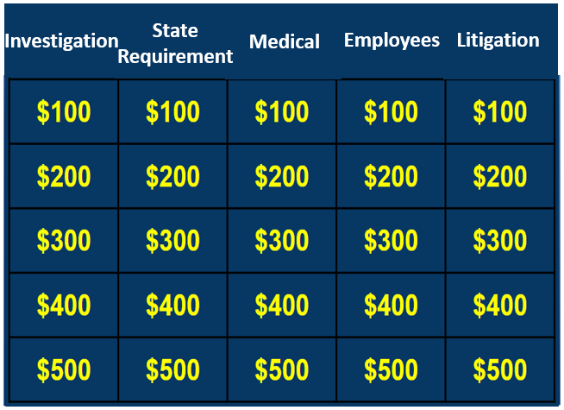
JEOPARDY!

Slide 3
Investigation for $100.00
This is the type of information that does not involve opinions or assumptions. Concrete data used for a basis for further interpretation – Just the __________ ma’am.

Slide 4
Investigation for $200.00
The process of reaching out and contacting the injured employee, supervisor, and physician

Slide 5
Investigation for $300.00
Who is a person with direct knowledge of a particular incident or even that could possibly provide valuable information relevant to an investigation?

Slide 6
Investigation for $400.00
Based on observed facts. Not influenced by emotions, opinions, assumptions or prejudices. Opposite of subjective.

Slide 7
Investigation for $500.00
Right to legally pursue a third party claim that caused a loss or is liable, in order to recover “damages” and reimburse any payments made.

Slide 8
State Requirements for $100.00
This state requirement ensures financial protection for injuries and/or illnesses related to employment to ensure injured employees receive appropriate benefits.

Slide 9
State Requirements for $200.00
The eligibility or acceptance as work related of claim after a reported injury at work under the state law for workers’ compensation claim. Factors can be state specific.

Slide 10
State Requirements for $300.00
Calculation used to determine the wage replacement paid during the time of disability in relation to a work injury or illness.

Slide 11
State Requirements for $400.00
This term refers to the resolution or conclusion of a worker’s compensation claim, usually involving an agreement between parties. The closure of outstanding issues in a workers’ compensation claim.

Slide 12
State Requirements for $500.00
This type of workers’ compensation benefit is provided when an injured worker sustains a permanent disability but can still work is some capacity. Can also be a physician determination that measures physical impairment that will not resolve and occurred as a result of the injury.

Slide 13
Medical for $100.00
The cause or the events leading up to a reported injury while in course and scope of employment?

Slide 14
Medical for $200.00
Examples of this include physician visits, medications, diagnostic testing, or physical therapy specific to the injury or illness sustained in course and scope of employment.

Slide 15
Medical for $300.00
This physician specializes in workplace injuries and/or illnesses.

Slide 16
Medical for $400.00
Type of medical professional serves as a liaison between the injured employee, physician, and employer. May be assigned to help manage the claim by coordinating medical treatment to aid in effective recovery/rehabilitation and keep the employer and claims adjuster up to date with the latest status.

Slide 17
Medical for $500.00
This is evidenced based information that provides standardized criteria for specific injuries or conditions and return to work guidance and or guidelines for people injured at work.

Slide 18
Employees for $100.00
What is a group comprised of employees and management working together to prevent workplace safety concerns by evaluating high risk areas and making recommendations for improvement?

Slide 19
Employees for $200.00
This term describes the process of an injured employee returning to their job while or after receiving medical treatment. A functional state every physician should address when treating an individual with a WC injury

Slide 20
Employees for $300.00
This term refers to the process of an employee suffering a new injury while they are still recovering from a previous work-related injury which may affect the recovery process and/or before the resolution of a workers’ compensation claim.

Slide 21
Employees for $400.00
This legal principal states that the condition of the employee at the time of hire should not affect their eligibility for worker’s compensation benefits. This includes pre-existing conditions.

Slide 22
Employees for $500.00
This can be defined as multiple injuries with the same employee over time while performing the same job duties and/or includes prior history of multiple claims by an employee.

Slide 23
Litigation for $100.00
This is the term for improper use of the workers’ compensation system that may include actions that are inconsistent, influences of possible secondary gain, and/or malingering.

Slide 24
Litigation for $200.00
What is the deliberate act of deceiving or misrepresenting information to gain an advantage or payment in a workers’ compensation claims.

Slide 25
Litigation for $300.00
This is the disallowance of workers’ compensation claim.

Slide 26
Litigation for $400.00
This term can used for employees who file workers’ compensation claim after workers’ compensation claim; often for minor or exaggerated injuries.

Slide 27
Litigation for $500.00
This term refers to the act of reporting a work-related injury or incident after the required deadline has passed. This delay could potentially complicate the investigation process.

Slide 28
Final JEOPARDY
Hint:
Think like a defense attorney.

Slide 29
Ask any defense attorney and they will tell you a good claim is ________ claim.

Slide 30
QUESTIONS

