Slide 1
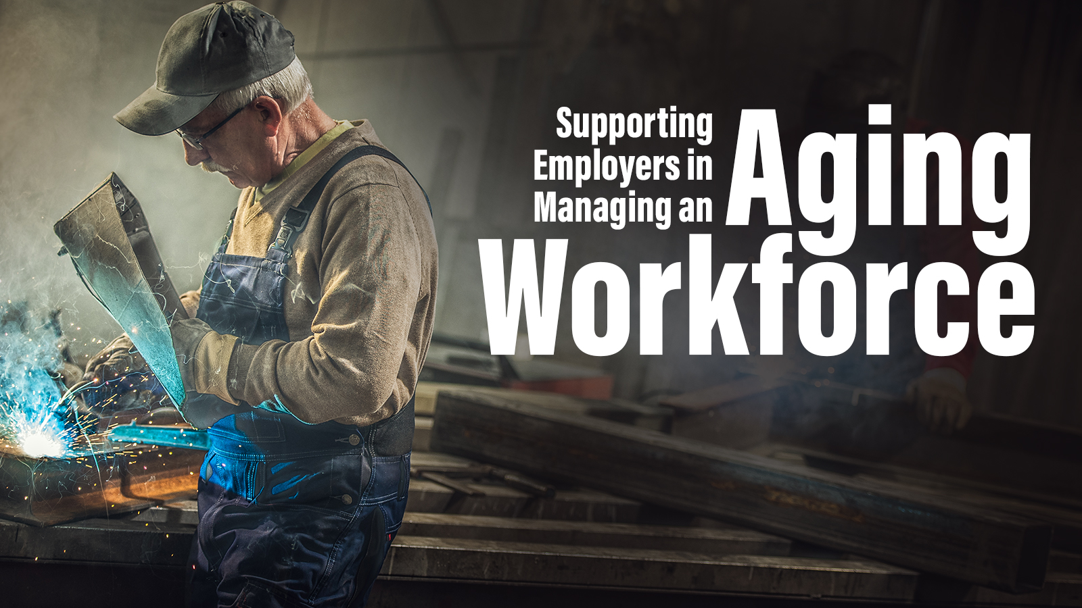

Slide 2
Introduction
Patty Reinecke, RN, BSN, CCM, MSCC. Patty Reinecke, RN, BSN, CCM, MSCC, Director of Client Consults and TPA Relationships at Midwest Employers Casualty (MEC), a Berkley Company, has over 28 years of experience in the workers’ compensation industry. She provides a unique healthcare perspective to identify high-risk claims quickly and develop solutions that help employers and injured employees achieve better outcomes. In her current role, she works to ensure quality claim handling within the MEC Claims Department and as a liaison to facilitate positive working relationships with our partners and their claim administrators.

Slide 3
Objectives
Learn why our workforce is aging
Know what drives the aging workforce to keep working
Effects of aging
Prevention and solutions for keeping the aging worker safe
Claims management
Question and answer

Slide 4
Objectives
Learn why our workforce is aging
Know what drives the aging workforce to keep working
Effects of aging
Prevention and solutions for keeping the aging worker safe
Claims management
Question and answer

Slide 5
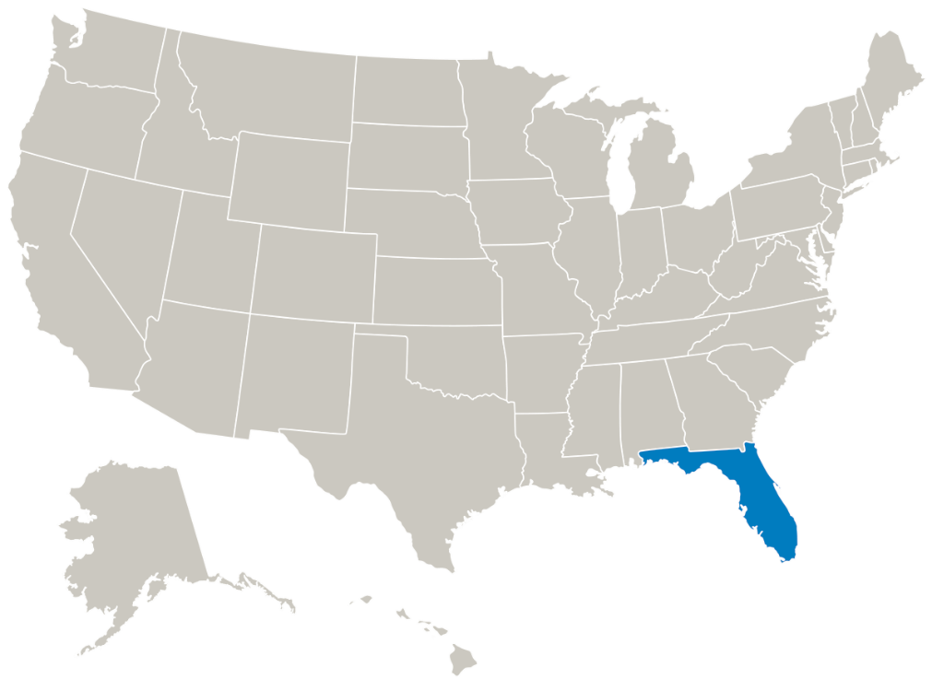
Changing Demographics
2000
States with at least 18 percent of the population age 65 or older

Slide 6
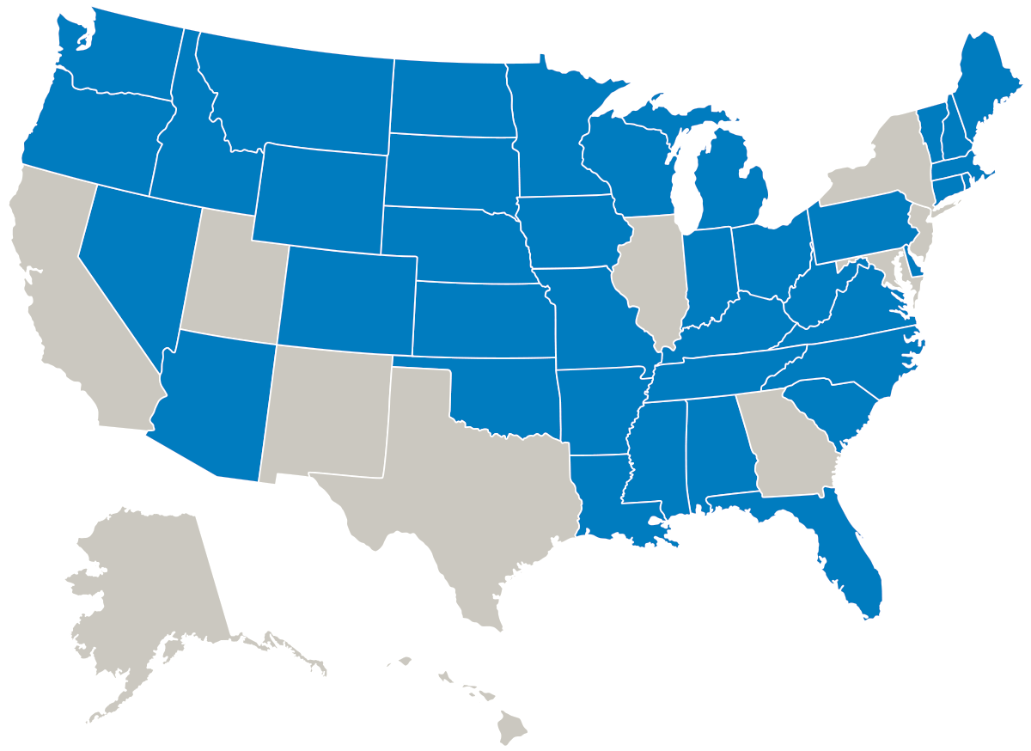
Changing Demographics
2025
States with at least 18 percent of the population age 65 or older

Slide 7
Aging Workers
By 2024, the labor force will be about 164 million people
41 million people will be age 55 or older
13 million people will be age 65 or older

Slide 8
The Tidal Wave is Coming
10,000 Americans will turn 65 every day
Within the next decade, 40 percent of the U.S. labor force will be eligible for retirement
The total number of Americans older than 65 and eligible for Medicare will double to more than 70 million within this generation
The population older than 85 will increase nearly five-fold, to almost 19 million, by mid-century

Slide 9
The Tidal Wave is Coming
Fewer younger workers are coming into the labor force
Retirement age is changing to 70
As many as 75 percent of older adults expect to work after age 70
How will the pandemic change people’s perspective on retirement?

Slide 10
The Tidal Wave is Coming

Slide 11
The Tidal Wave is Coming

Slide 12
Objectives
Learn why our workforce is aging
Know what drives the aging workforce to keep working
Effects of aging
Prevention and solutions for keeping the aging worker safe
Claims management
Question and answer

Slide 13
Retirement?
“I can’t imagine retiring. It’s bad enough being semi-retired.”

Slide 14
Myths and Realities #1
Myth
Older workers don’t need to work.
Reality
Many older adults do not have adequate savings to support full retirement and can’t live at the standard of living for which they have become accustomed; therefore, many must work to support their lifestyle choices.

Slide 15
Myths and Realities #2
Myth
Generally, the “aging workforce” is eagerly anticipating retirement, and will not work at all after reaching the typical retirement age.
Reality
Generally, “aging workforce” employees want to continue to work after reaching the typical retirement age.

Slide 16
Social Security
Depending on your birthday, electing to take Social Security early at age 62 will create a reduction in benefits anywhere from 20 to 30 percent.
Social Security benefits are increased by a certain percentage every year you delay your retirement, beyond the full retirement age, up to age 70. No additional benefits accrue past age 70.

Slide 17
Myths and Realities #3
Myth
Older workers are viewed negatively by customers.
Reality
While there might be some who want to avoid an older worker, there are many instances where the line is longer for the knowledgeable, experienced worker as opposed to their younger colleagues.

Slide 18
Primary Reasons for Working

Slide 19
Reality
Workers older than 55 are more productive People age 60 and over are projected to out number children under the age of five within the next year, and by 2025 we expect 25% of workers in the U.S. to be over the age of 55.
Research actually shows that people who stop working and retire often suffer from depression, heart attacks, and a general malaise of not having as much purpose in their lives. Less likely to report an injury. (Source: Harvard Business Review, 2019)
Job satisfaction is higher. (Source: psychologicalscience.org, 2016)

Slide 20
Reality
For most people, raw mental horsepower declines after the age of 30, but knowledge and expertise — the main predictors of job performance — keep increasing even beyond the age of 80.
Age-diverse teams feel more psychologically safe and innovative than teams which are age-biased. Age brings a sense of security and wisdom to teams.
Companies become more innovative, engaging, and profitable. (Source: Harvard Business Review, 2019)

Slide 21
A Black Hole?
“Boomers make up over one third of the nation’s work force. They fill many of its most skilled senior jobs. Thanks to their near-workaholic habits, they are among the most aggressive, creative, and demanding workers in the market today. Economists predict their exit will cause a great, sucking hole in the workplace universe.”
Source: Daniel Holden, Disaster Resource Guide

Slide 22
Objectives
Learn why our workforce is aging
Know what drives the aging workforce to keep working
Effects of aging
Prevention and solutions for keeping the aging worker safe
Claims management
Question and answer
Notes:
.

Slide 23
Effects of Aging
Decreased strength
Decreased joint range of motion
Decreased movement speed
Postural changes
Balance changes
Increased fatigability

Slide 24
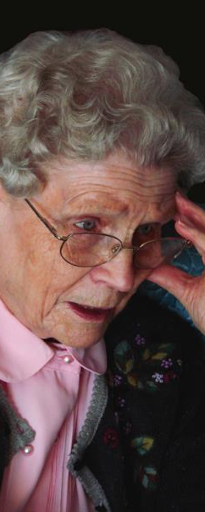
Effects of Aging
Loss of vision
Hearing loss
Decreased spatial sense
Cognitive changes
Altered sleep
Reduced cardiac and lung function

Slide 25
Effects of Aging
Increased incidence of chronic conditions
Arthritis
Hypertension
Heart and lung
Diabetes
Stroke
Medications and side effects

Slide 26
Risks of Aging
Increased risk of falls
33 percent of all injuries are from workers older than 65
14 percent of all fatalities result from falls
Increased muscle weakness
Increased prescription side effects
Increased risk of MVAs

Slide 27
Aging Worker Injuries
Top five types of injuries that impact aging workers
Rotator cuff sprains
Lumbar disc disease
Brain injuries – which are most likely due to falls or MVAs
Carpal tunnel syndrome
Knee cartilage injuries

Slide 28
Aging Workers’ Healing
Cardiovascular illness causes reduced work capacity, lower fatigue threshold, and increased susceptibility to deconditioning when injured
Diabetes – disruption in the healing process, poor circulation, and peripheral neuropathy
Pre-existing osteoarthritis
Increased disease rates in obesity

Slide 29
Objectives
Learn why our workforce is aging
Know what drives the aging workforce to keep working
Effects of aging
Prevention and solutions for keeping the aging worker safe
Claims management
Question and answer

Slide 30
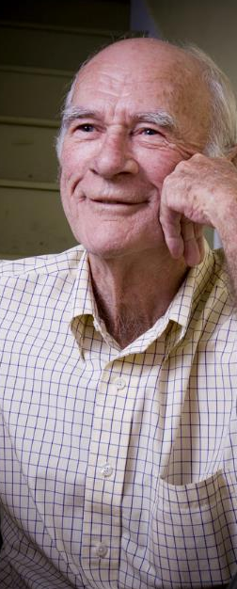
Solutions
Reduce or minimize heavy lifting
Reduce static standing time
Improve walking and working
Improve illumination
Review office ergonomics
Eliminate work on ladders
Keep floors clear, dry and cushioned

Slide 31
Solutions
Remove clutter
Use large video displays
Use hands-free telephone equipment
Avoid above shoulder work
Ergonomic interventions to reduce discomfort

Slide 32
Prevention
Corporate wellness programs
Increase productivity
Improves employee retention
Reduce sick leave
Decrease rates of illness and injury
Helps speed recovery
Source: HR Tech Outlook, 2021

Slide 33
Most Common WRI Age 50-70
Wound, finger
Lumbar sprain
Lumbosacral sprain
Knee sprain
Shoulder sprain
Knee contusion
Wound, hand
Contusion, face
CTS
Neck sprain
Source: Bureau of Labor Statistics

Slide 34
Most Costly WRI Age 50-70
Rotator cuff sprain $29m
Lumbar sprain $24m
Lumbar disc displacement $23m
Lumbosacral strain $12m
Medial meniscal tear $11m
CTS $7m
Knee sprain $7m
Shoulder sprain $6m
Neck sprain $6m
Cervical disc displacement $5m
Source: Bureau of Labor Statistics

Slide 35
Most Costly WRI
Higher cost due to higher severity, and not frequency
Higher indemnity costs due to higher wages
Older injured workers received 26 percent more in temporary benefits per day than injured workers ages 20-34

Slide 36
Frequent Injuries
What is causing the injuries?
Intolerance
Disease
Consider fitness for duty evaluation

Slide 37
Rotator Cuff Injuries
More prevalent with age (by age 67, 30 percent have bilateral tears)
Strong evidence for age and BMI
Some evidence for force/repetition and force/posture

Slide 38
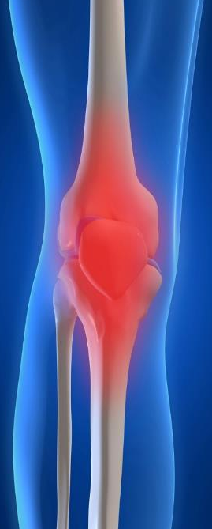
Knee Pain
Osteoarthritis
Very strong evidence for age and BMI (also prior injury)
Internal derangements
Strong evidence for BMI
Not for age

Slide 39
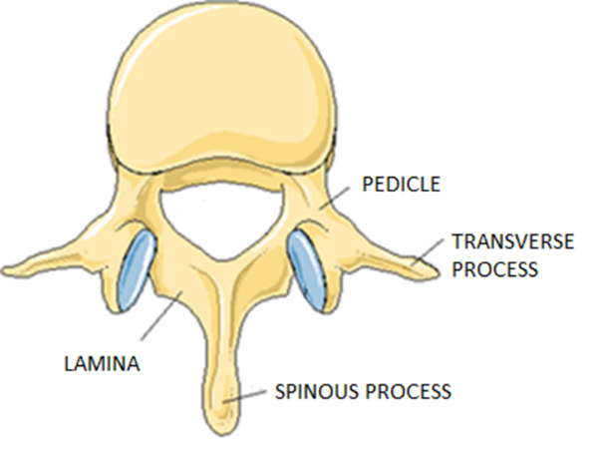
Spinal Canal Stenosis
Common at age 60 and older
Ligaments, bone, and discs narrow the canal

Slide 40
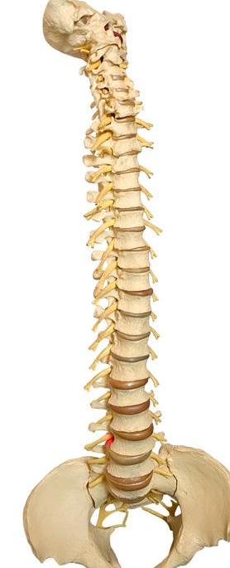
DDD
“Degenerative disc disease”
Is NOT a disease or medical condition
46 to 93 percent asymptomatic patients
It is a radiographic finding unrelated to symptoms

Slide 41
Normal Aging
Consider the significance (or lack thereof) of many commonly ordered diagnostic tests, especially spinal and joint imaging
Rotator cuff
Internal knee derangements
Spinal canal stenosis
“DDD”
Second opinions for surgical recommendations

Slide 42
MRI: Asymptomatic pts
Disc degeneration age 30 = 30 percent
age 60 = 80 percent
Disc bulging 50 to 80 percent
Disc prolapse 40 to 70 percent

Slide 43
MRI: Appropriate Use
Strong neurologic signs
Objective findings
Red flags
Persistent symptoms longer than four to eight weeks
Patients should understand that imaging is to rule out serious conditions, and to expect degenerative findings.

Slide 44
MRI: Inappropriate Use
Overuse of imaging studies risks:
Reinforcing the suspicion of serious disease
Magnifying the importance of nonspecific findings
Labeling patients with spurious diagnoses

Slide 45
Objectives
Learn why our workforce is aging
Know what drives the aging workforce to keep working
Effects of aging
Prevention and solutions for keeping the aging worker safe
Claims management
Question and answer

Slide 46
Management of Claims
Investigation: Causation
Caused by work?
Symptoms at work?
Shoulder
Knee
Low back

Slide 47
Management of Claims
Investigation
Gather as much medical and activity information as possible
Only use relevant information for compensability decision
Use the same process regardless of age
Beware of an appearance of age discrimination
Presumption claims

Slide 48
Management of Claims
When do you think you will return to work?
Conversations with employees
Early intervention
Transitional duty program is key
No different from other ages
Individualized
Close follow up

Slide 49
Communication
Stay in touch
Talk about health in general
This is important to the older patient
They want to remain active
Emphasize function, not pain
A process by which information is exchanged between individuals through a common system of symbols, signs, or behavior: exchange of information

Slide 50
Objectives
Learn why our workforce is aging
Know what drives the aging workforce to keep working
Effects of aging
Prevention and Solutions for keeping the aging worker safe
Claims management
Question and answer

