Slide 1
Safety Management How Mature is your Safety Program? Tiffany Allen, ARM-P, PS-MESH Travelers Insurance

Slide 2
Disclaimer
This program or presentation is only a tool to assist you in managing your responsibility to maintain safe premises, practices, operations and equipment, and is not for the benefit of any other party. The program or presentation does not cover all possible hazardous conditions or unsafe acts that may exist and does not constitute legal advice. For decisions regarding use of the practices suggested by this program or presentation, follow the advice of your own legal counsel. Travelers disclaims all forms of warranties whatsoever, without limitation. Implementation of any practices suggested by this program or presentation is at your sole discretion, and Travelers or its affiliates shall not be liable to any party for any damages whatsoever arising out of, or in connection with, the information provided or its use. This material does not amend, or otherwise affect, the provisions or coverages of any insurance policy or bond issued by Travelers, nor is it a representation that coverage does or does not exist for any particular claim or loss under any such policy or bond. Coverage depends on the facts and circumstances involved in the claim or loss, all applicable policy or bond provisions, and any applicable law.

Slide 3
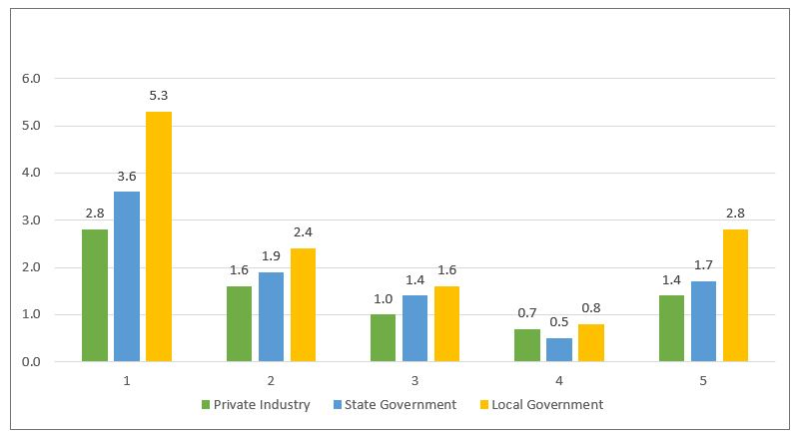
Nonfatal Occupational Injury & Illness Rates by Case Type and Ownership 2018
TRC: Total Recordable Cases DART: Days Away from Work, Job Transfer, or Restriction Cases DAFW: Days Away From Work Cases DJTR: Days of Job Transfer or Restriction Cases Only ORC: Other Recordable Cases

Slide 4
Incidence Rates Nonfatal Occupational Injury & Illness - 2018
Local Government per 100 employees
Nursing and Residential Care Facilities 7.3
Public Administration 6.5
Water, Sewage, & Other Systems 5.8
Hospitals 5.4
Elementary and Secondary Schools 4.5

Slide 5
Safety Management System Overview/Objectives
Participants will be able to:
List the eight key components of a safety management system
Describe why each component is important to the success of the overall safety management system
Evaluate their current safety management system for areas of potential improvement

Slide 6
Safety Management System
Management Vision, Values, and Commitment
Organization for Safety
Line Responsibility & Accountability
Safe Work Practices and Procedures
Safety Communications
Safety Training
Safety Review and Improvement Process
Post Injury Management

Slide 7
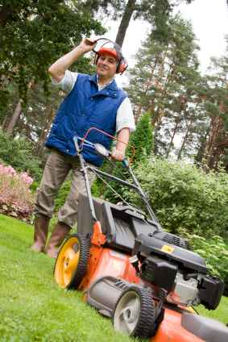
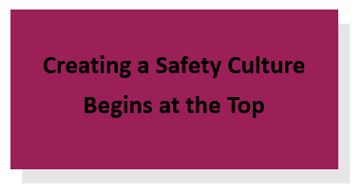
Management Vision, Values & Commitment

Slide 8
Management Vision, Values & Commitment
Vision
Business vision
Considers: financials, quality, HR, image, etc.
Safety vision
Safety record
Effect on financials
Influence on quality
Support for the vision
Management creates the culture needed for success

Slide 9
Management Vision, Values & Commitment
Values
Business and personal values
Safety values and norms
All injuries are preventable
Management responsible to provide safe workplace
Employees are accountable for working safely
Safety is integral to the business plan
Support for shared values
Built through reward systems

Slide 10
Management Vision, Values & Commitment
Commitment
Safety leadership
Demonstrated commitment
Management’s actions must support the words

Slide 11
Organization for Safety

Slide 12
Organization for Safety
Organizational Structure
Executive safety and health committee chairmanship
Organizational safety responsibility assigned for:
Overall safety program administration
Safety rules and procedures
Education and training programs
Audits and inspections programs
Health and environmental programs
Fire and emergency preparedness programs
Accident investigation programs
Housekeeping programs
Safety and health committees and teams

Slide 13
Organization for Safety
Organizational Structure
Executive safety and health committee chairmanship
Organizational safety responsibility assigned for:
Overall safety program administration
Safety rules and procedures
Education and training programs
Audits and inspections programs
Health and environmental programs
Fire and emergency preparedness programs
Accident investigation programs
Housekeeping programs
Safety and health committees and teams

Slide 14
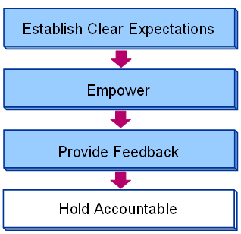
Line Responsibility & Accountability

Slide 15
Line Responsibility & Accountability
Responsibility
Communicating the safety vision and safety values
Establishing performance objectives
Achieving loss reduction objectives
Communicating safety to employees
Identifying safety and health training needs
Participating on committees
Enforcing safe work rules and procedures
Continually improving the organization’s safety performance

Slide 16
Line Responsibility & Accountability
Authority
Delegating authority
Providing training
Providing the resources to be successful
Feedback
Communicating frequently on performance issues
Providing performance evaluations
Showing recognition, approval and respect
Hold them accountable for their responsibilities

Slide 17
Safe Work Practices & Procedures
Safe Work
Procedures
People
Equipment
& tools
Process
Environment

Slide 18
Safe Work Practices & Procedures
Facility-wide safety rules and procedures
General safety rules
Housekeeping
Preventative maintenance
Subcontractors and construction
Purchasing
Task or operation-specific rules and procedures (JSA)
Equipment-specific work practices
Task specific work practices
Non-routine task work practices

Slide 19
Safe Work Practices & Procedures
Emergency and disaster rules and procedures
Anticipate potential emergencies
Develop plans to respond to the emergency and ultimate recovery

Slide 20
Safety Communications

Slide 21
Safety Communications
Two-way process
Purpose of communications
Who is the audience?
What is the purpose of the communication?
What are the verbal and non-verbal methods by which we can communicate?
How frequently should this be communicated?
Change process communications vs. day-to-day safety communications

Slide 22
Safety Communications
Feedback
What are the methods for receiving feedback?
What communication changes are made as a result of feedback?

Slide 23
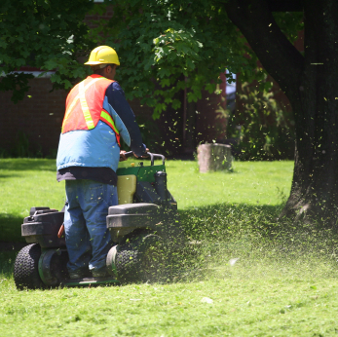
Safety Training

Slide 24
Safety Training
Goals of safety training
Types of safety training
Regulatory training
Technical training
Safety management training
Safety training recipients
Employee training
Non-employee training

Slide 25
Safety Training
Training development, delivery, and effectiveness
Analysis
Development
Implementation
Training effectiveness

Slide 26
Safety Review & Improvement Process

Slide 27
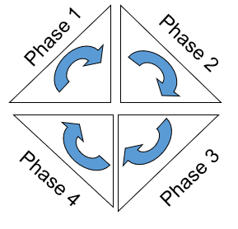
Safety Review & Improvement Process
Phase 1: Information gathering and problem identification
Accident/incident awareness
Data analysis and trending
Audits
Employee feedback
Product, quality, service feedback
Phase 2: Root cause of problems
Accident/incident analysis
Job safety analysis

Slide 28
Safety Review & Improvement Process
Phase 3: Solutions and implementation
Developing the solution
Choosing the best solution
Communicating solutions
Developing implementation strategies
Determining performance measurements
Phase 4: Monitoring the impact
Monitoring performance results
Communicating results
Beginning the cycle again

Slide 29
Post Injury Management

Slide 30
Post Injury Management
Five essential strategies of post injury management
Immediate post injury response
Medical providers
Transitional duty
Case management
Performance measurement

Slide 31
Post Injury Management
Benefits of a post injury management process
Severity reduction
Speedier recovery
Positive system
Structured process
Improved productivity

Slide 32
Thank You!
Tiffany Allen
Travelers Insurance
tallen6@travelers.com
704.540.3520

