Slide 1
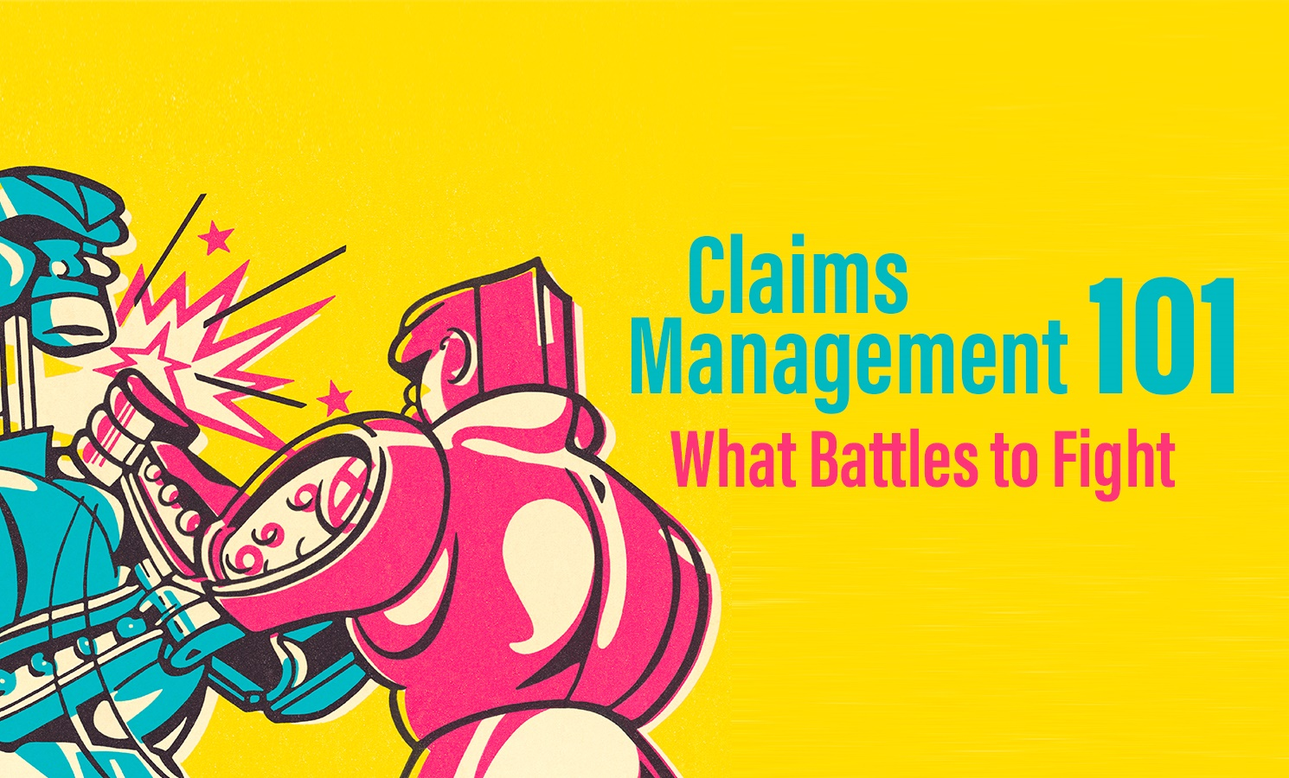

Slide 2
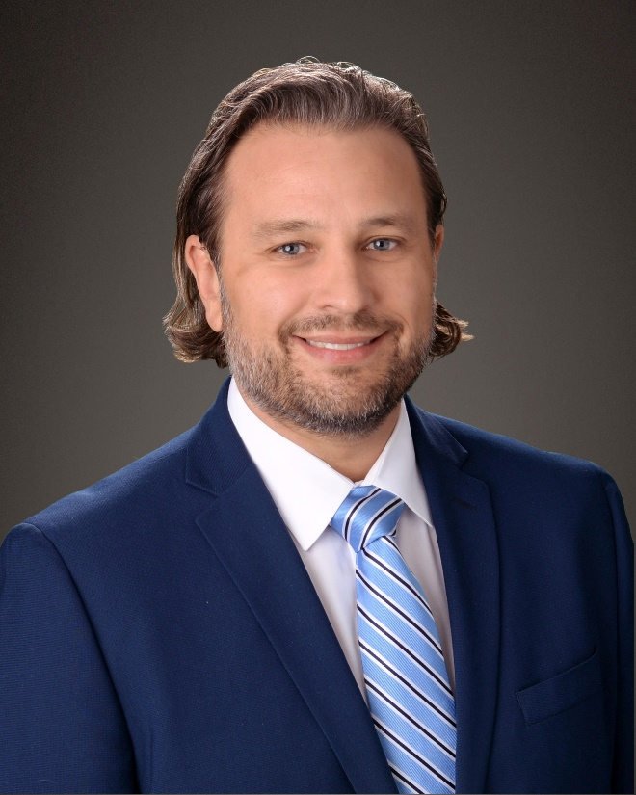
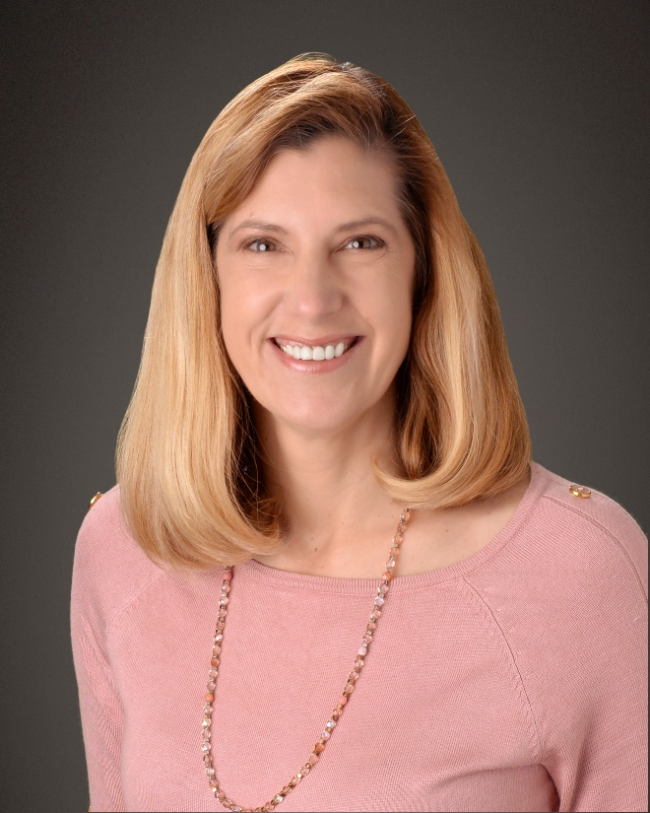
Introduction
Geoffrey R. Jones, Esq. Geoffrey R. Jones, Esq. is a Senior Claims Attorney for Midwest Employers Casualty (MEC), a Berkley Company, where he has worked throughout the United States for the past 10 years providing claims oversight and recommendations. He has handled mediation/settlements in over 22 states. One of Geoff’s strongest assets is his ability to mitigate and resolve high exposure claims which has led to millions of dollars in savings. When not settling claims, Geoff may be found working with MEC’s predictive analytics unit and clients to ensure positive outcomes.
Patty Reinecke, RN, BSN, CCM, MSCC Patty Reinecke, RN, BSN, CCM, MSCC, Director of Client Consults and TPA Relationships at Midwest Employers Casualty (MEC), a Berkley Company, has over 28 years of experience in the workers’ compensation industry. She provides a unique healthcare perspective to identify high-risk claims quickly and develop solutions that help employers and injured employees achieve better outcomes. In her current role, she works to ensure quality claim handling within the MEC Claims Department and as a liaison to facilitate positive working relationships with our partners and their claim administrators.

Slide 3
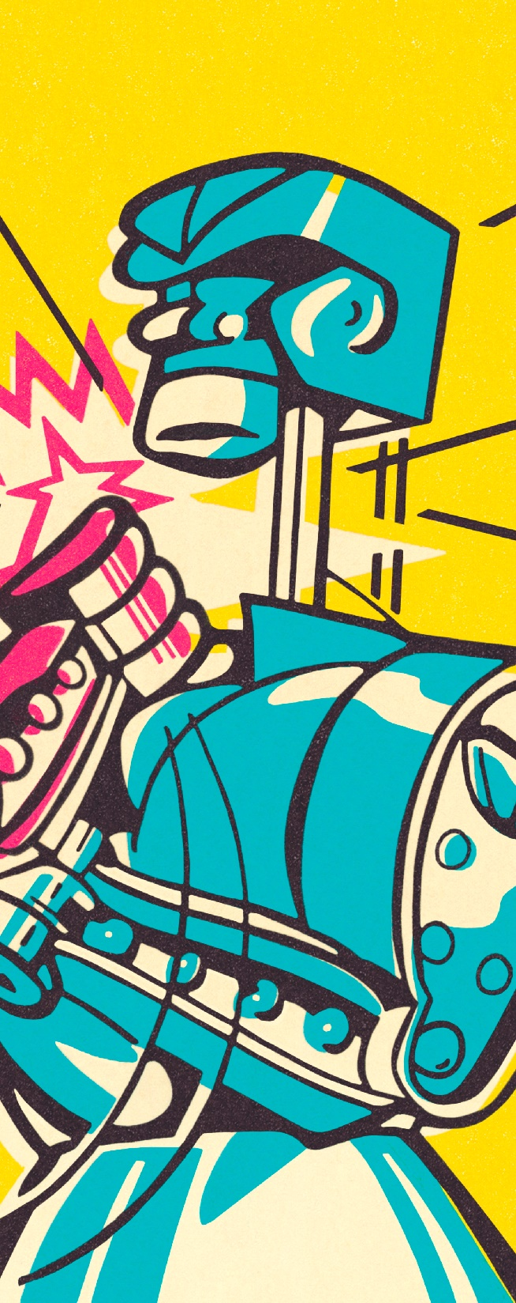
Should we start with a Fight
Understand why we fight and when we fight?
Fraud
The Coalition Against Insurance Fraud (CAIF) estimates that workers’ compensation insurance fraud costs insurers and employers $6 billion a year.
Control
Excessive treatment
Prolonged time off work

Slide 4
Injury or Occupation Disease
Initial evaluation
Facts of the accident
Three-point contact
Employee
Employer
Information beyond the injury itself
Information about the employee
Medical

Slide 5
Focus on the Details
Identifying and collecting other sources of information
Examples
Co-workers
Police report
OSHA
GoFundMe

Slide 6
Fight?
No fight
Focus on the collection of information
Be mindful of statutory requirements
In the course and scope of employment
Look for inconsistencies and opportunities
Subrogation
Defenses

Slide 7
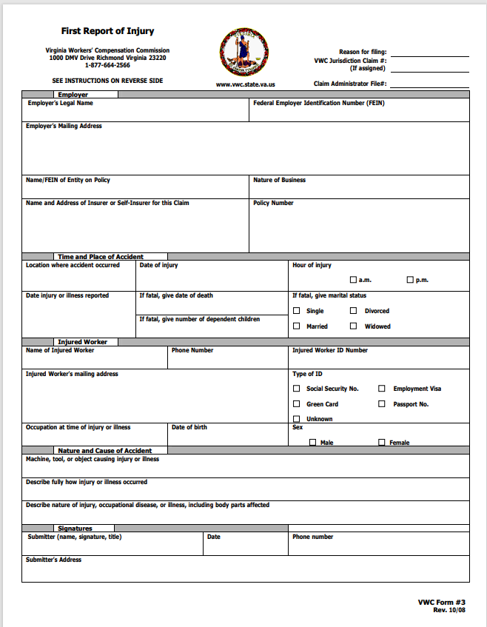
State Filings
First Report of Injury form
Verification of information

Slide 8
Fight?
No fight
Understanding jurisdictional issues
Time limits for converting or denial
Penalties for late reporting of FROI

Slide 9
Medical Treatment
First aid
Occupation medicine
Emergency room
Telemedicine
Indirect direction of care

Slide 10
Medical Treatment
Continue evaluation of facts and circumstances.
Is the injury consistent with job description/duties?

Slide 11
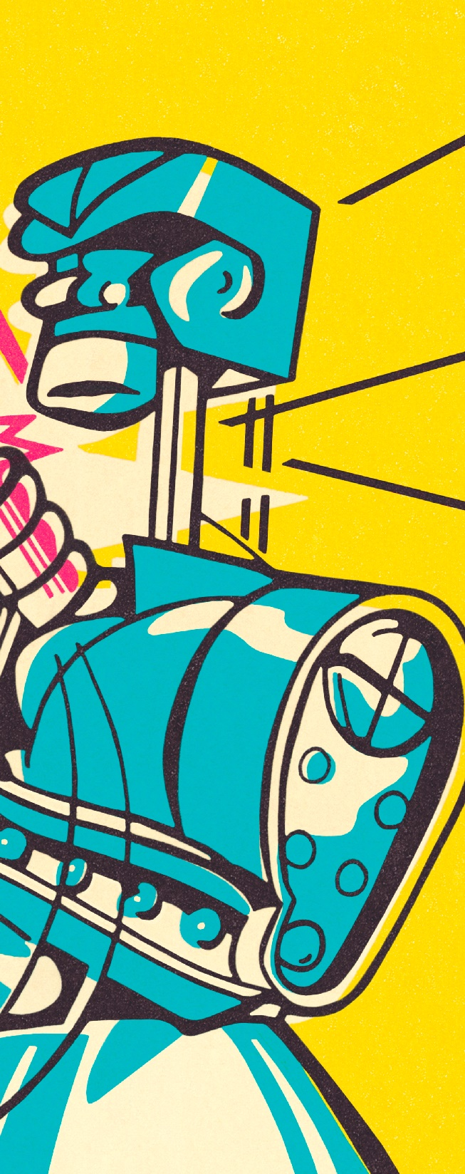
Fight?
Maybe…..
Majority of cases are going to be compensable

Slide 12
Understanding the Employee
Prior claims
ISO index
Division of Workers Compensation records
Pre-existing conditions
Review of the medical records
Medical Canvass
Other risky behavior

Slide 13
In Most Cases…
Injured employee heals from the reported injury and returns to work in the original position.
File is closed.
All your hard work paid off, even though you didn’t need all of it.
But in those claims where that is not the case…

Slide 14
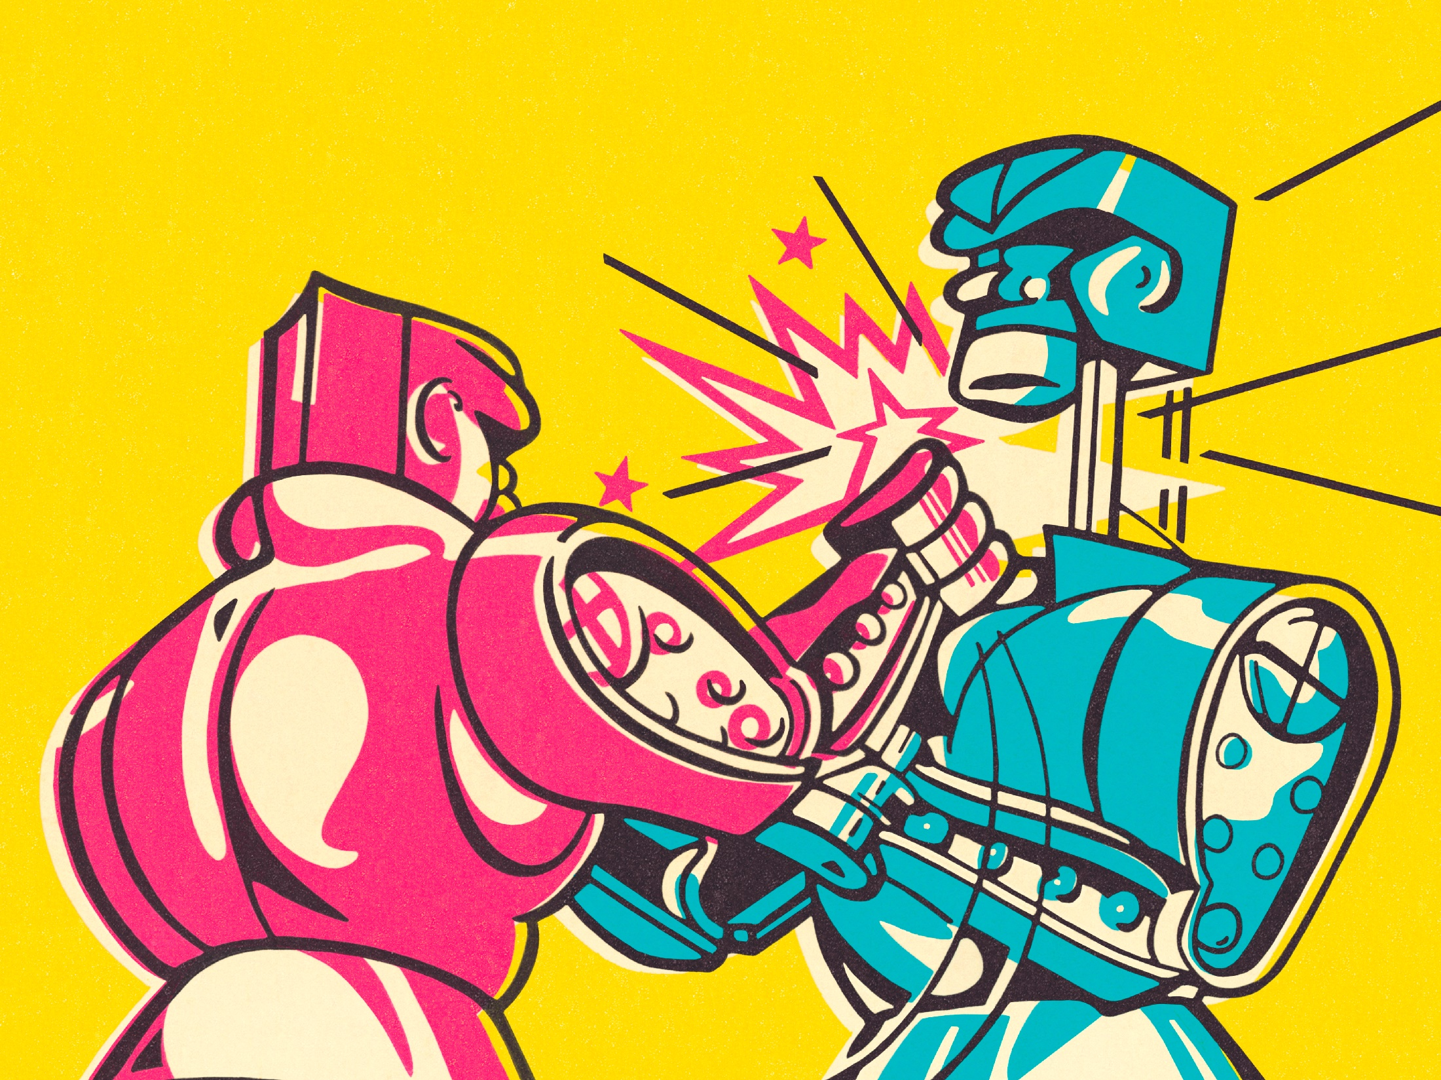
Fight! Fight! Fight!

Slide 15
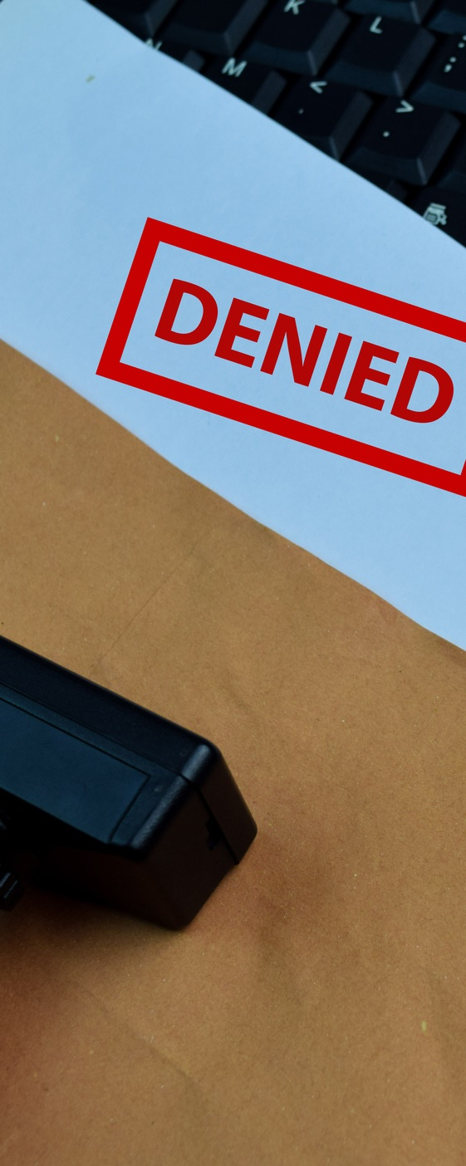
Denials
The claim didn’t occur in the course and scope of employment
Horseplay
Pre-existing condition

Slide 16
Are You Picking a Winner?
According to research from Lockton, 67% of claims originally denied are converted to paid claims within a year. Denied workers' compensation claims that are converted to paid claims can cost up to 50 percent more.
See riskandinsurance.com Mercedes Ott, June 25, 2018

Slide 17
Picking Your Battles
What are the implications of losing the fight?
Medical control (depending on jurisdiction)
Increased exposure
Attorney fees
Penalties
Interest

Slide 18
Picking Your Battles
What are the possible benefits from fighting?
Exposure mitigation
Resolution
Denial

Slide 19
Controverting Portions of a Claim
Average weekly wage
Consequently injuries
Additional medical treatment
Treatment outside the OGD (Official Disability Guidelines)
Intervening injury
Again-understanding our employee

Slide 20
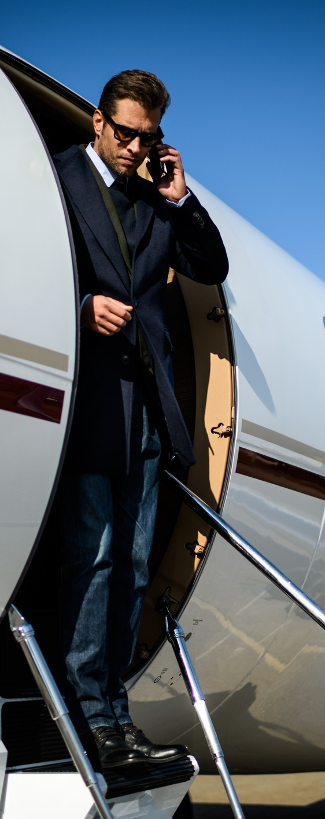
To Fight or Not to Fight: Case Study #1
Mr. Jetsetter was a 46-year-old Director of Marketing with lower extremity issues requiring personal leave from work.
After returning to work, in the Spring of 2007, Mr. Jetsetter flew to Asia while still wearing a walking cast.
Mr. Jetsetter tripped getting off a plane in Seoul, South Korea.
Weeks later, Mr. Jetsetter was in California when he may have suffered an embolism.
Mr. Jetsetter sought long-term disability benefits and left work for surgery on his foot.
In 2011, Mr. Jetsetter filed a worker’s compensation claim at which time the Employer discovered Mr. Jetsetter was wheelchair-bound with an amputation of his left lower extremity…..

Slide 21
Case Study #1
Where do we start……..
Investigation
Risk evaluation (Fight or Not to Fight)
Handling for the best outcome
Settlement of workers’ compensation claim
Recovery from medical malpractice claim

Slide 22
To Fight or Not to Fight: Case Study #2
Ms. Saturday-Night had a stressful job as a claims adjuster. As she prepared to meet friends for a weekend dinner party, she suffered a stroke.
Her stroke was complicated by a severe brain bleed rendering her unable to speak or provide for herself.
Ms. Saturday-Night may have been given an aspirin by her supervisor when she last worked on Thursday.

Slide 23
Case Study #2
Where do we start…..
Investigation
Medical records review
Interviewing co-workers/supervisor
Risk evaluation (to fight or not to fight)
Monitor evolving facts

Slide 24
Be a Lover Not a Fighter

Slide 25
Questions

