Slide 1
Telematics
Speaker:
Julie Waller, MBA, CWCP, MESH
Alliant Insurance Services, Inc.
Public Entity | Education | Pooling Practice
Proprietary & Confidential
© 2021 Alliant Insurance Services, Inc. All rights reserved.

Slide 2
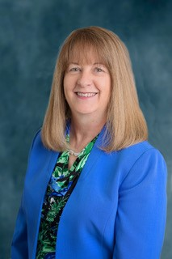
Speaker Bio
Julie Waller, MBA, CWCP, MESH
Senior Risk Control Consultant
Alliant Insurance Services, Inc.
Public Entity | Education | Pooling Practice
Over 28 years of combined experience in both the public and private sectors
Bachelor of Science Degree in Occupational Safety and Health
Masters of Business Administration in Public Administration
Certified Workers’ Compensation Professional (CWCP)
Manager of Environmental Safety and Health Programs (MESH)
U.S. Navy Veteran
Proprietary & Confidential
© 2021 Alliant Insurance Services, Inc. All rights reserved.

Slide 3
Learning Objectives
Clearly define fleet telematics, purposes and capabilities.
Examine fleet telematics technology and ways in which it can enhance a modern fleet management program.
Identify fleet telematics best practices and program development.
Establish employee responsibilities, expectations and driver training opportunities.
Discuss methods that fleet telematics can reduce exposures, therefore mitigating risk.
Proprietary & Confidential
© 2021 Alliant Insurance Services, Inc. All rights reserved.

Slide 4
Overview
In this session, the use of telematics will be examined to include capabilities for real-time fleet tracking, driver behavior and performance monitoring, and the importance of data analytics to enhance modern fleet management, improve operational efficiency, and fleet safety.
Further, telematics best practices will be discussed, as well as employee training and driver coaching opportunities.
Proprietary & Confidential
© 2021 Alliant Insurance Services, Inc. All rights reserved.

Slide 5
Introduction
Telematics refers to the integration of telecommunications and informatics technologies to collect, transmit, and analyze data from multiple vehicles. This technology enables real-time tracking, performance monitoring, and data-driven insights that optimize fleet management, improve operational efficiency, and enhance safety.
Proprietary & Confidential
© 2021 Alliant Insurance Services, Inc. All rights reserved.

Slide 6
Definition
Telematics
Installed applications and services that provide near real-time data about vehicle activity, location, and condition.
Proprietary & Confidential
© 2021 Alliant Insurance Services, Inc. All rights reserved.

Slide 7
Poll Question - 1
Does your entity currently use fleet telematics?
Proprietary & Confidential
© 2021 Alliant Insurance Services, Inc. All rights reserved.

Slide 8
How Telematics Works
There are three fundamental technologies:
Global Positioning System (GPS)
Wireless Communication (Cellular, Wifi, etc.)
Onboard Diagnostic Hardware
These technologies work together to provide second-by- second data about location, driving performance, vehicle speed, fuel consumption, and vehicle diagnostic data.
Proprietary & Confidential
© 2021 Alliant Insurance Services, Inc. All rights reserved.

Slide 9
Telematics vs. GPS
Telematics | GPS
Who | Where
What | When
Why
How
Example:
Telematics provides detailed information regarding what your fleet is doing over time (performance metrics), whereas the GPS can identify where the vehicle is on the route.
Proprietary & Confidential
© 2021 Alliant Insurance Services, Inc. All rights reserved.

Slide 10
Telematics vs. GPS Examples
Telematics provides detailed information regarding what your fleet is doing over time (performance metrics), whereas the GPS can identify where the vehicle is on the route.
GPS can indicate how long a driver took to complete their route, whereas Telematics can assist to optimize the route next time.
GPS is an important piece of the Telematics puzzle, and Telematics requires GPS as a pivotal piece of the overall data sent back to the hub about specific vehicles.
Proprietary & Confidential
© 2021 Alliant Insurance Services, Inc. All rights reserved.

Slide 11
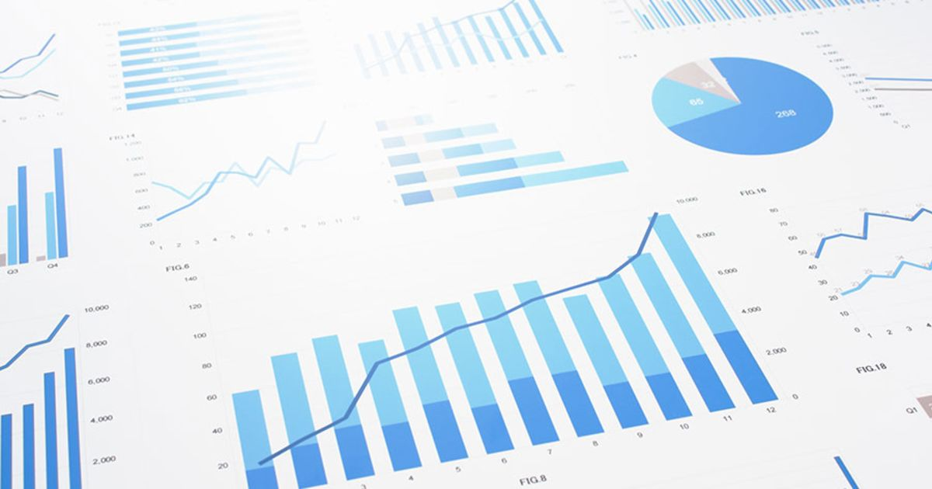
Data Analytics
Proprietary & Confidential
© 2021 Alliant Insurance Services, Inc. All rights reserved.

Slide 12
Poll Question - 2
How does your entity use data analytics to ensure telematics are effective?
Proprietary & Confidential
© 2021 Alliant Insurance Services, Inc. All rights reserved.

Slide 13
Data Analytics Management
Are you measuring the right things in a meaning and relevant way?
Total Cost of Ownership (TCO) = Fixed Vehicle Cost + Variable Vehicle Costs.
- Fixed Vehicle Costs (permits, registrations, etc.)
- Variable Vehicle Costs (fuel, tolls, maintenance, etc.)
Vehicle Cost Per Mile (VCPM) = Total Cost of Ownership/Total Miles Driven.
Proprietary & Confidential
© 2021 Alliant Insurance Services, Inc. All rights reserved.

Slide 14
Telematics Data Points
Hard Braking | Vehicle Idling
Fuel Consumption | Driver Behavior
Rapid Acceleration | Speeding
Vehicle Location | Vehicle Fault Codes
Seat Belt Usage | Route Optimization
Proprietary & Confidential
© 2021 Alliant Insurance Services, Inc. All rights reserved.

Slide 15
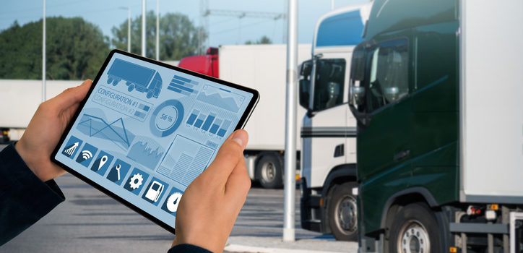
Fleet Management & Maintenance
Proprietary & Confidential
© 2021 Alliant Insurance Services, Inc. All rights reserved.

Slide 16
Improving Fleet Management & Maintenance
Utilizing Telematics
Reduces operating costs
Improves asset ROI
Proactive measures through route optimization, idling reduction, alerting fleets to mechanical issues, and improves safety
Improves driver training and coaching
Automates maintenance workflows, immediately addressing vehicle issues
Reduces vehicle downtime and improves fleet efficiency by ensuring managers have access to information such as vehicle status, maintenance schedules and inspection results
Proprietary & Confidential
© 2021 Alliant Insurance Services, Inc. All rights reserved.

Slide 17
Improving Fleet Management & Maintenance
Utilizing Telematics
Fleet operations receive real-time data
Preventative maintenance conducted based on automatic odometer readings, not manual mileage readings.
Ability to immediately address issues from diagnostic trouble codes (DTCs)
Integrating fleet maintenance and telematics data into effective reports so fleet managers can analyze data quickly and monitor operations more effectively.
Proprietary & Confidential
© 2021 Alliant Insurance Services, Inc. All rights reserved.

Slide 18
Fleet Telematics
Proprietary & Confidential
© 2021 Alliant Insurance Services, Inc. All rights reserved.

Slide 19
Best Practices
Data Collection Plan
Train drivers on software
Fleet Compliance
Control fuel costs
Optimize Vehicle Routes
Build
Safety Program
Monitor
Data Consistently
Track Maintenance Milestones
Reward Good Performance
Effective Communication
Set
Up Geofences
Proprietary & Confidential
© 2021 Alliant Insurance Services, Inc. All rights reserved.

Slide 20
Benefits of Telematics
Productivity | Safety
Compliance | Fleet Optimization
Sustainability | Efficiency
Profitability | Improved Maintenance
Driver Monitoring | Longevity
Reduced Costs | Fuel Management
Maintenance & fuel are the two largest expenses in fleet.
Proprietary & Confidential
© 2021 Alliant Insurance Services, Inc. All rights reserved.

Slide 21
Roles & Responsibilities
Proprietary & Confidential
© 2021 Alliant Insurance Services, Inc. All rights reserved.

Slide 22
Multi-Disciplinary Approach to Telematics
It takes a village …
Employee
Manager
Safety
Risk Mgmt.
Maintenance
Supervisor
Human Resources
Legal
IT
Proprietary & Confidential
© 2021 Alliant Insurance Services, Inc. All rights reserved.

Slide 23
Poll Question - 3
Do you have a fleet telematics training program in place to ensure employees and supervisors are properly trained?
Proprietary & Confidential
© 2021 Alliant Insurance Services, Inc. All rights reserved.

Slide 24
Employee Training
All employees should be properly trained in telematics and how to use the software
Supervisors and Managers should clearly communicate expectations to employees.
A formal driving training and coaching program should be in place to sufficiently address driving behavior.
Those responsible for monitoring data analytics should be trained in how to analyzed the data, generate reports, and effectively share that information to appropriate staff
Proprietary & Confidential
© 2021 Alliant Insurance Services, Inc. All rights reserved.

Slide 25
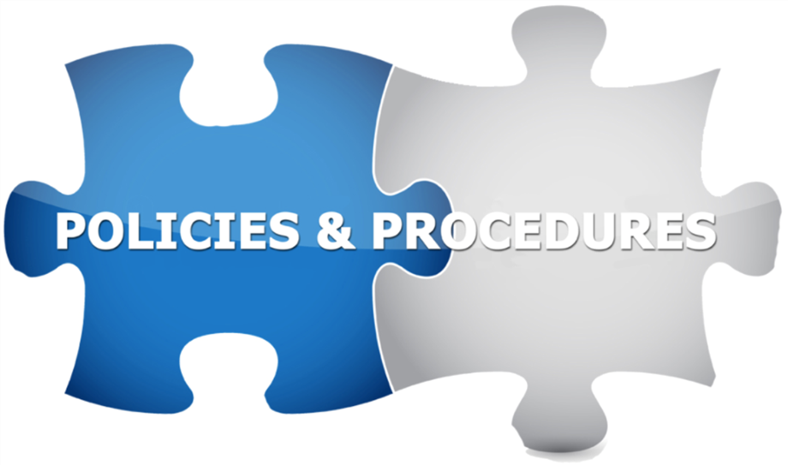
Policy Development
Proprietary & Confidential
© 2021 Alliant Insurance Services, Inc. All rights reserved.

Slide 26
Poll Question - 4
Do you have a policy for the use of telematics, to set employee expectations and accountability? This could be part of your driving policy.
Proprietary & Confidential
© 2021 Alliant Insurance Services, Inc. All rights reserved.

Slide 27
Pros & Cons of Telematics
Pros
Savings
Cons
Data Analysis & Processing
Driver Privacy
Cost to Implement
Driver Monitoring & Coaching
Safety
Visibility
Accessibility
Proprietary & Confidential
© 2021 Alliant Insurance Services, Inc. All rights reserved.

Slide 28
Strategic Advantage
Integrating a fleet telematics system allows your fleet strategic advantages in efficiency and profitability. If provides fleets with the ability to be proactive in making informed business decisions and streamlines the operational processes for effective fleet management.
Proprietary & Confidential
© 2021 Alliant Insurance Services, Inc. All rights reserved.

Slide 29
Poll Question - 5
What fleet telematics system are you currently using?
Is it working for you?
Proprietary & Confidential
© 2021 Alliant Insurance Services, Inc. All rights reserved.

Slide 30
Contact Information
Julie Waller, MBA, CWCP, MESH
Senior Risk Control Consultant
Alliant Insurance Services, Inc.
101 North Tryon Street, Suite 6000
Charlotte, NC 28246
(980)355-3530
Julie.Waller@Alliant.com
Proprietary & Confidential
© 2021 Alliant Insurance Services, Inc. All rights reserved.

Slide 31
Questions?
Q & A Session
Proprietary & Confidential
© 2021 Alliant Insurance Services, Inc. All rights reserved.

