Slide 1
State of the Insurance Market: Understanding the Global Market and What You Can Control
Carleen C. Patterson, ARM-P, CIC, CRM Public Entity & Higher Education Practice Leader Alliant Insurance Services, Inc.

Slide 2
Understanding how the market works—Insurance v Reinsurance
Insurance for insurance companies
Risk is ceded to another insurance company
Frees up capital
Allows insurer to support more or larger insurance policies
2 categories
Treaty
Facultative
Insurance Premium
Insurance Premium
Individual City Purchases Insurance Policy
Insurance Liability Created
Cession
Insurance Liability Transferred

Slide 3
It’s a Global Insurance Market

Slide 4
Market Overview
Financial Performance
Underwriting Trends
Loss Trends & Market Disruptors
Toward the Future

Slide 5
Insurance Market & Financial Performance

Slide 6
Market Pressures…
“While the industry balance sheet is strong enough to meet the commitments to insureds, it is facing emerging challenges from the significant and increasing impact of catastrophic weather events, cyber risk and significant price and social inflation/lawsuit abuse,” Robert Gordon, senior vice president of policy, research, and international for APCIA, said in a statement.”
Great
Resignation & Quiet Quitting
Pandemics & Epidemics
Aging Infrastructure
Geo Political
Climate Change
Mass Shootings
Natural Disasters
Inflation
Supply Chain & Labor Shortage
Social Inflation & Nuclear Verdicts
Cyber Attacks
Ukraine War
Legislation

Slide 7
Market Conditions
Impactful issues for insureds:
Liability capacity pull back and withdrawals have been significant over the past two years
Property capacity reductions:
15% to 30% reduction in capacity from incumbents
Coastal and wildfire capacity continues to be especially difficult
Cyber capacity is shrinking and particularly acute for certain industries (Public Entity)
Insurers produced negligible profit in 2021 – $112b in Global Insured CAT losses in 2021 – 4th Worst Loss Year on Record.
Workers Compensation remains stable.
Historically low interest rates have hampered carrier investment returns.
An increased pattern of major property catastrophes such as hurricanes, typhoons, wildfires, etc. over the past 5 years. Is this the new normal?
Consistent increases in attritional property losses (fires, water damage, tornados, hail, wildfires).
Increased inflation has added to the issue of valuation across all property classes.
Social inflation & Litigation Financing driving up liability verdicts and settlements.
Ransomware cyber losses are systemic - $6 Trillion Impact in 2021 – Expecting $10 Trillion by 2025 – 2019 was $2 Trillion
Property
Excess Liability
Cyber

Slide 8
Policyholder Surplus (Capacity), 2006:Q4–2020:Q4E and 2021F*
The P/C insurance industry entered the COVID-19 pandemic from a position of strength and was able to withstand the 9.0% surplus decline in Q1 2020 (far less than during the Financial Crisis). 2020 ended with record surplus. 2021 will likely set another new record, reaching $1 trillion for the first time.
($ Billions)
Drop due to near-record 2011 CAT losses (-4.9%)
Financial Crisis (-16.2%)
2010: Q1 data includes $22.5B of paid-in capital from a holding company parent for one insurer’s investment in a non-insurance business
Policyholder Surplus is the industry’s financial cushion against large insured events, periods of economic stress and financial market volatility. It is also a source of capital to underwrite new risks.
Notes:
8

Slide 9
Policyholder Surplus
2007–2020 Quarterly
Surplus at end of 2020 stood at $929.1B, an all-time high
$ Billions
Drop in 2011 due to very large CAT losses
2007:Q3 Pre-Crisis Peak
Drop in 2018 due to unrealized investment losses
Policyholder Surplus: Positive

Slide 10
P/C Insurance Industry Combined Ratio, 2001-2022**
COVID-19 has had no discernable net impact on pre-COVID expectations for the combined ratio in 2020;
-7.5 pts. due to CATs vs. 4.1 in 2019 (about twice avg.)
As Recently as 2001, Insurers Paid Out Nearly $1.16 for Every $1 in Earned Premiums
Relatively Low CAT Losses, Reserve Releases
Relatively Low CAT Losses, Reserve Releases
Higher CAT Losses, Shrinking Reserve Releases, Toll of Soft Market
Sharply higher CATs are driving large underwriting losses and pricing pressure
Best Combined Ratio Since 1949 (87.6)
Avg. CAT Losses, More Reserve Releases
Cyclical Deterioration
Lower CAT Losses
Heavy Use of Reinsurance Lowered Net Losses
Sandy Impacts
Pre-COVID 2020 Combined Ratio Est. 99.1 (A.M. Best)Actual = 98
*Excludes Mortgage & Financial Guaranty insurers 2008–2014.
**2022 forecast from A.M. Best Review and Preview (Sep. 2021).
Sources: A.M. Best, ISO (2014-2019).
10

Slide 11
Net Investment Yield on Property/Casualty Insurance Invested Assets, 2007–2021
Investment yields in 2021 were depressed--down about 200 BP from pre-crisis (and 50-80BP from pre-COVID) levels. Yields in 2021 were the lowest since at least 1960.
Average: 1960-2019 = 4.9% | Low: 2.8% (1961) | High: 8.2% (1984/85)
Sources: NAIC data, sourced from S&P Global Market Intelligence; 2017-19 figures are from ISO. 2020-21 data from the APCIA. Risk and Uncertainty Management Center, Univ. of South Carolina.
11

Slide 12
Investment yields in 2021 were depressed--down about 200 BP from pre-crisis (and 50-80BP from pre-COVID) levels. Yields in 2021 were the lowest since at least 1960.
Property/Casualty Insurance Industry Investment Income: 2000–2021
Due to persistently low interest rates, investment income remained below pre-crisis levels for a decade. Lower interest rates during COVID drove investment income down once again. Fed rate hikes in 2022 could reverse this trend.
*2021 figure is actual as of 12/31/21. 2018-19 figures are distorted by provisions of the TCJA of 2017. Increase reflects such items as dividends from foreign subsidiaries.
1 Investment gains consist primarily of interest and stock dividends. Sources: ISO; University of South Carolina, Center for Risk and Uncertainty Management.
12

Slide 13
P/C Industry Net Income After Taxes, 1991–2021
$ Millions
*ROE figures are GAAP; 1Return on avg. surplus. Excludes Mortgage & Financial Guaranty insurers for years (2009-2014). Sources: A.M. Best, ISO, APCIA.
13

Slide 14
Underwriting Trends

Slide 15
Sample Casualty Market Capacity Reductions
2015 ($ Millions): 25
2020 ($ Millions): 5
2015 ($ Millions): 10
2020 ($ Millions): 5
2015 ($ Millions): 10
2020 ($ Millions): 5
2015 ($ Millions): 10
2020 ($ Millions): 2
2015 ($ Millions): 5
2020 ($ Millions): 5
2015 ($ Millions): 10
2020 ($ Millions): 5
2015 ($ Millions): 10
2020 ($ Millions): 10
2015 ($ Millions): 10
2020 ($ Millions): 2
2015 ($ Millions): 5
2020 ($ Millions): 5
2015 ($ Millions): 5
2020 ($ Millions): 3
2015 ($ Millions): 10
2020 ($ Millions): 5
2015 ($ Millions): 10
2020 ($ Millions): 5
2015 ($ Millions): 10
2020 ($ Millions): 5
2015 ($ Millions): 20
2020 ($ Millions): 10
2015 ($ Millions): 10
2020 ($ Millions): 5
2015 ($ Millions): 10
2020 ($ Millions): 5
2015 ($ Millions) Total
170
2020 ($ Millions) Total
83

Slide 16
Product Line | Pricing | Capacity | Retentions | Coverage
PROPERTY
Challenged Exposures
Non-Challenged Exposures
Builder’s Risk
CASUALTY
General Liability
Excess Liability
Automobile Liability
Workers’ Compensation
Umbrella Liability
MANAGEMENT & PROFESSIONAL
Cyber
Employment Practice Liability
Fiduciary
Fidelity/Crime
Market Trends
By Product Line
Arrow Key
Increasing
Color Key
Positive change
What direction are pricing, capacity, limits, deductibles and coverages moving?
Stabilizing / No change
As a buyer, is that movement positive, neutral, or something that could present a challenge during my renewal?
Neutral / No change
Decreasing
Potential Challenge

Slide 17
Property
Rate Trends | “Low End” | “High End”
Challenged Exposures | 10% | >10%+
Non-Challenged Exposures | Flat | 10%
Standalone Earthquake | Flat | 10%
Builder’s Risk | Flat | 10%
Capacity
Coverage
Retentions
Pricing
There remains an abundance of general property capacity, including new capacity, however, much of this is not available to all industries and/or exposures. Insurers are often willing to increase line size and deploy additional capacity on insureds in desirable industries with good risk profiles. They are carefully managing their capacity on accounts in with notable losses and on risks that have significant secondary CAT peril exposure (wildfire, hail, tornado, etc.). Capacity for large Builders Risk projects has been cut in certain territories. We are carefully watching trends and feedback on reinsurance treaties and their impact on CAT capacity for 2023.
Valuations are part of almost every property renewal discussion given concerns about supply chain and inflation. Where insureds are unwilling or unable to substantiate replacement cost valuations, insurers are taking corrective actions in the form of: prescriptive policy language (scheduled limits provisions), internal valuation adjustments which can drive rate, or reductions in capacity. Insurers continue to scrutinize manuscript policy language, especially as relates to time element coverage extensions with no known or ambiguous physical damage triggers
Pushes by insurers for retention increases has stabilized this quarter following multiple quarters of insurers imposing industry and peril specific minimum retentions (i.e $100,000 or $250,000 AOP’s for frame residential, 2% for tornado/hail exposed areas, etc.) Exceptions to this stabilization are on accounts with poor loss activity where insurers feel that more corrective action is necessary to create a path to account profitability
Rate increases are still the norm; albeit not at the levels seen in earlier quarters. Insureds with good risk profiles and in desirable industry classes can often obtain flat to low single digit rate increases, and even the occasional rate decrease, given there is often an abundance of well-priced capacity willing to offer terms. Insureds with significant loss activity or that have a significant amount of secondary CAT peril exposure, however, are often still experiencing high single digit to double digit rate increases, although very rarely at the levels seen in earlier quarters. Expect continued pressure on pricing as it relates to cat exposures

Slide 18
Casualty
Rate Trends | “Low End” | “High End”
General Liability | 5% | 15%
Automobile Liability | 5% | 25%
Workers’ Compensation | Flat | 5%
Umbrella Liability | 10% | <20%
Excess Liability | 10% | <25%
Capacity
Coverage
Retentions
Pricing
Capacity still constrained for difficult risks; capacity is readily available for less complex risks.
Many insurers have indicated a focus on growth in 2022 with potential to open capacity for difficult risks, albeit with significant rate impacts which reflect the risk
New insurer capacity continues to emerge, but not with lower rates AND very limited appetites
Auto liability capacity will continue to be limited, possibly seeing more insurers exit the marketplace
Reinsurance market remains capitalized
Increased focus on clarifying or excluding chemicals, energy, communicable disease (COVID-19), abuse & molestation and wildfires.
ESG concerns appear to be on the rise and could impact insurer underwriting decisions
While still early the impact of COVID-19 and the war in Ukraine will likely have insurers review coverage definitions continuing a trend to narrowing/limiting coverage
2022 will see less retention adjustment and umbrella/excess attachment points will continue to shift as insurers seek out most profitable layers for deployment of capacity
Retentions are consistent - stable
Primary marketplace is competitive – slow increases driven mainly by loss severity
Umbrella and excess and market remains challenging – rate and growth in client are major price factors
Auto liability remains unprofitable, continued rate pressure in 2022
Workers’ Compensation continues to be profitable consistent and stable

Slide 19
Management Professional
Rate Trends | “Low End” | “High End”
Cyber | 5% | 200%
Employment Practices Liability | 5% | 20%
Fiduciary | 10% | 20%
Fidelity/Crime | 5% | 15%
Cyber
Capacity
Coverage
Retentions
Pricing
Insurers have been extremely conservative with capacity, with most only offering $5M limits. Total capacity available in the marketplace is likely below $400 million and could continue to shrink. Energy sector being watched more closely, and avoided by some markets, given the conflict in the Ukraine.
Coverage generally intact for most classes of business with mature information security programs and strong controls. However, leading Primary insurers are pushing for 50% coinsurance provisions and sublimits or other coverage restrictions for ransomware losses where companies are less secure. Dependent Business Interruption and Dependent System Failure coverage is slowly being lowered or removed entirely
Continued pressure on primary retentions and waiting periods for business interruption losses
Short-tail nature of Cyber risk results in rapid pricing feedback, with abrupt pricing correction due to uptick in severity of claims. Insurers have consistently secured primary increases of 80% - 250% on Q1 and Q2 2022 renewals, depending on controls and what increases they had in 2021. Still very dependent on strength of controls, with minimum standards being tightened. Excess insurers are following Primary increases and pushing for higher percentage increases on certain attachment points, with ILF’s still well over 80%.

Slide 20
Management Professional
Employment Practices Liability
Capacity
Coverage
Retentions
Pricing
Capacity remains stable in the United States and Bermuda following past cutbacks
Coverage remains intact with an eye on flood of pandemic-related claim activity.
Continued pressure on retentions, especially in California
Continuing to see separate retentions for California claims and for “highly compensated” employees
Premium increases from 5% to 20%.
Excess EPL markets are following primary increases
Fiduciary Liability
Capacity
Coverage
Retentions
Pricing
Insurers are pulling back on deployed capacity. Expect layer sizes to shrink as they have in D&O
Expect trimming of layers larger than $10 million
Coverage is broad; carriers continue to monitor excessive fee case development
Retentions of six to seven figures for class, mass and/or fee claims are continuing to be applied.
Given continued adverse claims trends, expect 10%-20% increases in renewal premiums

Slide 21
Management Professional
Fidelity & Crime
Capacity
Coverage
Retentions
Pricing
Insurers are closely monitoring aggregate exposure to social engineering fraud
London continues to correct pricing and deductibles
Insurers continue to underwrite social engineering and will only consider offering broader coverage and/or higher sub-limits (for additional premium) where the controls and procedures presented are best in class.
In certain instances, insurers are looking to increase deductibles
London still looking to correct deductibles they think are below what should be market standard
Expect Primary premium increases from 5% to 15%, with insurers looking to “right size” premiums, both on a primary and excess basis.

Slide 22
Loss Trends & Market Disruptors

Slide 23
What are Risk Manager’s Concerns?
The most important global business risks for 2022
Allianz Risk Barometer 2022
Based on the insight of 2,650 risk management experts from 89 countries and territories (% of responses). Figures do not add up to 100% as up to three risks could be selected

Slide 24
Exposure Concerns: From our Clients
Common Client Concerns:
Employment
Retirements, wage growth, coasting, recruitment and succession
Cyber Liability
Constant threat, significant investment needs, coverage costs
Property Insurance
Valuation, cost of construction, availability of high limit program, wildfire threatened locations
Economy
Inflation, the “R” word, allocation of funds
Liability
Jury verdicts, litigation management, retentions and availability of coverage in challenging markets for loss leaders
Digital/Technological Transformation
Public Safety Drones, increased cyber exposure, new uncharted
24

Slide 25
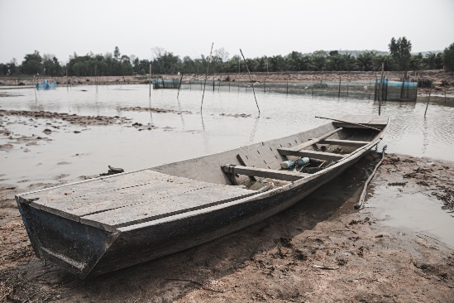
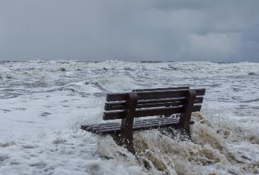
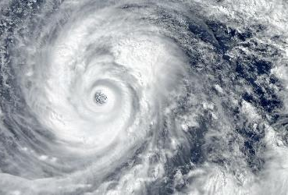
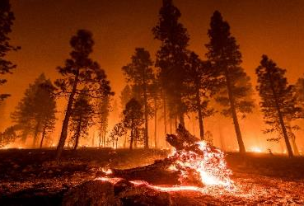
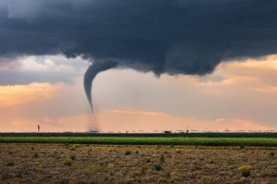
Recent CAT Losses
Drought
Flooding
Hurricanes
Wildfires
Tornado/Convective Storm
50% of the Lower 48 States are in drought
2021 – More than 50 severe flood events
Record-breaking 21 named storms in 2021
2021 wildfires
2021 1376 tornadoes in the US compared to 1075 in 2020
299.9 Million acres of crops in U.S. are experiencing drought conditions this week.
$80b Economic Loss – only $20b insured
$45B+ in insured losses (US ) IDA = $30b Alone
Burned over 7,000,000 acres
Over 100 deaths associated
2022 – KY Floods 37 deaths
Hurricane Ian = $?
$15B in insured loss
Estimated $10B+ insured losses
120.2 Million
people in the U.S. are affected by drought this week.
2022 To Date = 5.7m acres

Slide 26
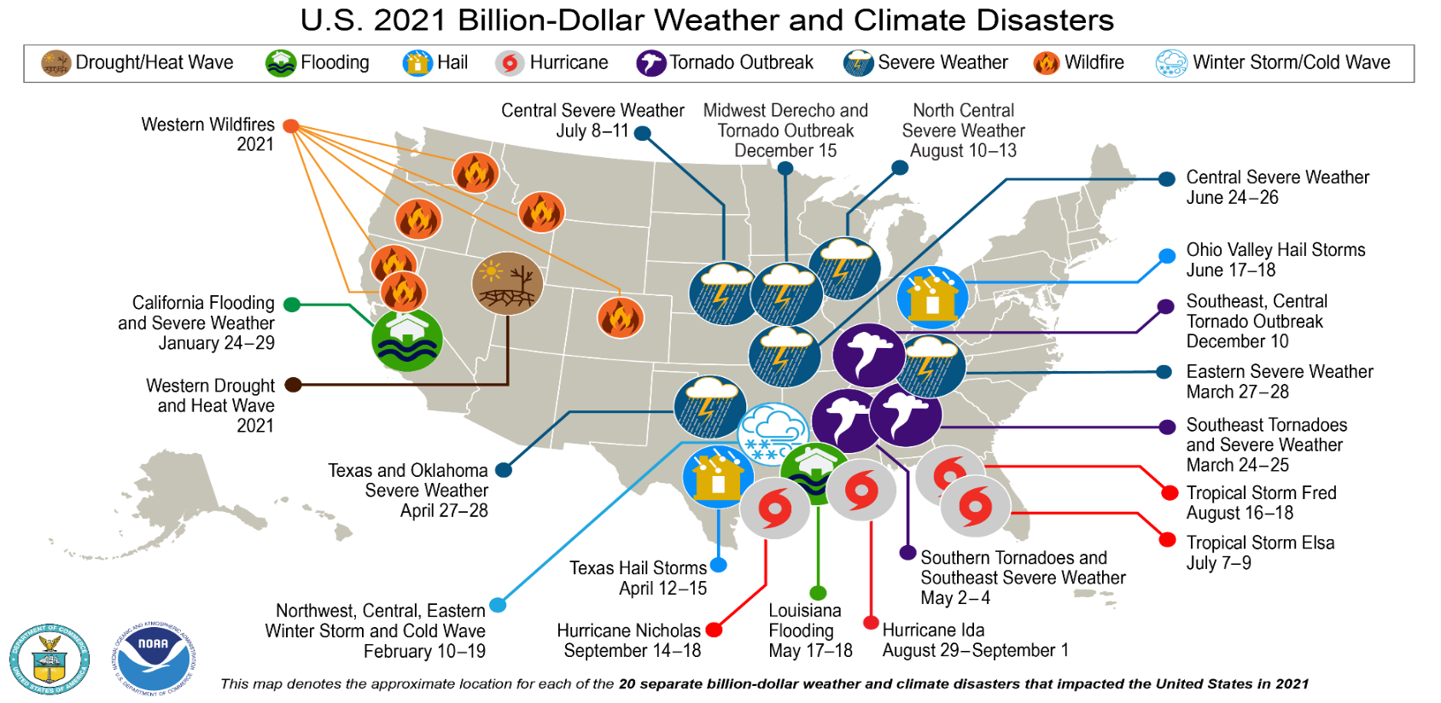
Major U.S Losses in 2021
Source: NOAA
26

Slide 27
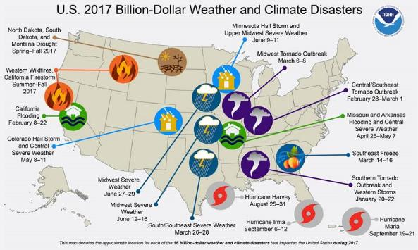
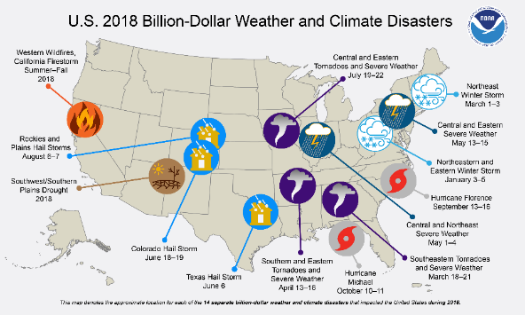
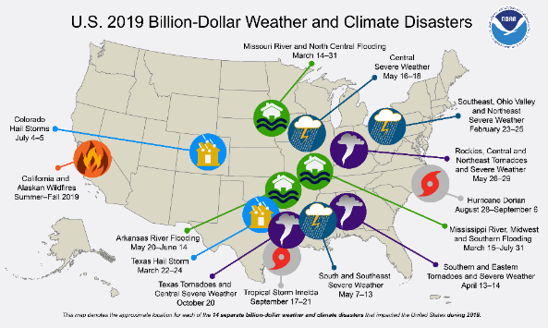
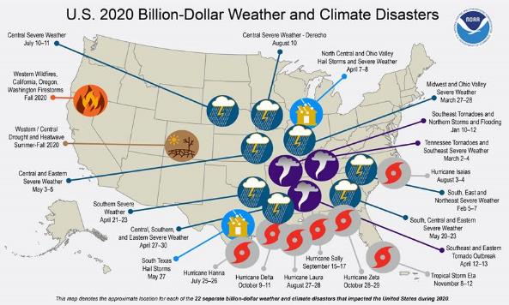
Four Year CAT History: $66B Events
Source: NOAA
27

Slide 28
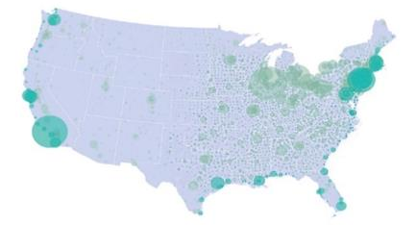
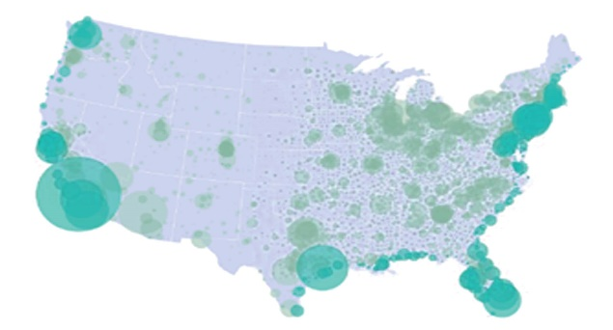
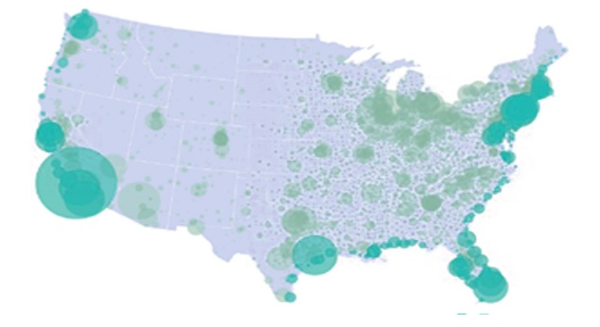
Population Growth and Bullseye Effect
1950
2000
2020
1950
1980
2010
2040
Rural
Exurban
Suburban
Urban
Tornado Scenario
After Ashley et al. (2014)

Slide 29
Average # of Events
29

Slide 30
Average # of Events
30

Slide 31
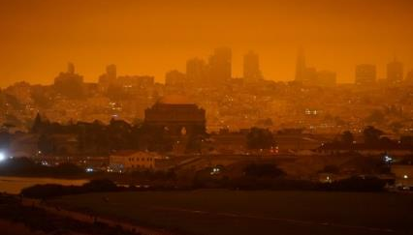
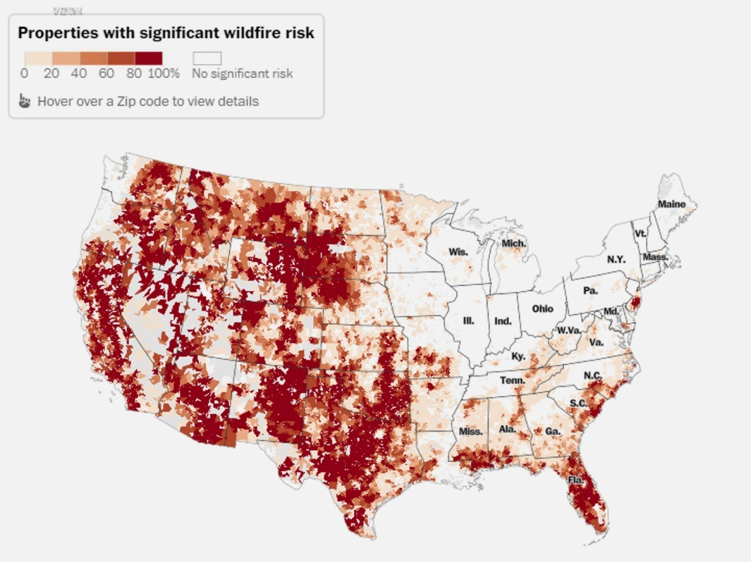
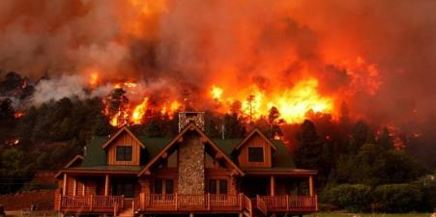
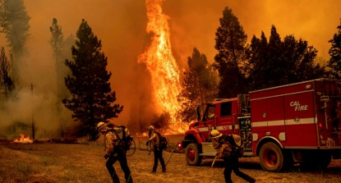
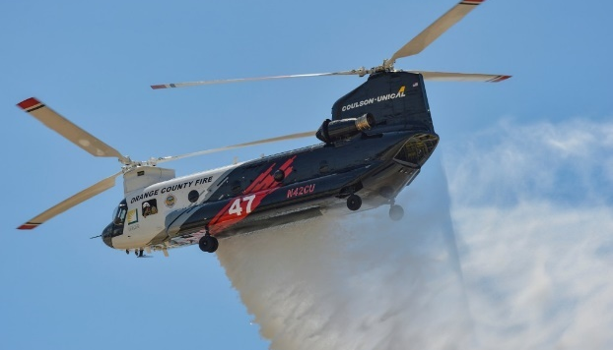
The Newest CAT Peril: Wildfire
Climatic changes are resulting in larger and hotter wildfires occurring each summer and later into fall.
Beyond the physical damage and destruction of wildfires, intense smoke significantly impacts the health and economy of communities:
Reduced travel and tourism leading to loss of sales and occupancy taxes.
Reduced school attendance and outdoor activities.
Smoke can hurt your eyes, irritate your respiratory system, and worsen chronic heart and lung diseases.
Continued investment & development of high-risk areas.
31

Slide 32
U.S. Inflation-Adjusted Insured CAT Losses
Harvey, Irma, Maria
$ Billions, 2019
Ida ($36B)
TX Freeze ($15B)
Katrina, Rita, Wilma
85
Hurricane Andrew
WTC
Ian?
20
21
22
Insured Cat Losses Are Increasing At An Alarming Rate – Nearly 700% Since 80’s
Average Insured Loss per Year* | 1980-2021: $23.8 Billion | 2012-2021: $44.1 Billion
Notes:
32

Slide 33
Casualty Market Major Disruptors
Cost of Vehicles/Technology
Fatality Trends
Distractive Driving – Cell Phones
Frequency and Severity Trajectory
Auto Liability
Opioids
Tele Medicine
Aging Workforce
Medical Cost Inflation
Cancer & PTSD Presumption
Workplace Violence
COVID
Out of State Exposure
Workers Compensation
Increase in Catastrophic Losses
Punitive Damage Awards
Organized Plaintiff Bar
Personal Injury Trends
Traumatic Brain Injury
Aging Infrastructure
Sexual Misconduct
Excessive Force
General Liability & Excess Liability

Slide 34
Increasing Impact on Liability Market
Reduced Capacity reinsurer withdrawals have been significant over the past two years
Litigation Financing continues to drive large claims and 68% of firms are using it in 2021
Plaintiff Attorney Strategies specialization and strategies have evolved to get larger verdicts and settlements.
Hyper Social Inflation “A Texas jury awarded $300 billion to the family of a teen and her grandmother, who were killed in a 2017 crash with a drunk driver.” This type of verdict is meant to send a message to others.
Labor Shortage everyone is doing more with less
Reviver Legislation Amendments A rise in Sexual Abuse and Molestation claims and settlements
Law Enforcement Increased focus on policing policy and procedures as well as pressure on Qualified Immunity
Auto Liability Frequency & Severity of losses has returned to pre COVID figures
Underwriter Scrutiny reinsurers are seeking to grow prudently and are maintaining a disciplined, conservative underwriter approach.
Inflation Rising cost are increasing the size of claims
Exclusions continued restrictions surrounding sexual abuse, Wildfire Exclusions, COVID, cyber, opioids and man made chemicals (PFAS – new focus)

Slide 35
Travel in Trillions of Vehicle Miles in U.S.: 1996–2021
Miles driven in 2021 were just 1% below 2019’s level and are virtually certain to set a new record in 2022
Miles driven plunged by 11% in 2020 as the pandemic severely curtailed travel
Miles driven in 2022 will likely set a new record, but could still be held back by soaring gas prices that could induce vehicle owners to scale back on their driving
Sources: Sources: Federal Highway Administration; USC RUM Center.
35

Slide 36
Auto Liability Bodily Injury Severity Trend Is Up, Frequency Plunge in 2020/21 Due to COVID Has Ended and Is Reversing
Annual Change, 2005 through 2022*
COVID pushed frequency down sharply, but severity increased
Frequency decline has ended. Q1 2022 BI frequency was +9.5% and Q4 2021 was +3.5%
*2022 figure is for the 4 quarters ending 2022:Q1.
Source: ISO/PCI Fast Track data; Center for Risk and Uncertainty Management, Univ. of South Carolina.
eSlide – P6466 – The Financial Crisis and the Future of the P/C
36

Slide 37
Traffic Fatalities in the U.S., 2000-2021
(Millions of Units)
During COVID, fatalities surged by 7.6% in 2020 and 10.5% in 2021 (up 18.9% since 2019)
Financial Crisis/ ”Great Recession” –fatalities fell 25.4%
Extraordinary Increase in Poor Driving Behaviors in 2020 and 2021 Contributed to Sharply Higher Auto Fatalities
Source: Insurance Institute for Highway Safety and Highway Loss Data Institute: : https://www.iihs.org/iihs/topics/t/general-statistics/fatalityfacts/overview-of-fatality-facts and NHTSA (2021): https://www.nhtsa.gov/press-releases/early-estimate-2021-traffic-fatalities#:~:text=NHTSA%20projects%20that%20an%20estimated,Fatality%20Analysis%20Reporting%20System's%20history Risk and Uncertainty Management Center, University of South Carolina.
37

Slide 38
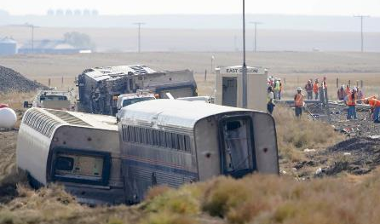
Public Transit
Motor vehicle maintenance and repair costs continue to increase in 2021 with supply chain disruptions, chip shortages and labor crunch.
12%
estimated year-over-year increase in fatality rate per mile for 2021²
Zero Emissions Vehicles
160,000
estimated number of commercial driver positions that will go unfilled by 2030⁴
38

Slide 39
Upward Trend in Liability Claims
Billions
11% Annual Growth for a Decade
Sources: NAIC data sourced from S&P Market Intelligence; Insurance Information Institute.
39

Slide 40
Median Value Large Liability Losses
40

Slide 41
Social Inflation: Many Interrelated Causes, Difficult to Manage
INSURANCE CLAIM COSTS
TOP VERDICT CATEGORIES
Increasing Propensity to Sue
Dollar Value of Top 100 verdicts by cause of action, in millions.
2020 |  |  |  |  |  |  | 2021
1 |  | Intellectual Property | $14,858 |  | 1 |  | Worker/Workplace Negligence | $301,929
2 |  | Products Liability | $3,117 |  | 2 |  | Intellectual Property | $3,675
3 |  | Worker/Workplace Negligence | $706 |  | 3 |  | Motor Vehicle | $2,046
4 |  | Construction | $285 |  | 4 |  | Transportation | $730
5 |  | Motor Vehicle | $261 |  | 5 |  | Products Liability | $651
6 |  | Medical Malpractice | $199 |  | 6 |  | Employment | $489
7 |  | Intentional Torts | $138 |  | 7 |  | Business Law | $410
8 |  | Legal Profession | $108 |  | 8 |  | Intentional Torts | $364
9 |  | Fraud | $94 |  | 9 |  | Insurance | $251
10 |  | Dangerous Condition of Public Property | $76 |  | 10 |  | Government | $167
Size of Jury Awards
Courts/Juries Favoring Plaintiffs
Growing Distrust of Large Corps.
Litigation Financing
Aggressive Plaintiff Bar Ads
Changes in Regulatory and Legal Environment
Source: Risk and Uncertainty Management Center, Univ. of South Carolina, adapted from Verisk “Social Inflation” presentation (2020); VerdictSearch. Figures are rounded to the nearest $1 million.
41

Slide 42
The average jury award reached an all-time record high of $2.5M in 2020, up 39% from 2019 and 274% since 2010
Median Award in 2020 = $125,366 (a record)
Average Jury Awards, 1999 – 2020 (latest available)
($000)
Source: Jury Verdict Research; Current Award Trends in Personal Injury (61st Edition), Thomson Reuters; Risk and Uncertainty Management Center, Univ. of South Carolina.
42

Slide 43
Liability Claim Values: Unfavorable Jurisdictions
California (with the plaintiffs’ bar taking advantage of unique California laws like the Private Attorney General Act);
New York City (particularly regarding Americans With Disabilities Act accessibility claims and an activist attorney general battling climate change with energy companies),
Georgia;
Philadelphia, which fell from the number 1 spot last year (especially in the Philadelphia Court of Common Pleas and the Supreme Court of Pennsylvania),
Illinois (especially Cook, St. Clair, and Madison counties and regarding asbestos litigation and Illinois Biometric Information Privacy Act class actions),
Louisiana (including deceptive lawsuit advertising practices and coastal litigation),
St. Louis, Missouri, and
South Carolina (particularly in asbestos litigation).
In its recently released annual report, the ATRA identified 8 jurisdictions on its 2021 hellholes list – which, in order, include:
No. 1
California
43
American Tort Reform Association (“ATRA”) publishes its “Judicial Hellholes Report.”

Slide 44
The Court Backlog
Court cases with verdicts above $20mn
Estimated cases as courts reopen and clear backlog aggressively
Source: Verdict Search, Inside P&C
44

Slide 45
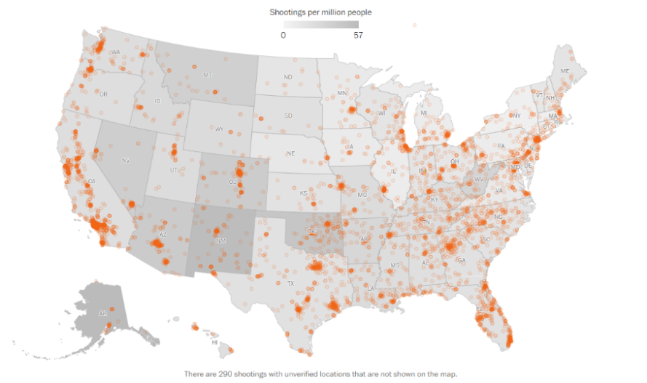
Evolving Law Enforcement Environment
Officer Involved Shootings
Policing Reform
Investigation into officer-involved deaths
Chokeholds & Neck Restraints
Officer Intervention
Age & Education Requirements
Limit or end officer’s use of qualified immunity
Criteria for traffic stops
According to MappingPoliceViolence.org
Database for Officer Misconduct
Body Cameras
1,126 in 2020
and
Decertify Officer
1,134 people in 2021
45

Slide 46
Spotlight: Cyber Liability
Marketplace stabilizing after several years of dramatic claims development.
Security standards across the marketplace:
Multi-factor authentication
Well managed end point detection
Well managed RDP connections – VPN, MFA, etc.
Back Ups
Planning and Training (and Frequency)
Reasonable patching schedule/plan
Plan or adequate measures in place to protect end of life software
IT Security Budgets
Email Security
Identity Access Management
Service Account Management
Sector view on resilience to cyber risk
Percentage of US and UK companies feeling ‘very prepared’ to anticipate and respond to cyber risk in 2021. Median line indicates the mid-point of the data set across all industries surveyed.
46

Slide 47
Toward the Future

Slide 48
Excess liability continues to be a challenge
Specific Problem areas:
Aggregate limits – Many carriers are looking to cap their exposure on pool programs
Attachment point/Retentions are being closely examined
Underwriter scrutiny on Law Enforcement and Sexual Abuse/Misconduct coverages
Emerging Exclusion - PFAS
Liability Renewal Outlook
Pricing expectations based on Q2 results for 2022 = Flat to +10% – based on losses and jurisdiction
Engage incumbent carriers early to gain commitment on renewal

Slide 49
Continued scrutiny of data (SOV, COPE, ITV with Increased Construction Cost)
Increased retentions and caps on certain types of exposure
Windstorm & Hail
Property Renewal Outlook
Rate increases expected and highly dependent on Wind Season, Reinsurance Market and individual client losses
Underwriter submission activity remains high – imperative to engage early and access global market
Regional Underwriting: Property markets are affected differently across the nation.
e.g. West Wildfire, East Hurricanes, Midwest Hail, etc.

Slide 50
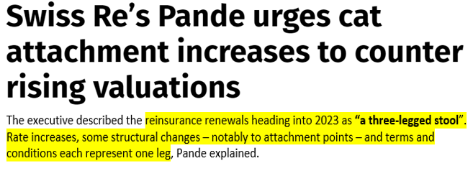
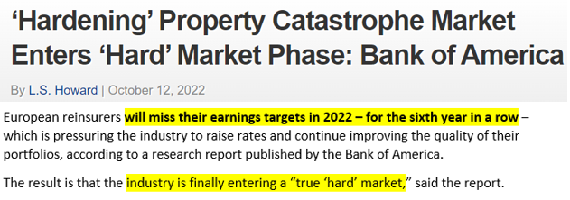
Specific Challenges:
Exposure increases (ITV) driven by inflation and supply chain
Knock on affect to modeling
$20B of additional capital required (10% of current $200b)
Supply & Demand Imbalance
Investor fatigue from years of losses = No new entrants
Increase of natural disasters
Recent poor industry performance (unprofitable in 4 of last 5 years)
Reduced capacity from incumbents “de-risking” book
Ian Loss ? = $35B to $70B
Trapped capital cannot be redeployed
ILS/Collateralized market seizing up
North American CAT Property Reinsurance Outlook

Slide 51
Leading insurers have indicated “We may have hit rate equilibrium”
2023 Forecast:
15% to 25% increases, at a minimum, for “good” risks and most starting much higher
Lower overall capacity deployment
Increased per-claim, self-insured retentions for poor security posture
Potential coinsurance percentages added for ransomware
Further reduction of ransomware limit
Cyber Renewal Outlook
Requirement to evidence security posture:
MFA
Data Backups
Endpoint Detection
Employee Education & Training Programs

Slide 52
Rate expectations: Account Specific
Wage Inflation’s impact on premiums &
Medical Expense Inflation
Workers Compensation Leading Concerns
Underwriter Concerns: Per Occurrence exposure to Cat loss
Remote Work: Out of State employees & Impact on productivity and compliance
Investment Yield on Long Tail Coverage

Slide 53
Thank you! Questions?
Please contact us if you would like a copy of this presentation.

