Slide 1
Insurance Requirements in Contracts
Presented by:
Courtney Ramirez
Senior Vice President
October 16, 2023
Alliant Insurance Services
www.alliant.com

Slide 2
Our Goal
Provide you with tips to get the most risk transfer with the least amount of effort.

Slide 3
Caveat
Always Consult with Risk Management/Legal/Procurement before Changing any Contract Requirements!

Slide 4
Introduction & Reference
Section I
Are you asking the right questions?
Risk Transfer & Identification
Section II
Are you using the right language?
Contract & Insurance Specs
Section III
Are you getting what you want?
Compliance

Slide 5
Introduction & Reference

Slide 6
How to Locate the IRIC Manual
www.alliant.com

Slide 7
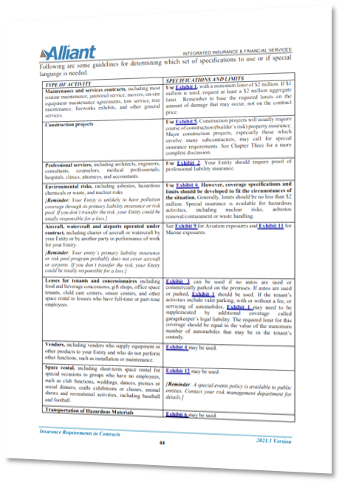
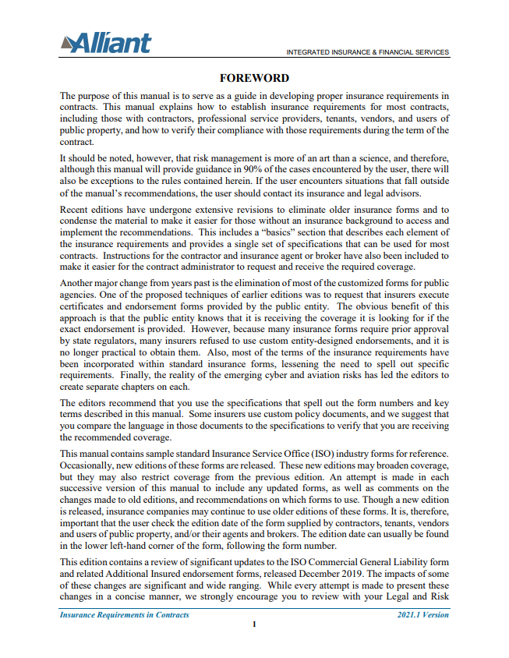
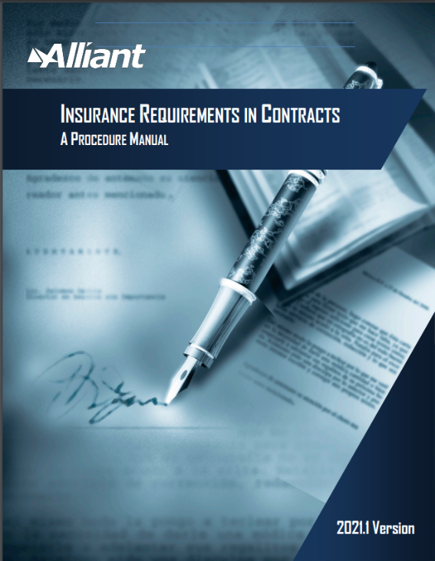
Navigating the IRIC Manual

Slide 8
Nine Chapters & Fourteen Exhibits
Insurance Specs For:
Most Contracts – Exhibit 1 – Focus for Today
Professional Services
Lessees
Suppliers and/or Vendors
Construction Contracts
Environmental Contractors & Consultants
Information Technology - Cyber
Airports
Unmanned Aerial Vehicles (aka Drones)
Chartering Aircraft
Marine Related Risks
Short-term Rentals of Facilities
Instructors
Schools including Bus & Transportation Costs

Slide 9
Glossary of Terms and Appendices
Foreword
Emerging Trends
Frequently Asked Questions (FAQs)
Introduction – Why Bother?
Contractual Risk Transfer – The Basics
*******************************************************
Appendix A Risk Assessment
Appendix B Common Insurance Industry Forms
Appendix C Sample Hold Harmless Agreements
Appendix D Sample Checklists
Appendix E Resources

Slide 10
Section I Are you asking the right questions?

Slide 11
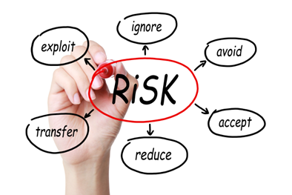
Risk Transfer – What is it?
Assigning responsibility for loss and related damages to the contracting party who controls the circumstances that might lead to the loss
Hold harmless or indemnification clause
Does NOT absolve you of liability
Promise of payment in event of a loss
Only as good as the person making the promise

Slide 12
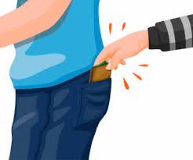
Risk Transfer – Why Require Insurance?
Hold Harmless gives you a pocket to pick. Insurance increases the chance that there will be money in the pocket!!!
Viability of contractor
Separate section of contract, provides protection
Must have endorsements on the policy
Additional insured – covered as an insured under other party’s policy.
Waiver of Subrogation – prohibits other party’s insurance carrier from recovering money for a loss.

Slide 13
Risk Transfer – When to Do it?
Any time you have, or should have, a written agreement with someone!
Construction projects
Professional services
Outsourced functions
Property leases
Special events
Recreational activities
Use of facilities
Permits

Slide 14
Risk Transfer – Why Bother?
Can be liable for damages – have risk
Place risks with those able to control them
Rely on the expert
Encourage safety
Source for payment of claims
Maintain project budget
Maintain good loss history
Lower funding/premium

Slide 15
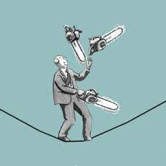
Risk Transfer – Understanding Exposure
Type of activity(ies)?
Who or what could be harmed? How bad?
Crowds likely to be involved? Alcohol?
Vehicles used, if any. Passengers?
Professional liability exposure?
Risk of Sexual Abuse and Molestation (SAM)?
Hazardous activities?
Risk sufficient to reject bids not meeting specs?
Consider prior losses
Check the IRIC Manual Checklists!

Slide 16
Section II Are you using the right language?

Slide 17
What Type of Contract? Using Your Contract Templates
General Services: for most contracts
Construction: for building projects or major remodeling
Professional Services: for architects, engineers, attorneys, accountants, medical, insurance, education, and software developers
Leases and Rentals: for long and short-term use of your real and/or personal property

Slide 18
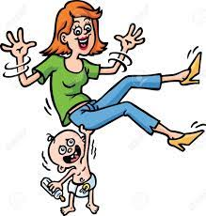
Who’s Holding Who & How Much?
Use Appropriate Hold Harmless Language
Defend and indemnify
Any and all claims, suits, proceedings
Include reasonable attorney’s fees
Costs paid as incurred
Full extent as permitted by law
May vary based on type of contract
Do not mix with insurance requirements

Slide 19
Note on Mutual Hold Harmless
Most of the time you shouldn’t do it!
Party who controls the circumstances should provide hold harmless
If you are paying for a service, you should be indemnified by the other party
You WANT to be indemnified even if you are a % at fault.
Agree on % of indemnity up front for Shared Services Agreements!

Slide 20
Minimum Scope of Coverage
Commercial General Liability
Commercial Auto Liability
Workers’ Compensation & Employer’s Liability
Other Lines as needed, based on risk, such as:
Professional Liability (if applicable)
Excess or Umbrella Liability (if higher limits needed)

Slide 21
Commercial General Liability
Includes the following types of coverage:
Bodily injury
Property damage
Personal injury (libel, slander, defamation)
Advertising injury (trademark)
Products & Completed Operations – must have for any product liability or construction exposures.
May not have for some service exposures, such as a teacher for a recreation class.

Slide 22
Automobile Liability
Important for any work or service involving the use of motor vehicles, and a legal requirement for all vehicle owners.
Additional Insured Status – generally Included in Policy Form
Symbol 1 – Covering any auto is preferred otherwise, Symbols 7, 8 and 9 requiring picking up coverage for owned, non-owned (employee cars) and hired.
Business Auto Coverage Form:
The following are "insureds":
a. You for any covered "auto".
b. Anyone else while using with your permission a covered "auto" you own, hire or borrow except:
(2) Your "employee" if the covered "auto" is owned by that "employee" or a member of his or her household.
c. Anyone liable for the conduct of an "insured" described above but only to the extent of that liability.

Slide 23
Workers’ Compensation
Coverage A: Workers’ Compensation
Statutory benefits – no limit
Critical that all subcontractors carry
N/A to sole proprietor &/or if have no employees
Coverage B: Employer’s Liability (EL)
$1,000,000 limit common
Covers “dual capacity” and other exceptions to exclusive remedy of workers’ compensation
This is NOT Employment Practices Liability

Slide 24
Coverage Required in Some Contracts
Cyber Liability
Professional Liability
Technology E&O
Sexual Abuse Molestation
Crime
Fidelity
Property Insurance
Pollution
Liability
Marine
Aviation
Drones

Slide 25
Excess or Umbrella Liability
This type of policy “lies above” primary liability policies to provide higher limits
It provides coverage in excess of reduced or exhausted underlying limits
Umbrella will provide some coverage not found in the CGL, AL, or EL. Excess coverage will not.
Refer to schedule of underlying in policy

Slide 26
Software E&O/Cyber Coverage
Software E&O will cover damages arising from developer’s professional negligence, not necessarily damages due to a cyber breach.
Needed for vendors providing software products or services.
Cyber Coverage will pay for damages to the insured, including cyber extortion and business interruption, as well as damages to third parties, including required privacy notifications, credit monitoring, and regulatory defense.
Needed when a vendor has access to your systems, any personally identifiable (PII) or Health Information (PHI) – regardless of form, including paper/hard copy documents!
This is also claims-made coverage – report ASAP!

Slide 27
How Much Coverage is Enough?
Tort Costs increased over 75% since 2001
An average annual increase of 8.7% over the past 60 years!!!
$1 million in 1986 is over $4 million today with PV based on COLA
$1 million in 1986 is over $9 million today with PV based on tort inflation
Jury Verdicts Continue to Rise
Verdicts over $20 million increased in 2019, up 300 percent from a decade earlier.
Median jury awards in personal injury cases more than tripled from 2009 to 2017.
The median cost of the top 50 single plaintiff bodily injury verdicts in the US rose from around $28m in 2014 to just over $54m in 2018.
Analyze the Exposure
Maximum Possible vs. Maximum Probable Loss

Slide 28
What Limits Are Reasonable Today? General Liability
$1 million per occurrence and $2 million aggregate is minimum
This has been the requirement since 1991 (CPI $1,750,000)
We now recommend $2 million/$4 million
$3 million for construction trades, food service, swimming, SAM, etc.
$5-10 million for general contractors, welding, crowds, childcare, toxics, etc.
$10 million or more for tunneling, blasting, large construction projects
IRIC Manual can help guide through appropriate limit decisions

Slide 29
Other Insurance Requirements
Additional insured status
Contractor insurance is primary and your entity’s insurance shall not contribute
Waiver of subrogation – Workers Compensation
Deductible or SIR declared/approved
A.M. Best rating A-:VII or otherwise acceptable
Notice of cancellation
Claims Made Policy extension

Slide 30
Occurrence – trigger of coverage is when loss occurs, regardless of when reported (can be years later).
What is Claims Made Coverage?
Claims Made – “trigger” of coverage is when claim is reported. Loss is covered if occurred after retro date and reported within policy or extended reporting period.
Consider requiring insurance for 3-5 or more years after completion of project for Claims Made coverage.

Slide 31
Section III Are you getting what you want?

Slide 32
Verify Compliance
Notification of requirements early
Obtain documentation before contract signed! Keep in mind, a certificate does not amend, extend or alter the policy. INFORMATION ONLY
Need at least three pieces of paper:
Certificate of Insurance
Additional Insured Endorsement
Naming your Entity and/or Automatic/Blanket Status
Adding your Entity in Section 9 of the certificate does not endorse the policy!
Waiver of Subrogation

Slide 33
Annotated Sample Certificate

Slide 34
Check Certificate for Compliance
Confirm name of insured
Date(s) of coverage
Limits, including aggregate
Liability – claims made v occurrence, and aggregate per project, location or policy?
Auto liability covers “any auto”?
Indicate if Additional Insured and/or Waiver of Subrogation applies
Description of operations, locations correct
Policy numbers on attached endorsements (if noted) should match certificate.
Check out insurers – www.ambest.com
Certificate holder should be Entity/Department
Certificate should be signed.

Slide 35
Additional Insured Endorsement
The most preferred insurer endorsement is ISO Form Number CG 20 10 11 85, covering damages arising from “your work.”
Covers both “products and completed operations” as well as “ongoing operations”
Newer endorsements forms that are acceptable
CG 2010 = “ongoing operations”
CG 2037 = “your work” – “products – completed operations hazard”
Must have both to get same coverage as the 11 85 form
Later versions may have to be accepted

Slide 36
Keep Good Records - Indefinitely
Original bid specs, contract, addenda, support documentation
Certificate(s) of insurance
Additional insured endorsement
Waiver of Subrogation
Any other endorsements
All correspondence concerning insurance or claims pertaining to the contract
Copy of contractor’s policy, if provided

Slide 37
Summary
Use the IRIC as a Guide
Ask the right questions
Risk ID & Transfer
Use the right language
Contract & Insurance Specs
Get what you asked for
Compliance & Claim Response

Slide 38
Questions?
The More Rewarding Way to Manage Risk

