Slide 1
Workers’ Comp/Liability Claims and the Benefits of Surveillance Ya'Sheaka C. Williams Quintairos, Prieto, Wood & Boyer, P.A. yasheaka.Williams@qpwblaw.com

Slide 2
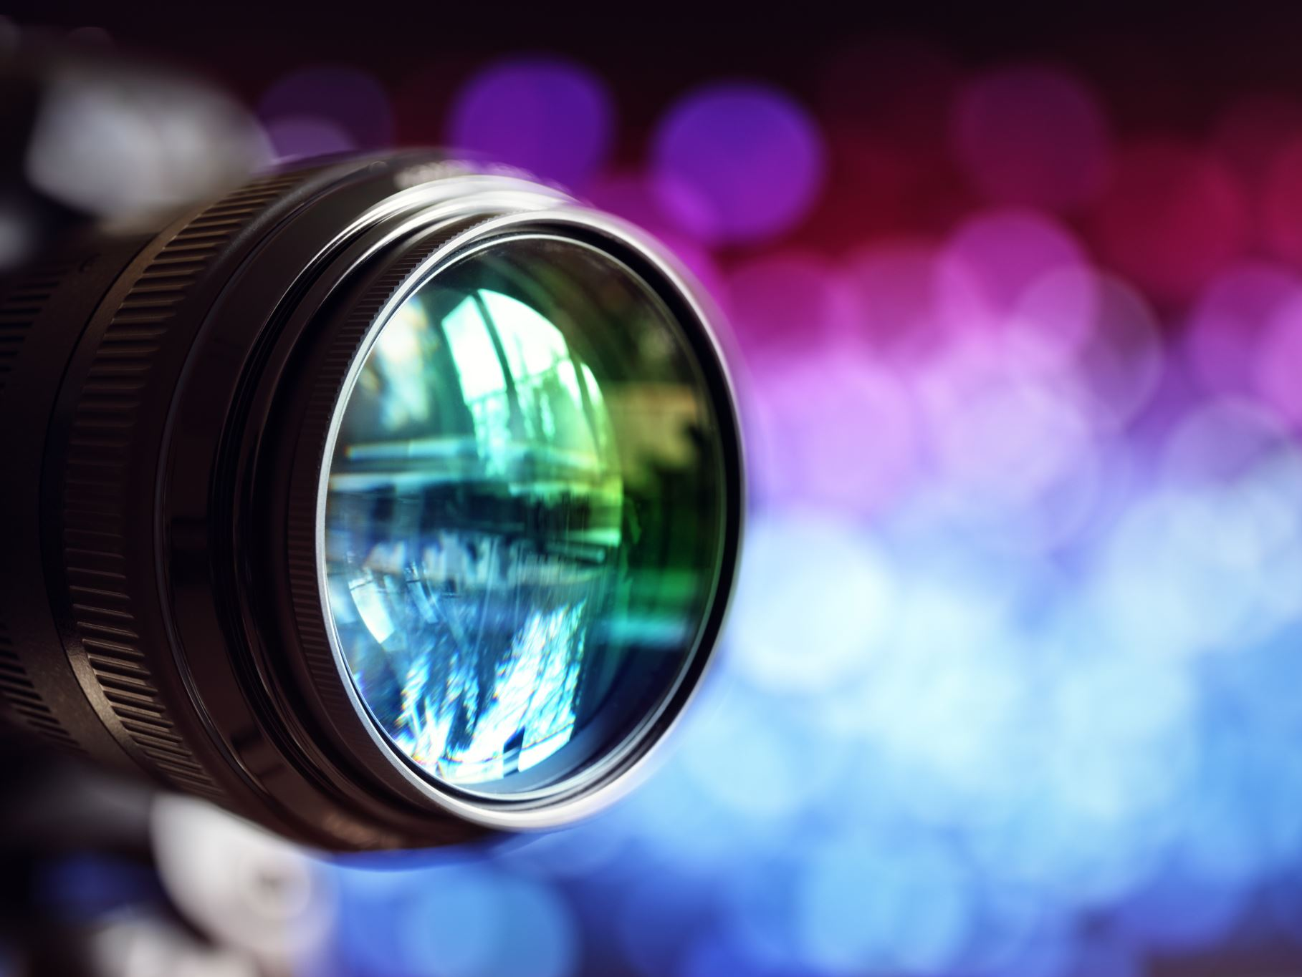
What is surveillance? A close observation, especially of a suspected spy or criminal.

Slide 3
Types of Surveillance
Background Investigations
Surveillance
Remote Camera Surveillance
Covert Camera Equipment
SIU/Fraud Investigations
Financial Asset Checks
AOE/COE Investigations
Hospital, Pharmacy & Medical Sweeps
Activity Checks
In-Person Recorded Statements
Pre-Employment Verification
Collection, Preservation & Storage of Evidence
Alive and Well Check
Telephonic Recorded Statements
Widow/Widower Check

Slide 4
Social Media As A Means Of Surveillance
Google
Facebook
Instagram
TikTok
Twitter

Slide 5
Surveillance Can Is Used To Establish How An Accident Occurred
Investigating the mechanism of injury
Must be preserved
Must be produced

Slide 6
Producing to Providers
Must be simultaneously produced to opposing counsel and provider
Anticipated that it will have an impact on the patient/physician relationship
Must disclose video and report timely

Slide 7
Surveillance is Discoverable
Dodson v. Persell, 390 So.2d 704 (Fla. 1980).
The existence of surveillance is discoverable in every instance and the contents are discoverable if the materials will be used as evidence. If the surveillance will not be used as evidence, the contents are discoverable only upon a showing of exceptional circumstances. The party seeking discovery must be afforded a reasonable opportunity to observe the surveillance before the final hearing, but it is within the JCC’s discretion to allow the surveilling party to depose the party or witness filmed before producing the surveillance for viewing. Dodson v. Persell, 390 So.2d 704 (Fla. 1980).

Slide 8
Surveillance May Be Excluded
Holiday Inn v. Re, 643 So.2d 13 (Fla. 1st DCA 1994)
JCC may refuse to admit surveillance evidence where the E/C willfully violated discovery rules by not giving the requested surveillance to the claimant until a short time prior to the hearing. E/C is not permitted to use the surveillance to influence the opinions of the medical witnesses during the on-going pretrial stages of the case.

Slide 9
Use of Surveillance to Establish Misrepresentation
Dieujuste v. J. Dodd Plumbing, Inc., 3 So. 3d 1275 (Fla. 1st DCA 2009)
The activities observable on surveillance video can serve as a basis for a finding of misrepresentation; although, only oral or written statements can serve as the predicate for disqualification from benefits. Dieujuste v. J. Dodd plumbing, inc., 3 so. 3d 1275 (fla. 1st DCA 2009). “Surveillance…has value only to the extent it contradicts or disproves an oral or written statement made by claimant.” Id. At 1277-1278.

Slide 10
Surveillance Pros/Cons
Can identify inconsistencies
Can reveal the extent of injuries
Can reveal potential misrepresentations
Can be used to investigate
Can be used to assess extent of injuries
Can be used to assess compliance with restrictions
Can be used to bolster injuries
Depending on the amount of surveillance taken, can be used to downplay what we see as an anomaly
Can be exc luded from evidence

Slide 11
Ya'Sheaka C. Williams, Esq. Quintairos, Prieto, Wood & Boyer, P.A. 1410 N. Westshore Blvd., Suite 200, Tampa, FL 33607 Ph: (813) 600-8627 Fax: (813) 286 9998 Email: yasheaka.williams@qpwblaw.com Web: www.qpwblaw.com

