Slide 1
Law Enforcement Exposures and Controls
Presented by: Geoffrey Jones

Slide 2
Presented By
Geoff Jones
Senior Claims Attorney at Midwest Employers Casualty

Slide 3
Highlights
Identifying Law Enforcement Exposures
Recognizing Risk Factors
Identifying Evolving Challenges
Controlling Chaos

Slide 4
Introduction
Due to the unpredictable, varied, and physical nature of law enforcement, police officers are at high risk of work related physical injury.
The physical demands of law enforcement duties may include running varied distances with and without loads, restraining non-compliant offenders, carrying injured or unconscious people, self-defense maneuvers and manual handling tasks.
Int J Environ Res Public Health; A Profile of Injuries Sustained by Law Enforcement Officers: A Critical Review, Lyons, Radburn, Orr and Pope. Feb. 2017

Slide 5
Traditional Exposures
Society and Law Enforcement have evolved but Officers remain subject to a number of common professional exposures.

Slide 6
Vehicle Related Exposures
Motor Vehicle Incidents account for 11% of law enforcement workplace injuries.
Police are twice as likely to be injured in a motor vehicle accident. Policeresponse.org: High Speed Pursuit and Traffic Crashes: Leading Causes of On-Duty Law Officer Fatalities (pursuitresponse.org)
From 2011-2020, 454 officers died due to motor vehicle incidents (struck by and crashes).
That accounts for 33% of all line of duty deaths. National Institute of Occupational Safety and Health.

Slide 7
Vehicle Exposures In Vehicle
Not wearing seat belts
Speeding (particularly through intersections)
Responding to a Call
Tunnel Vision (from stress-heightened focus)
Distracted driving
Mobile data terminal or other in car electronic device

Slide 8
Safety Sources
National Highway Safety Administration
Implement safe driving polices
Continues education operating policies within policy
National Institute for Occupational Safety and Health
Officer road code toolkit
International Association of Chiefs of Police

Slide 9
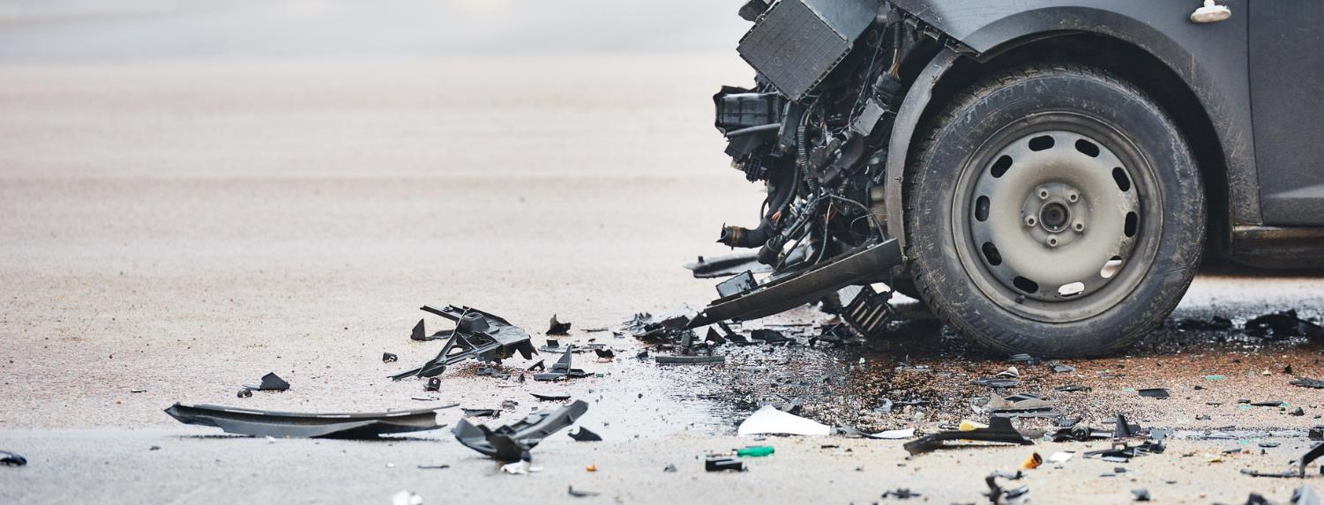
Preparing for the unexpected

Slide 10
Vehicle Exposures on foot
Temporary Traffic Control
Traffic Stops
Crash Scene Investigation

Slide 11
Roadside Prevention
Maintain situational awareness
Keep your head on a swivel
Work within the traffic control zone
Avoid the gap between vehicles
Do not turn your back to traffic
Always have an escape plan

Slide 12
Setting Tire Spikes

Slide 13
Felonious Events
In 2021, 73 officers died in felonious killings in the line of duty.
Highest number recorded by the FBI since 1995.
60 law enforcement officers died during felonious incidents in 2022.
U.S. Department of Justice-FBI LEOKA, 2022

Slide 14
Felonious Circumstances
49 killed with firearms
12 died during investigation/enforcement activities
12 were ambushed
6 unprovoked attacks
6 responding to disorders/domestic disturbances
Fights, disorderly subjects, family quarrels
6 tactical situations
Serving warrants, hostage situations
4 encounters assisting emotionally disturbed persons

Slide 15
Preventing Attacks
Environmental Awareness
Proper Use of Cover
Movement

Slide 16
What is the Best Approach?

Slide 17
Presumptive Exposures
A legal inference that must be made in light of certain facts.
Rebuttable vs. Conclusive
Line of Duty Benefits

Slide 18
Heart/Lung
[A]ny police officer of any city or village, including any city having a home rule charter, shall suffer death or disability as a result of hypertension or heart or respiratory defect or disease, there shall be a rebuttable presumption that such death or disability resulted from accident or other cause while in the line of duty for all purposes of the Police Officers Retirement Act. Nebraska Revised Statute 18-1723

Slide 19
Cancer
The cancer so developing or manifesting itself in these cases shall be presumed to arise out of and in the course of the employment. Labor Code Section 3212.1 (d)

Slide 20
Breaking Bad

Slide 21
Emerging Exposures
Bio-Hazards
Fentanyl
Staffing Shortages

Slide 22
Post Traumatic Stress Disorder
Presumption
Reduced burden

Slide 23
Officer Down

Slide 24
Ancillary Exposures
Biometric
Equipment carrying
Off Duty Employment
Shift work
Boredom

Slide 25
Pre-Injury Mitigation Strategies
Wellness Programs
Incorporate advanced arrest procedure and tactics training and use-of-force training
Regular Safety Meetings
Tracking Injuries
Near Miss Reporting System

Slide 26
Post Injury Recovery Strategies
Best Treatment Possible
Incorporate the Officers Family

Slide 27
Post Injury Challenges
Loss of function
Loss of Identity
Loss of Family

Slide 28
Conclusion
Studies suggest the life expectancy of an officer is significantly lower than that of the U.S. Population.
Int. J Emerg Mental Health, Life Expectancy in Police Officers: A Comparison with the U.S. General Population. Violanti, Hartley, Gu, Fekedulegn, Andrew, and Burchfiel 2013
***
Continue your efforts to combat that study.

