Slide 1
What to look for in a Cyber Liability Policy
Presented by: Temo Garcia , CISR
Vice President & Team Leader
Aon Cyber Solutions Group | San Francisco, CA

Slide 2
About Aon’s Cyber Solutions
Uniquely Qualified and Purpose Built
Global strategic acquisitions have strengthened Aon’s fight against cyber risk. We are purpose built to be our clients’ best asset against cyber threats. Aon’s Cyber Solutions is uniquely qualified to offer clients tools to assess, test, quantify, transfer, and respond to cyber risk exposures. Aon is recognized as one of the industry’s premier resources in cyber risk management, and our multidisciplinary team of 600+ global professionals offers strong technical and investigative aptitude, enhanced consulting and risk transfer expertise, long-standing carrier relationships, and robust claims handling capabilities.
Cyber Security
+
Risk
+
Insurance Capabilities
+600 dedicated cyber professionals serving you locally
10 of 30 largest cyber breaches were managed by Aon
+1,400 cyber claims handled since 2012
Who We Are
+$1 Billion U.S. cyber premium dollars placed per year
50,000 Aon colleagues across 120 countries
Recognized industry leaders by IDC, Forrester, and Forbes

Slide 3
Cyber Liability Q3 Market Dynamics
Pricing Primary: (Consistent) Excess: (Consistent to Decreasing) | ●
Capacity/Limit (Improving) | ●
Underwriting / Process (Rigorous / Consistent) | ●
Retentions (Consistent) | ●
Coverages (Consistent to Restricting) | ●
Claims & Loss (Increasing) | ●
Overall | Market conditions have been buyer friendly throughout 2023. More capacity is available in comparison to 2022 or 2023. While risk differentiation remains important to insurers, many insureds have improved their security controls to a level that aligns with underwriting expectations.
A Look Ahead | As we look forward to what may be a volatile market over the next 3-5 years, identifying the right long-term insurer who understands your risk and is willing to customize policy wording to address your exposures and incident response strategies is critical. Pricing for large market cap companies should continue to improve throughout 2H of 2023. Competition and new capacity in the primary middle market segment and national account excess layers segment continue drive pricing down compared to Q2 of 2022. Systemic risk is a top concern for insurers. They continue to evaluate, scrutinize, and in some instances restrict coverage offered for critical infrastructure, systemic and/or correlated events, and war. Certain insurers restrict coverage on either a generalized or event specific basis. Privacy related losses are mounting, and they are severe. Insurers are increasing underwriting scrutiny related to privacy exposures and data collection including biometric information, pixel tracking and new privacy/consumer protection regulations.
Exceeds Norms
Meets Norms
Below Norms
3

Slide 4
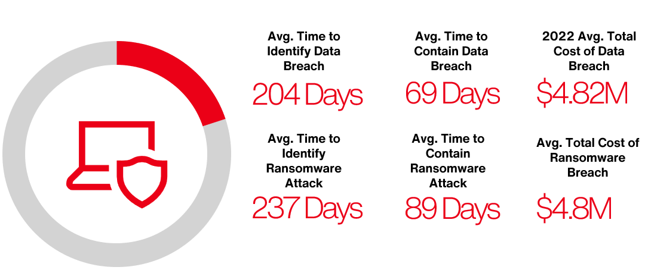
Public Entity By the Numbers

Slide 5
Cyber Key Controls
Marketplace Minimum Expectations
Token Based Multi-factor Authentication (MFA)
Vulnerability Scanning & Patch Management
Endpoint Protection & Response (EDR)
E-mail Filtering & Security (DMARC/DKIM)
Social Engineering Exercises & Awareness Training
Identity, Access, and
Privileged Access Management
Network Segmentation: Secure RDP, VPN, OT/IT
Disaster Recovery Testing, BCP, & Immutable Backups
Incident Response Plan (Written & Tested)

Slide 6
Cyber Incident Rates Indexed to Q1 2019
Key Observations:
Ransomware activity continues to outpace Non-Ransomware Data Breach/Privacy Event activity.
Ransomware up 1,010% from Q1 2019 to Q1 2023
Compared to Q1 2023:
Ransomware up 74%
Non-Ransomware Data Breach/Privacy up 6.5%
*Claim count development may mitigate this decrease
The most commonly impacted industries by Ransomware in Q2 2023 were:
Manufacturing
Business Professional Services
Education
Healthcare
IT-Services
Public Entities
Source: Risk Based Security, analysis by Aon. Data as of 7/2/2023
Proprietary & Confidential: The content, analysis and commentary included herein are understood to be the intellectual property of Aon. Further distribution, photocopying or any form of third-party transmission of this document in part or in whole, is not permitted without the express, written permission of Aon.

Slide 7
Cyber Risk Impacts All Loss Quadrants
1st Party
3rd Party
Any major cyber event will result in
PR, response, and continuity costs
Immediate and extended revenue loss
Restoration expenses
Defense costs
Financial
Third parties will seek to recover
Civil penalties and awards
Consequential revenue loss
Restoration expenses
Tangible
Physical damage is possible
Property damage
Bodily injury
Cyber Loss Spectrum
Physical damage may cascade to others
3rd party property damage
3rd party bodily injury

Slide 8
Scope of Cyber Insurance Coverage
Defense Costs + Damages + Regulator Fines | Insured’s Loss | Expenses Paid to Vendors
Liability Sections Failure of Network Security Failure to Protect / Wrongful Disclosure of Information, including employee information Privacy or Security related regulator investigation All of the above when committed by an outsourcer Wrongful Collection of Information (some policies) Media content infringement / defamatory content | First Party Sections Network-related Business Interruption Extra Expense System Failure Business Interruption (some policies) Dependent Business Interruption (some policies) Intangible Asset damage | Expense / Service Sections Crisis Management Breach-related Legal Advice Call Center Credit Monitoring, Identity Monitoring, ID Theft Insurance Cyber Extortion Payments

Slide 9
Cyber Insurance | Coverage Descriptions
Breach Event Expenses Triggered by discovery of a privacy or security incident
Reimbursement coverage for the insured’s costs to respond to a data privacy or security incident. Policy triggers may vary but typically are based upon discovery of such an event, or a statutory obligation to notify consumers of such an event. Covered expenses can include computer forensics expenses, legal expenses, costs for a public relations firm and related advertising to restore your reputation, consumer notification, and consumer credit monitoring services.
Cyber Extortion Triggered by a threat to cause a security failure or privacy breach
Reimbursement coverage for the insured for expenses incurred in the investigation of a threat and any extortion payments made to prevent or resolve the threat.
Digital Asset Protection Triggered by a network security failure, unless system failure coverage provided
Reimbursement coverage for the insured for costs incurred to restore, recollect, or recreate intangible, non-physical assets (software or data) that are corrupted, destroyed or deleted due to a network security failure.
Computer Hardware Replacement Triggered by the loss of use of computer hardware/electronic equipment
Reimbursement coverage for the insured for the replacement of computer hardware that has been rendered useless due to unauthorized reprogramming/ransomware. Coverage is sometimes added as its own insuring agreement but is often triggered in conjunction with another insuring agreement, typically network business interruption or data restoration. As such, coverage may only apply if the computer hardware replacement would mitigate business income loss or help restore data/systems
This is a summary and is not intended to be an exhaustive analysis of all coverage items, exclusions, terms or conditions relevant to all claims and exposure situations.
Please refer to the actual policy(ies) for coverage items

Slide 10
Cyber Insurance | Coverage Descriptions
Network Business Interruption Triggered by a network security failure, unless system failure coverage
Business Interruption - Reimbursement coverage for the insured for actual lost net income, as well as associated extra expense, caused by a computer system outage
Security Failure - Provides coverage for interruption to an insured’s business due to an interruption of an insured’s computer system due to a malicious attack
System Failure - Provides coverage for interruption to an insured’s business due to an interruption of an insured’s computer system due to an unintentional/unplanned outage
Dependent Security Failure - Provides coverage for an interruption to an insured’s business due to the outage of a computer system of a business on which the insured is dependent on caused by a malicious attack. Coverage varies but can include businesses such as information technology providers (cloud providers) or non-information technology providers. Coverage generally only extends to a dependent business where the insured has a contract in place
Dependent System Failure - Provides coverage for an interruption to an insured’s business due to the outage of a computer system of a business on which the insured is dependent on caused by a unintentional/unplanned outage. Coverage varies as described in dependent security failure/
Coverage does not typically apply until after the greater of a waiting period or retention. Reimbursement periods vary greatly, but usually reimburse the insured until the restoration of computer systems (up to 120+ days)
Reputational Harm Triggered by an Adverse Media Event during the Policy Period
Reimbursement coverage for the insured for actual lost net income as a result of an adverse media report of a network security or privacy incident. Reimbursement period (period of indemnity) varies but often ranges from 30 days to 180 days. A waiting period, usually, from 10 hours to 14 days, may also apply. Coverage may not apply if a computer system outage occurs
This is a summary and is not intended to be an exhaustive analysis of all coverage items, exclusions, terms or conditions relevant to all claims and exposure situations.
Please refer to the actual policy(ies) for coverage items

Slide 11
Cyber Insurance | Coverage Descriptions
Network Security Liability
Liability coverage for defense costs and damages suffered by others resulting from a failure of computer security, including liability caused by theft or disclosure of confidential information, unauthorized access, unauthorized use, denial of service attack or transmission of a computer virus.
Privacy Liability
Liability coverage for defense costs and damages suffered by others for any failure to protect personally identifiable or confidential third-party corporate information, whether or not due to a failure of network security. Coverage may include: unintentional violations of the insured’s privacy policy, actions of rogue employees, and alleged wrongful collection of confidential information.
Regulatory Proceedings Liability
Liability coverage for defense costs for proceedings brought by a governmental agency in connection with a failure to protect private information and/or a failure of network security. Includes coverage for fines and penalties to the extent insurable by law. Compensatory damages, i.e. amounts the insured is required by a regulator to deposit into a consumer redress fund, may be covered.
Payment Card Industry Data Security Standards (PCI-DSS)
Coverage for a monetary assessment (including a contractual fine or penalty) from a Payment Card Association (e.g., MasterCard, Visa, American Express) or bank processing payment card transactions (i.e., an “Acquiring Bank”) in connection with an Insured’s non-compliance with PCI Data Security Standards.
Media Liability Coverage
Liability coverage for defense costs and damages suffered by others for content-based injuries such as libel, slander, defamation, copyright infringement, trademark infringement, or invasion of privacy. The scope of covered media is variable and can range from the insured’s website only to all content in any medium.
This is a summary and is not intended to be an exhaustive analysis of all coverage items, exclusions, terms or conditions relevant to all claims and exposure situations.
Please refer to the actual policy(ies) for coverage items

Slide 12
Cyber Insurance | Coverage Considerations
Market Strategy & Key Coverage Considerations
Start the renewal process early, early identification of possible underwriting concerns will allow time for remediation. Be prepared to market and host an underwriting meeting.
If MFA is not fully implemented for remote access, Office 365, remote desktop protocol (if applicable), backups, and admin/privileged users, consider implementing as soon as possible.
Vendor considerations. Review your insurers preferred vendor schedule to confirm they align with your incident response plan.
Try to maintain breadth of coverage and improve coverage where possible.
Avoid reductions in coverage for Widespread Events
Seek to maintain current language for War Exclusion and Cyber Terrorism Carveback
Affirmative Wrongful Collection Coverage
Business Interruption and Dependent Business Interruption language (IT vs Non-IT)
Limits, Retention, & Premium
Discuss Limit Adequacy – does your broker offer quantification tools?
Discuss tradeoffs of maintaining retention or potentially increasing retention – are the savings worth the increase? Is a lower retention available?
Stabilizing market conditions is allowing for successful marketing efforts. Results will vary greatly on controls and underwriting meeting. Differentiate yourself. Expect renewal pricing between flat and -15% YoY.

