Slide 1
Mental Health
in the Workplace
Mark Morgan
President, SHERRILL MORGAN
Terri Evans
Vice President, EAS

Slide 2
What is Wellness?
Our Current Evaluative Status
BMI
Cholesterol
A1C
BP
Regular Exercise
Diet
Annual Exam
The goal is to live a healthier, longer life
During COVID-19, we all had the apparent time to address these issues, though no major improvement was made

Slide 3
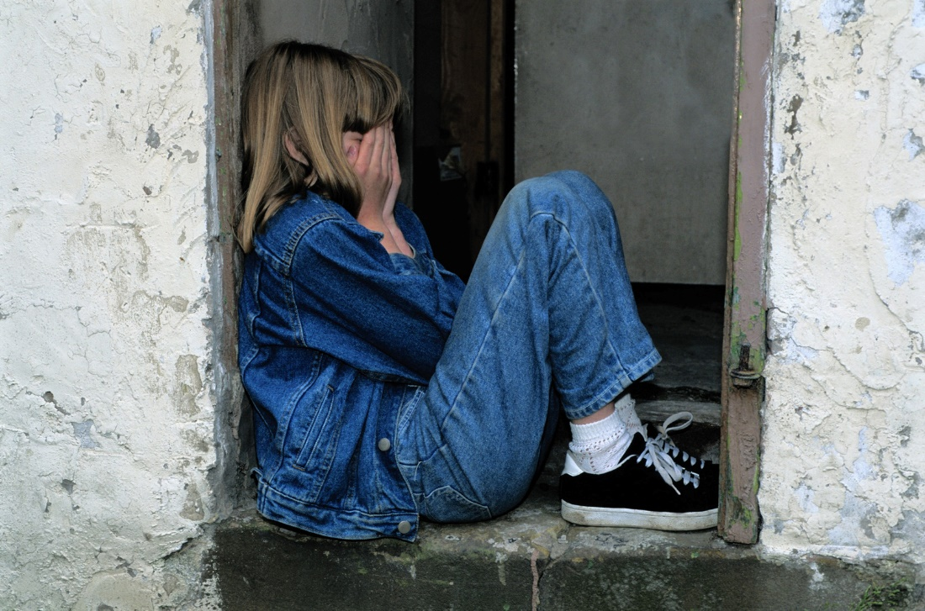
The Impact of Isolation
The prolonged confinement is evidently related to psychological damage, considering that individuals would be subjected to stressors for a longer period of time. In some cases, these psychic losses lasted for many months after the end of this confinement.
It is necessary to develop and implement actions to minimize the population psychological distress in meeting the needs of the communities affected by COVID-19.
“Effects of quarantine on mental health of populations affected by Covid-19”. Journal of Affective Disorders

Slide 4
The Self-Reported Problem: An Increase from 21% to 37%
The percentage of Americans who reported feeling hopeless more than half of the time has increased from 21% in 2019 to 37% in 2020.
According to the Substance Abuse and Mental Health Services Administration:
Adults reporting any kind of mental illness has lingered between 17% and 21% for the past 10 years.
1 in 5 adults reported having mental illness in 2019
Young women are the most impacted, with over 1 in 3 people ages 18-29 reporting mental illness
16.1% of adults received mental health treatment at some point in 2019
“As Covid-19 cases rise, 37% of adults are reporting a significant symptom of depression”. USA Facts

Slide 5
Screen Time is NOT a Social Substitute
32% of teen girls said that when they felt bad about their bodies, Instagram made them feel worse
For the past 3 years, Facebook has been conducting studies into how Instagram affects its millions of young users. Repeatedly, the company’s researchers found that Instagram is harmful for a sizable percentage of them, most notably teenage girls.
“We make body image issues worse for one in three girls,” said one slide from 2019, summarizing research about teen girls who experience the issues.
Mission
TO EXCEED THE EXPECTATIONS OF THE CUSTOMERS AND PROVIDE THEM WITH THE BEST INTERNET SERVICES AND THE MOST RELIABLE SUPPORT SYSTEM.
“Facebook knows Instagram is toxic for teen girls, company documents show”.
Georgia Wells, Jeff Horwiitz, and Deepa Seetharaman. Wall Street Journal

Slide 6
Drug Overdoses
Have Jumped 30%...
Deaths from drug overdoses hit a record 93,000 in 2020, a nearly 30% jump from the prior year, according to a report from the CDC’s National Center for Health Statistics
The estimated number of overdose deaths reached 93,331 in 2020, according to the new data. More than 900,000 people have died of overdoses since the U.S. drug epidemic began about 1999, according to the CDC.
Amid the COVID-19 pandemic, “we took our eye off the opioid epidemic,” said Tami Mark, PhD, health economist and senior fellow at think tank RTI International. “When we weren’t looking, it got horribly worse.”
“’Terrifying’: 2020 drug overdoses jump 30%, hit record 93,000 deaths”.
Gabrielle Masson. Beckers Hospital Review

Slide 7
You Aren’t Alone
As of July 16, 2022, the U.S. has transitioned from a 10-digit National Suicide Prevention Lifeline to a 3-digit one: 988. The lifeline, which also links to the Veterans Crisis Line, follows a three-year joint effort by the U.S. Department of Health and Human Services (HHS), Federal Communications Commission (FCC), and the U.S. Department of Veterans Affairs (VA) to put crisis care more in reach for people in need.
SAMHSA.GOV

Slide 8
New Age of Awareness of an Existing Problem
The frequency of telehealth claims for behavioral and mental health disorders far exceeded all other clinical issues. Claims for behavioral and mental health disorders were 4-5 times more frequent than those for other common categories of disease, including circulatory and endocrine disorders.
“A Covid-19 telehealth impact study: exploring one year of telehealth experimentation”. Telehealth and Medicine Today

Slide 9
In My Own Experience
Training from Hazelton/Betty Ford Clinic, Minnesota
Characteristics and symptoms of mental distress:
Desire to separate/be apart
Blaming others for events in our lives
Inability to control certain behaviors such as drinking or eating
Destruction of personal and community support systems
Some of these characteristics were forced unnaturally upon us due to the isolation of the
COVID-19 response

Slide 10
Limited Access to Care

Slide 11
Through COVID-19, Our Wellness Programs Couldn’t Make US Well
PERHAPS WE WERE ONLY MEASURING HALF OF THE CRITERIA NEEDED FOR WELLNESS
IF WELLNESS IS OUR GOAL, TO LIVE LONGER, HEALTHIER, AND HAPPIER LIVES, THEN ADDITIONAL MEASURES SHOULD BE USED TO ACHIEVE THIS

Slide 12
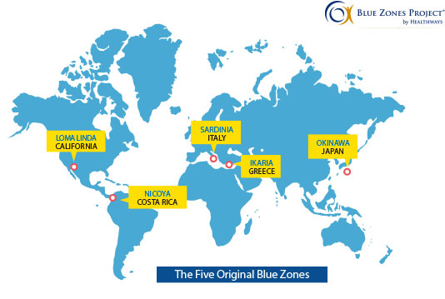
Longevity

Slide 13
“Socializing and maintaining tight-knit communities also plays a significant role in longevity. The healthiest people in the world don’t eat in front of the TV. They eat with their family and friends. They linger over shared meals because they are enjoyable. They don’t grab a quick bite simply to eat.”
Longevity
The Longevity Solution: Rediscovering Centuries-Old Secrets to a Healthy, Long Life
Dr. James DiNicolantonio & Dr. Jason Fung

Slide 14
“Although these people live throughout the world, with seemingly widely divergent diets and lifestyles, they all share certain characteristics that might help them live longer, fuller lives. These people often smoke less, move more (and at a moderate level), and prioritize family and socializing above all else.”
Longevity
The Longevity Solution: Rediscovering Centuries-Old Secrets to a Healthy, Long Life
Dr. James DiNicolantonio & Dr. Jason Fung

Slide 15
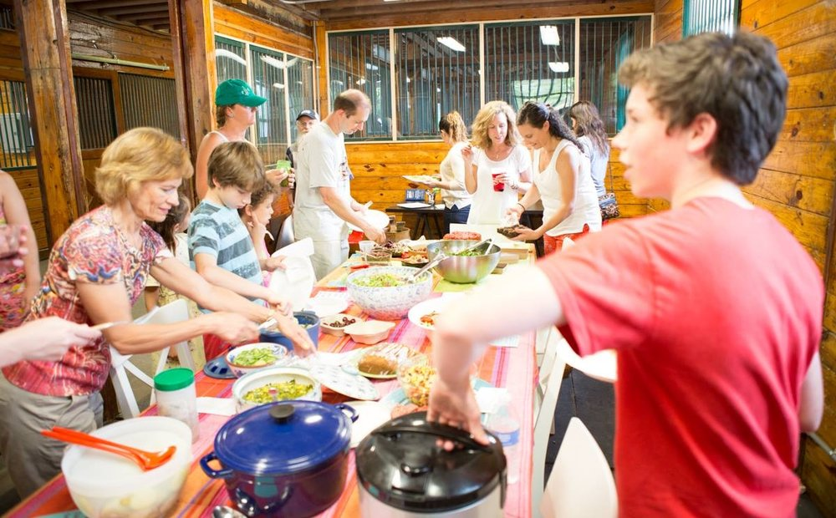
Family Meal 1

Slide 16
Family Meal 2

Slide 17
WHAT IS WELLNESS?
HEALTHY LIVING
=
LONGEVITY
=
HAPPINESS

Slide 18
WHAT IS WELLNESS?
HEALTHY LIVING
=
LONGEVITY
=
HAPPINESS
OR
HAPPINESS
=
HEALTHY LIVING
=
LONGEVITY

Slide 19
WHAT IS HAPPINESS?
HAPPINESS
HEALTHY LIVING
LONGEVITY
=
=

Slide 20
Happiness Today
“We are promised happiness with the next pay raise, the next new gadget – even the next sip of soda.
The Swedish business professor Carl Cederström argues persuasively in his book “The Happiness Fantasy” that corporations and advertisers have promised satisfaction but have led people instead into a rat race of joyless production and consumption.
“Though the material comforts of life in the U.S. have increased for many of its citizens, those things don’t give life meaning.”
The Atlantic 2020, “Are We Trading Our Happiness for Modern Comforts?”

Slide 21
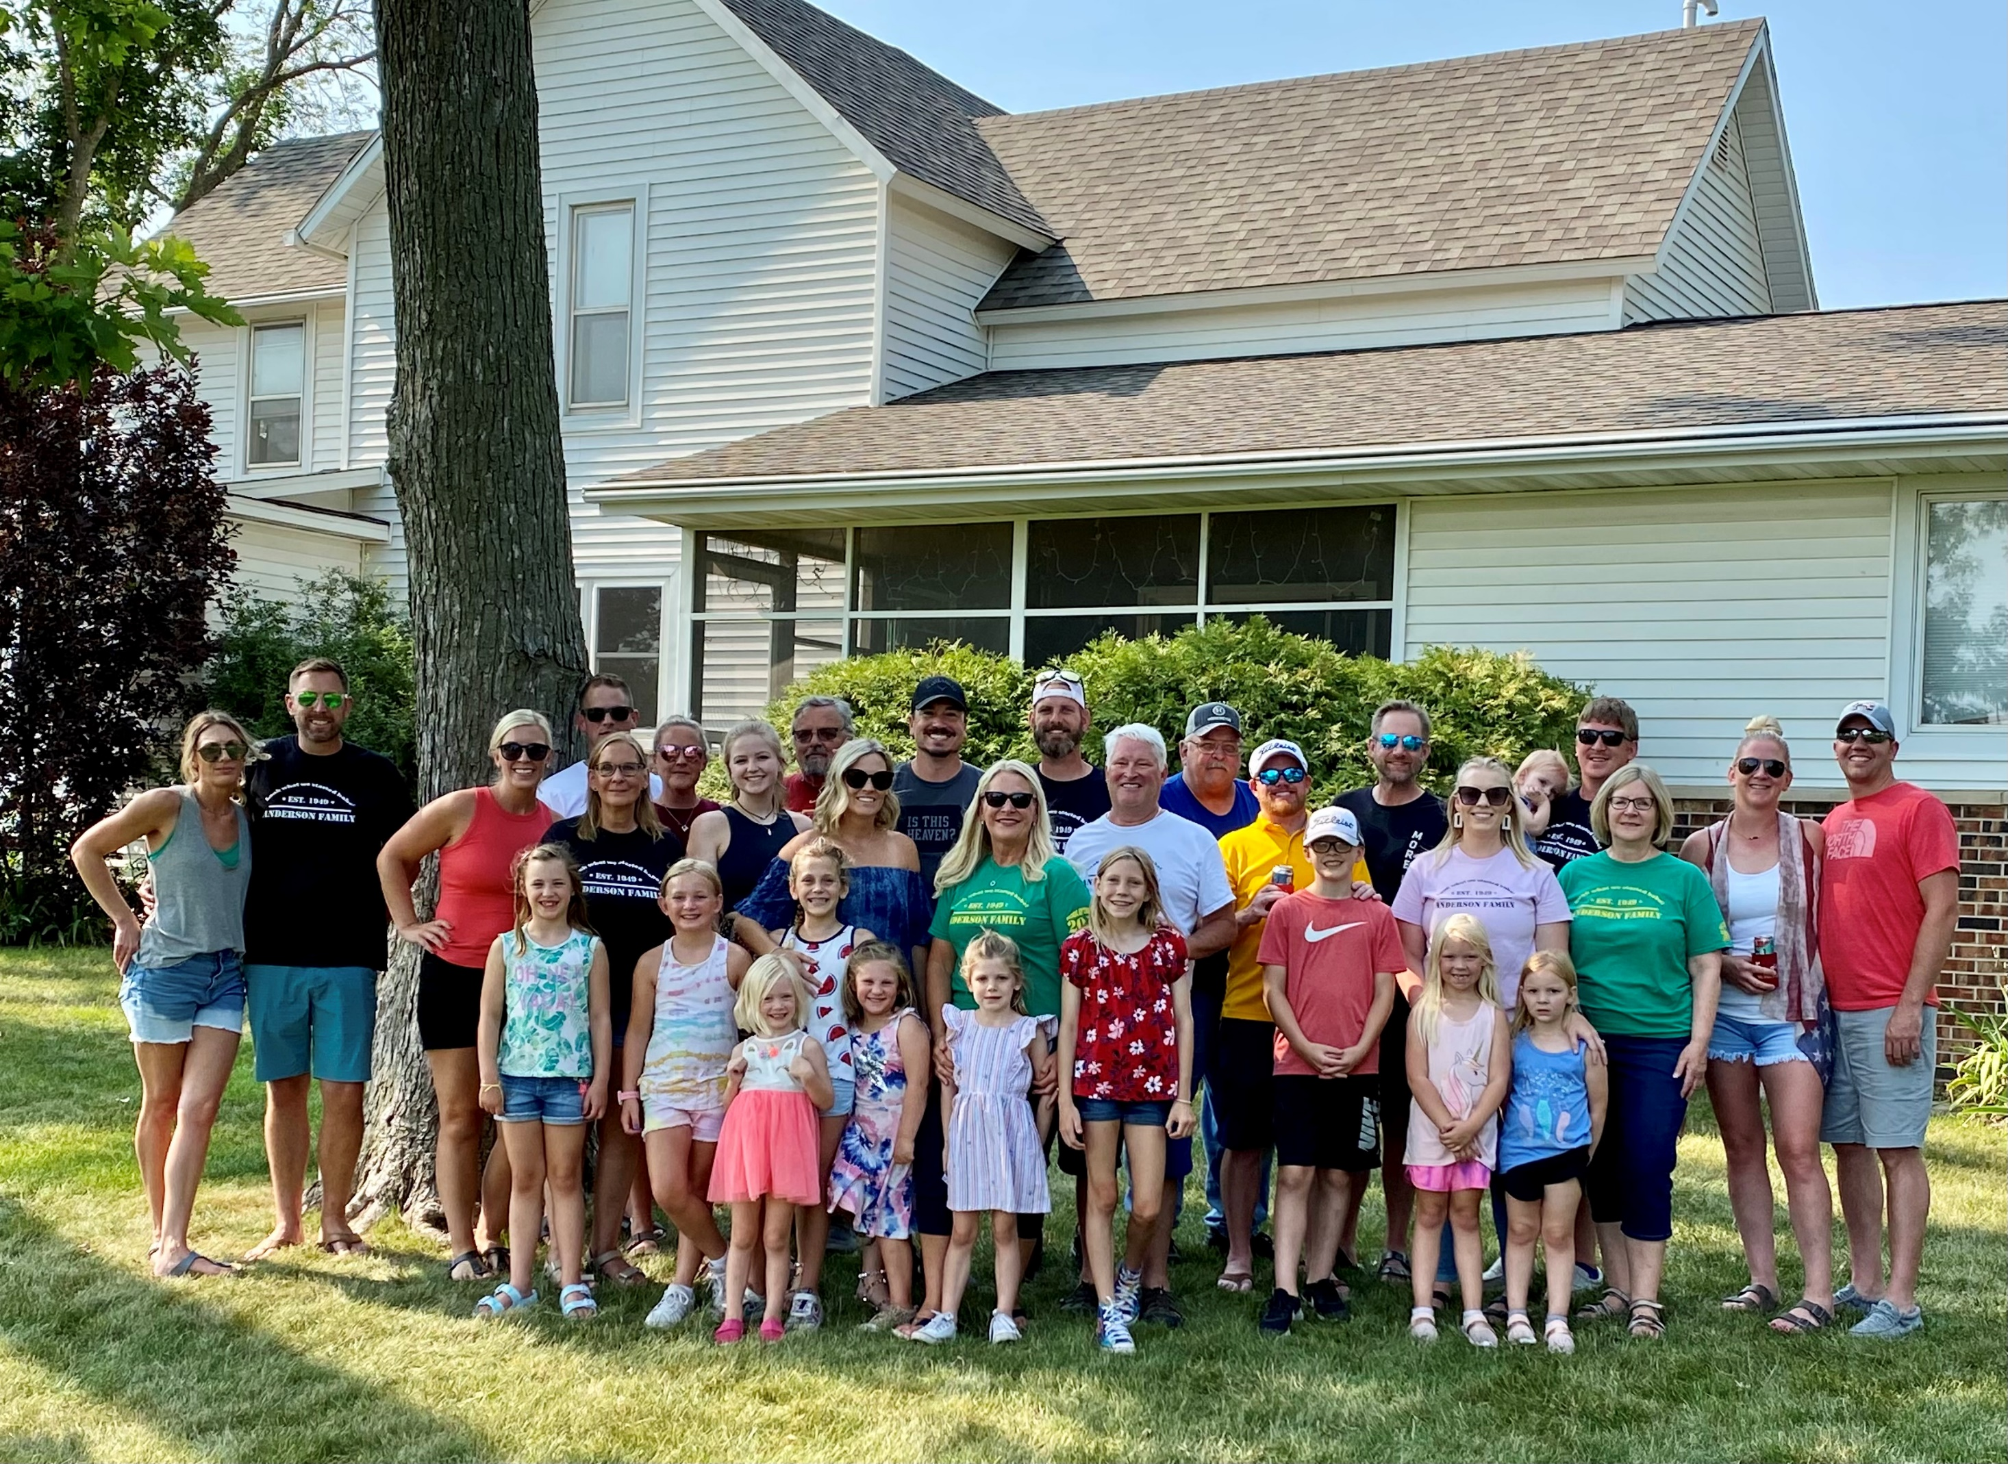
Mark’s Family

Slide 22
Church

Slide 23
Biking

Slide 24
Health & Happiness Principles
“Love Your Neighbor as Yourself”
“No Judgement or Acceptance”
“Belief in a Higher Power”

Slide 25
Cincinnati Skyline

Slide 27
How Can You Help?

Slide 28
Reminders For Your Workplace
The National Institutes of Mental Health estimate 1 in 5 people will suffer from a mental illness at some time in their lives
ADA implications for mental health issues:
Considered like any other illness
Interactive process, reasonable accommodations, limitations on questions/information available to employers
The Mental Health Parity and Addiction Act: coverage must equal any other medical benefits
Public safety personnel are, and always have been, at great risk. They are also often the least willing to request help

Slide 29
Employers Can:
Know your employees
Get out into the workplace and be a positive influence
Build trust
Promote mental health awareness
Learn and train management on signs of distress
Check in with employees
Show you truly care
Look and listen
Keep an eye out for clues that your employees are struggling
“’Terrifying’: 2020 drug overdoses jump 30%, hit record 93,000 deaths”.
Gabrielle Masson. Beckers Hospital Review

Slide 30
Other Ways to Help
Create a system for reporting
Anonymous concerns (i.e. stressful work environments)
Private requests for assistance
Train managers to evaluate workloads
Don’t keep piling on the “do-ers”
Actively support a healthy work/life balance
Teach problem solving, communication, and conflict resolution
Consider giving managers the authority to grant mental health days off
Promote EAP and mental health benefits on health insurance plans
Support mindfulness practices
Laugh and have fun

Slide 31
BEHIND THE SCENES OF WELLNESS PROGRAMS
The design is up to the employer
ACA and EEOC requirements
don’t apply to incentives
based upon activities like
going to dinner,
spending time with
friends, or being social
Issues
How to get reports / how employees can prove they are meeting the requirements
If money / valuables (i.e., gift cards) are offered as benefits, they will be taxable income because the value of the incentive will be considered imputed income for tax purposes

Slide 32
Going Forward, Should We Be Measuring These In Our Wellness Programs?
Should these be incentivized wellness activities?
Weekly friends/family activities
Reduction in screen time “Device Free-Time”
Weekly participation in religious/community organizations
Regular physical exercise with friends/family
Communicating the availability of access to care
Number of meals shared with friends/family
Employer-sponsored community action opportunities

Slide 33
QUESTIONS?
MARK MORGAN
TERRI EVANS
NEIL
TRAN
President
859.291.6600
mark@sherrillmorgan.com
Vice President
859.291.6600
tevans@employeradvisoryservices.com
Content
Department

