Slide 1
Police Body Worn Camera Video as a Risk Management Tool
David Weightman, CPCU, CSP, ARM-P
Risk Control Manager
PMA Companies

Slide 2
Disclaimer
IMPORTANT NOTICE: This risk control training program by PMA Companies is completed to help support your loss prevention efforts. It is not intended to be complete or definitive in discovering or identifying all hazards associated with your business, preventing workplace accidents, or complying with any safety related or other laws or regulations. You are encouraged to address the specific hazards of your business and have your legal counsel review all of your plans and company policies. PMA Companies and Old Republic Insurance Group do not provide legal advice and the information and suggestions in this program should not be construed as such.

Slide 3
Objectives
Discuss how body-worn camera (BWC) reviews identify opportunities for agency-wide improvement in risk management and officer performance management
Reveal how to utilize BWC video to codify officer performance
Lessons learned - Experience using BWC review program

Slide 4
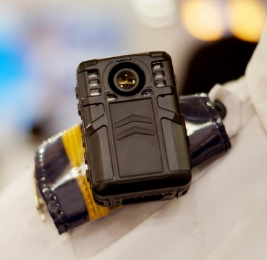
Observations…
The public is demanding transparency and accountability from law enforcement agencies.
Law enforcement agencies often push back due to legal and tactical considerations.
47% of general-purpose law enforcement agencies have acquired Body Worn Cameras (BWC); for large police departments, that number is 80%
Studies suggest < 4% of BWC video is reviewed
*The Bureau of Justice Statistics – November 2018 (BJS)

Slide 5
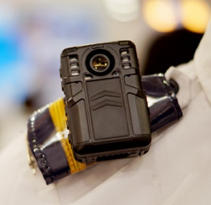
Observations…
When reviewing BWC video after a serious event, we often discover officer performance concerns that went unnoticed
Performance standards are historically outcome-oriented instead of process-oriented
Standardization from agency to agency does not exist
Officers frequently receive little feedback and coaching following their initial training
The feedback that is provided is often punitive

Slide 6
Law Enforcement Agencies Where do we start?
Strategies for Improving …
Workers’ Compensation Claims
Law Enforcement Liability Claims
Automobile Claims

Slide 7
How do we integrate safety and risk management into our management systems?
How are we measuring officer performance? Are our metrics promoting the desired performance?

Slide 8
What if we… look at more BWC video and measure officer performance against the agency’s best practices in a system where we believe…
• Error is normal, everyone makes mistakes
• Blame fixes nothing
• Learning is an active and deliberate improvement strategy
• Better systems produce better and more consistent outcomes
• How an agency responds to failure matters
• There is a difference between mistakes and misconduct

Slide 9
Codifying Officer Performance
What we did …
Step 1
Identify the incident types and key competencies that are integral to law enforcement response
Step 2
Identify and prioritize the job tasks and key performance indicators (KPIs) associated with each incident type
Step 3
Establish performance goals; monitor, measure and train to achieve those goals
Identified and standardized key competencies. Emphasized the most critical skills associated with performance outcomes.

Slide 10
Example: High-Risk Motor Vehicle Stop “Key Performance Indicator” (KPI) Execution of KPIs = Correct Process & Reduced Risk
High-Risk Motor Vehicle Stops KPIs
Notify dispatcher of the make, model, registration number, and color of the vehicle
Notify dispatcher of the number of occupants in the vehicle
Wait for backup
Turn off sirens
Position police vehicles to block roadway
Utilize contact/cover principle to communicate
Have subject exit vehicle and walk back to officers
Remove subjects from vehicle one at a time
Handcuff subjects from behind cover
Give verbal instructions to vehicle occupants not in view
Tactfully approach vehicle to clear vehicle

Slide 11
BWC Performance Ratings
How we “Code and Measure” Officer Performance?
Performance Ratings
No Action - The performance viewed was consistent with departmental policy and best practices
Commendation -The performance exceeds expectations and merits recognition
Counseling - The performance is inconsistent with policy and best practices, requiring the officer to be made aware of the inconsistency and begin improvement
Training - The performance is inconsistent with policy and best practices, requiring the officer to be retrained on the steps to successfully perform the series of job tasks
Performance Improvement Plan – The officer’s performance has failed to meet agency standards, even after receiving counseling, training and retraining. A documented 90-day plan will be implemented where the officer error is identified, training and counseling provided, performance expectations set, and scheduled meetings to discuss performance.
Forward to Internal Affairs - The performance violates a rule, regulation, policy, or procedure and requires additional review by Internal Affairs

Slide 12
Officer BWC Review Pilot Program (> 10,000 Videos Reviewed)
Supervisor Follow Up | Quantity | % of Total
Commendation | 14 | 1%
No Action | 1019 | 85%
Counseling | 115 | 10%
Training | 50 | 4%
Internal Affairs | 2 | -1%
Performance Improvement Plan | 1 | -1%
10 Agencies
180 Days
1201 BWC Reviews
Results taken from Union County, NJ BWC Performance Pilot Oct 2021 – April 2022 - 10 Agencies - 180 days - 1201 BWC Reviews

Slide 13
What Does Officer Coaching Looks Like?
….Let’s Review the Game Film Together
Officer Performance vs. KPI Standard

Slide 14
What can we measure and manage?
Law Enforcement
Data Available from
BWC Review Program
Officer performance vs. agency best practices (KPIs)
# of supervisor video reviews
Length of time from incident to review
Type of service call reviewed
Timeliness of employee feedback/improvement interventions
Officer demographics vs. performance
Link to loss trends and costs

Slide 15
Is the Officer BWC Review Process Working?
Workers’ Compensation Claims
Law Enforcement Liability Claims
Automobile Claims

Slide 16
Officer Error Rates Down!
The XXXX Police Department experienced a 25% reduction in officer error from October 2021 to March 2022
XXXXX Department 22Mar22
Q1: Oct ‘21 – Dec ‘21
41% Counseling & Training
55% No Action
Q2: Jan ‘22 – Mar ‘22
17% Counseling & Training
80% No Action
Sample Agency results taken from Union County, NJ BWC Performance Pilot Oct 2021 – April 2022 - 10 Agencies - 180 days - 1201 BWC Reviews

Slide 17
Officer Safety Errors - Top 10
Officer Error = Increased Risk
Lack of situational awareness
Not waiting/calling for back-up
Hands in pocket/vest carrier​
Allowing subjects to wander unescorted​
Poor/no search
Not placing vehicle in park before exiting vehicle
Failing to separate parties when conducting interview​
Failing to physically control combative subjects ​
Failing to notify Dispatch of location​
Standing too close

Slide 18
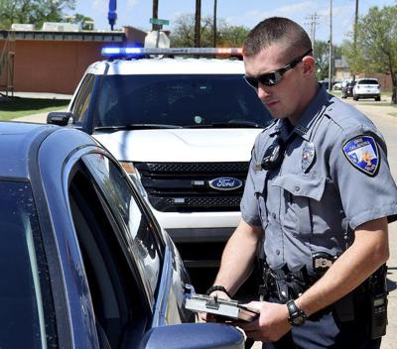
Case Study:
“Tell me why you stopped me.”
Identify the chain of events that lead to the increase in arrests for Disorderly Conduct
Where can we interrupt the chain of events?

Slide 19
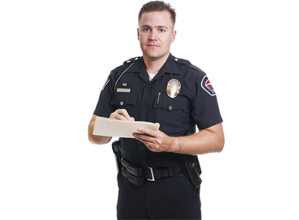
Case Study:
Working in the kitchen
State created danger
What are the types of losses the officer, agency, and public experience when tragedy occurs as a result of poor tactics?

Slide 20
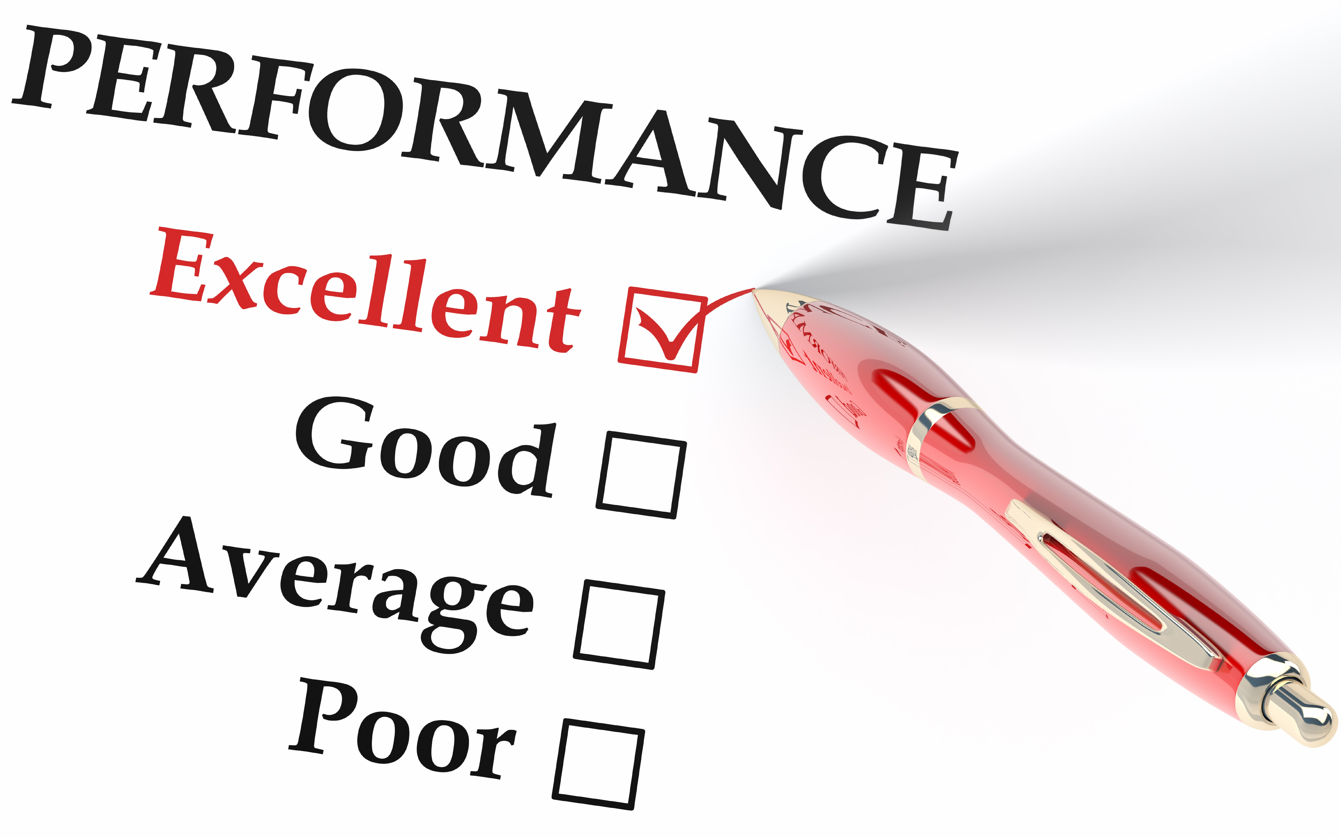
Defining Success… Changes Observed
Agencies are consistently viewing more BWC video than ever before​
Agencies are establishing clear performance standards ​/ KPIs
Agencies are prioritizing BWC video selection based upon the risk the response type exposes to the officer, the agency, and the public​
Agencies are setting performance goals, and monitoring officer performance to ensure performance improves ​
Agencies are documenting their performance improvement efforts
Officer morale has improved

Slide 21
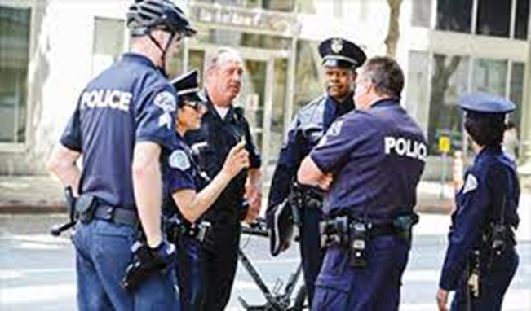
How to Get Started?
Identify program leadership
Identify Raters
Approve KRIs / Procedures
Establish Rate of Review
Define & Manage Data Collection
Software Platform
Establish Sample Group
User Group Meetings
Develop & Distribute “Insight Reports”
Recommended
Meet with Union Representatives & Sample Group
Share Performance Indicator List

Slide 22
Questions We Wanted to Probe
What we learned…
Are officer demographics predictors of performance (residency, age, education, race)
There is no data to support this. Experience is #1 predictor.
Which incident response types involve the most officer error?
Mental Health, DWI, and Motor Vehicle Stops
Where do officers display the most error - procedures, tactics, policy, or equipment?
Officer error appears most often in tactical issues
Does counseling, training, and discipline resolve officer error? If so, for how long?
When supervisors identify specific officer error, and provide remediation, improvement occurs in that officer.

Slide 23
Questions We Wanted to Probe
What we learned…
Does the solution lie in policy, culture, supervision, training, or the individual officer?
All of the above! But it rests on agency standards and performance review
Is there an accepted standard for police performance?
In most cases Agency SOP (standard operating procedures) and best practices are not captured or codified
Is the current method of officer development designed to achieve its intended results?
Historically officer performance is focused on outcomes – BWC review is focused on officer performance vs. standards (objective)

Slide 24
Discussion with Your Law Enforcement Command Staff
"Who watches the watchers?" / Who will police the police? – The Police
Roman poet Juvenal - ‘”Quis custodiet ipsos custodes?”
Are we proactively reviewing officer BWC video?
How many videos are reviewed per month/annually?
Is BWC review a job standard for supervisors?
How are service calls selected for reviews?
Is officer coaching occurring after reviews (documented)?
Has the agency clearly defined the job processes officers should be following?
What data and documentation are being collected from the BWC review process? What have we learned?
Difference between Agency Accreditation and Officer Performance?

Slide 25
Application Opportunities to Consider
Where do we have video…?
Corrections
Bus Drivers
Vehicle Pre-Trip Inspections (yard)
Customer Service Desks
…Coaching, feedback and performance metrics

Slide 26
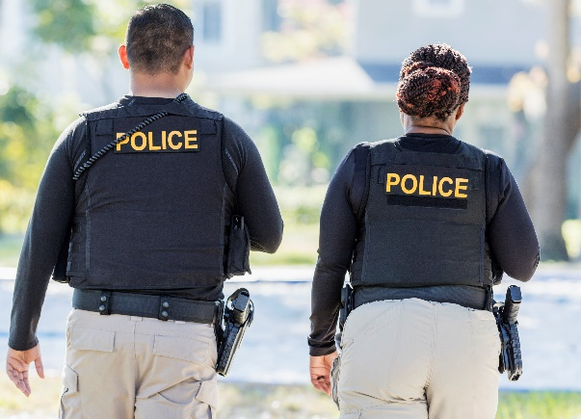
Summary Value of formal BWC Program for Law Enforcement Agencies
Identify specific areas of officer performance
based on error trends that lead to loss
Identify officers, officer groups, or supervisors
who over-represent on error data
Create evidence-based training solutions
Track officer performance life cycle (from initial interaction and supervisory review to mitigation and post-mitigation review)
Focus on loss-leading areas of officer performance

Slide 27
Summary Value of formal BWC Program for Law Enforcement Agencies
Inform organizational decision-making
Guide in-service training development
Guide field-training officer program
development
Identify policy gaps
Provide proof of performance for performance evaluations, collateral duty assignments and promotions
Officer recognition and reward
…Organization Culture Change

Slide 28
Questions….
David Weightman, CPCU, CSP, ARM Risk Control Manager PMA Companies 610-937-2696
david_weightman@pmagroup.com

