Slide 1
Special Events
Amy Larson, JD ARM
Risk and Litigation Manager
City of Bloomington, MN

Slide 2
Disclaimer
The material being provided in this presentation is for your general information and is not a substitute for legal advice. Consult your entity’s attorney for advice concerning specific situations.

Slide 3
Why Manage Risks Associated with Special Events?
Increase their chance of success.
Prevent potential losses.
Decrease the magnitude of a loss.
Support effective use of their resources.
Promote continuous improvement.
Reduce the number of unwelcome surprises.
Quickly grasp new opportunities.
Reassure stakeholders.

Slide 4
What are we going to cover?
What are Special Events?
Who are the stakeholders?
Internal
External
Event Basics
Permitting
Contracting
What types of risks are associated with Special Events?
How can you mitigate risks associated with Special Events?

Slide 5
Types of Special Events
Concerts
Fairs, Festivals, and Farmers’ Markets
Fireworks
Food Trucks
Parades
Petting Zoos
Political Rallies
Private Use of Public Facilities
Graduations
Weddings
Sporting Events

Slide 6
Internal Stakeholders
Licensing/Permit Department
Police
Police/Fire/EMT
Code Enforcement
Public Works
Parks and Recreation
Planning
Legal
You

Slide 7
External Stakeholders
Educational Institutions
Businesses
Chambers of Commerce
Homeowners/Residents
Other Governmental Organizations

Slide 8
Risk Management Goals for a Special Event
Prevent Injury and Loss to participants as well as your organization
Operate legally and in compliance with your entity’s rules/regulations/ordinances
Fulfill your entity’s social responsibilities

Slide 9
Risks associated with Special Events
Alcohol
Attendance
Size of the Special Event
Rides/Inflatable devices
Political Activities
Amplified Sound
Animals
Fire/Explosives/Combustibles
Use of Your Entity’s Name
Weapons

Slide 10
Event Basics
Permits
Assembly Permits
Food
Sales
Operational Plan
Tents
Power Needs
Porta-potties
Trash/Recycling
Traffic/Parking Plans
Safety Plan
Liquor?
Vendors
Communications Plan
Marketing Plans
Insurance???

Slide 11
How Do You Minimize the Risk when the event is being held on your property????
Insurance
Contracts
Hold harmless
A party agrees not to hold the other party responsible for any loss, damage, or legal liability
Indemnification
A party agrees to compensate the other party for any harm, liability, or loss arising out of the contract.

Slide 12
Drafting hold harmless and indemnification provisions:
Keep it simple
Avoid outdated terms
Avoid requirements that cannot be achieved in the marketplace
Allow flexibility
The type of clause you include will depend on the specific situation and your bargaining power with the other party

Slide 13
What about Waivers??
Include an indemnification clause (generally limited form).
Include a provision that the Contractor agrees to be personally liable if there is no insurance coverage, or if the coverage is not of an acceptable amount.

Slide 14
Name of the Special Event: _________________________________________
Date of Special Event:
I hereby acknowledge that my participation in the aforementioned event carries with it the potential for death, serious injury and/or property loss. I hereby expressly assume all risk of injury and damage and release ________________________from all liability and claims of whatever nature or cause which may occur as a result of my participation in this event. I further acknowledge that “No person or entity shall have the right to bring an action against _______________or any person employed by _______________________, who was acting within the scope of their authority, for damages resulting from or in connection with any such race, contest or exhibitions.”
_______________________________
Printed Name of Participant/Contestant
_______________________________
Address
_______________________________
Signature of Participant/Contestant and Date
If participant/contestant is a minor, (less than 18 years of age), parent or legal guardian must also sign:
________________________________
Printed Name of Parent/Legal Guardian
________________________________
Relationship to Participant/Contestant
_______________________________
Signature of Parent/Legal Guardian and Date

Slide 15
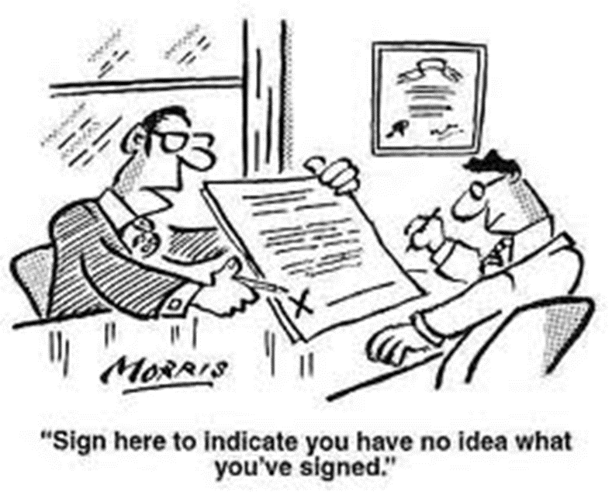

Slide 16
Questions?

Slide 17
Tomahawk Story……

Slide 18
Contact Info:
Amy Larson
City of Bloomington
1800 W. Old Shakopee Road
Bloomington, MN 55431
alarson@bloomingtonmn.gov
(952) 563-4932

