Slide 1
Narcan: Should Its Use Be Extended To Non-First Responders?
Fernando Branco M.D.
Chief Medical Officer/AVP Claims
Midwest Employers Casualty
A Berkley Company

Slide 2
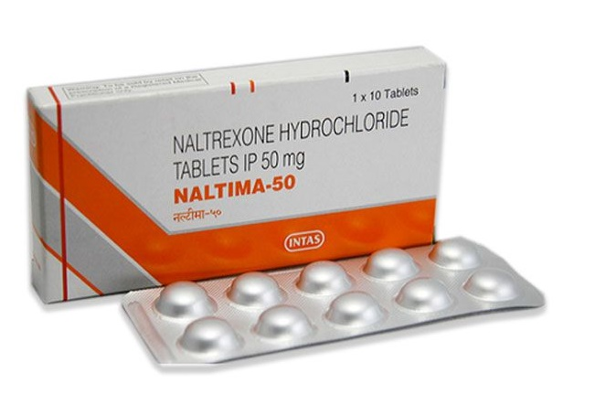
Naloxone or Naltrexone?
Naloxone brand name is Narcan It is not to be confused with Naltrexone, sold brand name Revia or Vivitrol, which are used for alcohol withdrawals and also to treat opioid use disorder by reducing cravings and feelings of euphoria. Naltrexone can cause opioid withdrawals like naloxone, but it is not used for overdoses. It is long-acting (4 to 13 hours).

Slide 3
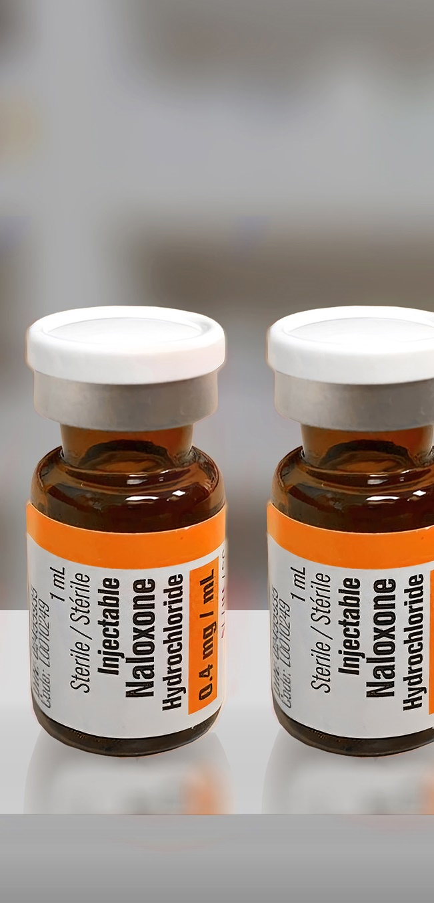
Narcan
Narcan is the brand name for Naloxone.
Patented in 1961 & first approved for opioid overdose in the United States in 1971
Non-selective, competitive opioid antagonist
Effects:
IV – 2 minutes
IM – 5 minutes
Nasal Spray – 2-5 minutes

Slide 4
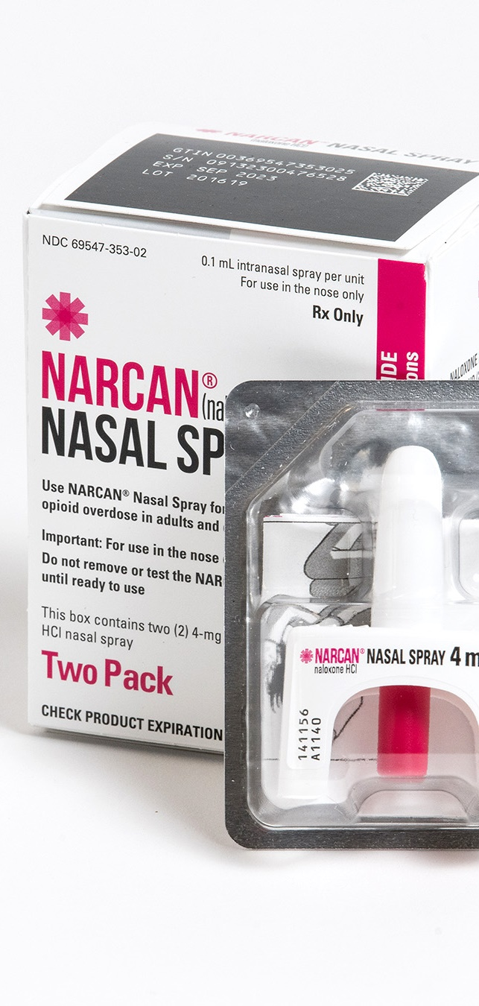
Narcan
Dosages: Nasal/IV/IM – 0.4-2 mg , repeat 2-3 minutes PRN, not to exceed 10 mg (0.01 mg/kg)
Effects wear out 30-90 minutes
Generic version available
Evzio discontinued due to low profit
ZIMHI – IM/IV use only
OTC Naloxone spray approved in all states except Hawaii (widely available by request)

Slide 5
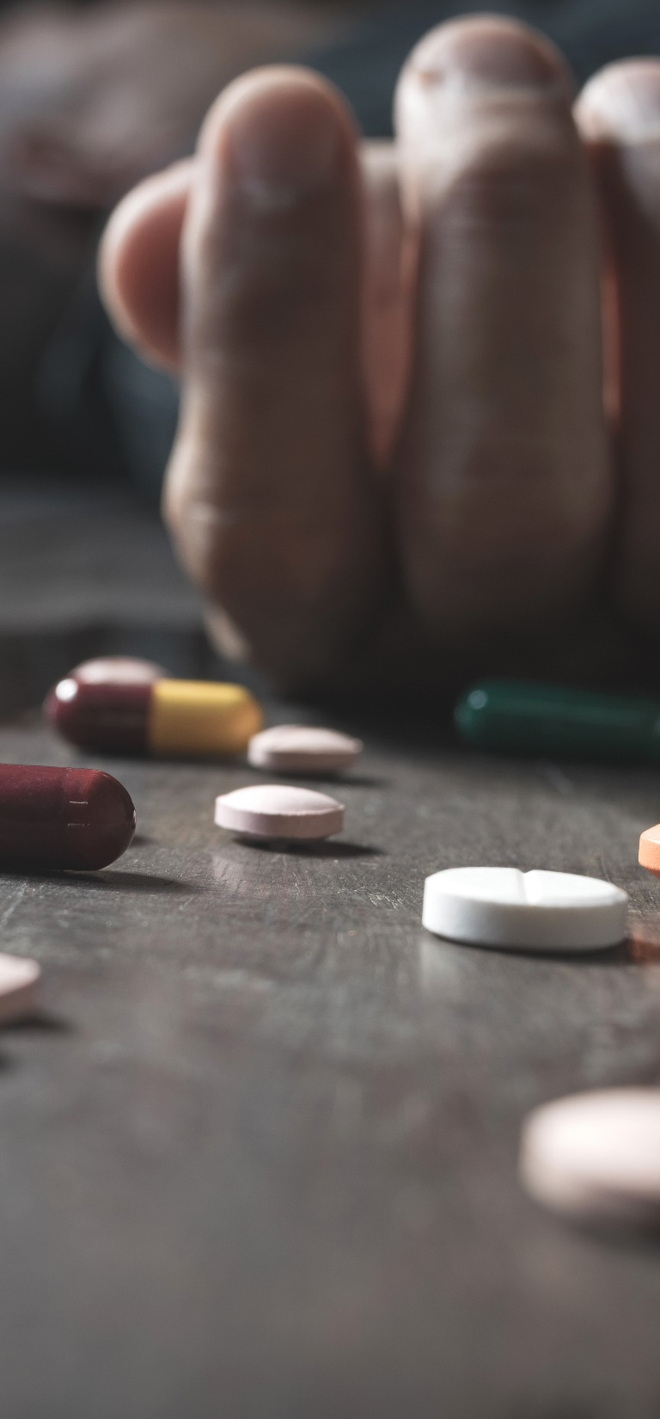
The Problem
Narcotic Epidemic – started in the 90’s, unchecked for decades
Initially, a whole generation of working individuals became addicted
Next, overdoses increased to record numbers
This led to paradigm shift, fewer doctors willing to prescribe
As a result, illegal use increases, leading to more overdoses
Add Fentanyl and Carfentanil to the picture
COVID further complicates situation

Slide 6
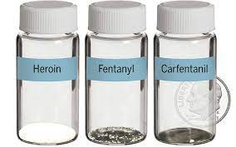
Illegal Fentanyl/Carfentanil
Synthetic opioids, liquid and powder
Cheaper, more powerful, more addictive, more dangerous
Fentanyl 50x stronger than heroine, 100x stronger than morphine
Carfentanil 100x stronger than Fentanyl, 10,000x stronger than morphine
Powder form is commonly mixed with drugs like heroin, cocaine and methamphetamines
Liquid used in nasal sprays, eye drops, candies, paper
Carfentanil has caused the deaths of several first responders
Add Xylazine (animal tranquilizer like Ketamine)

Slide 7
Illegal Fentanyl/Carfentanil
Now the most common drugs involved in overdose deaths
150 deaths per day (CDC)
Testing strips available but do not detect Carfentanil
Test strips also very expensive
Several doses of naloxone needed to reverse

Slide 8
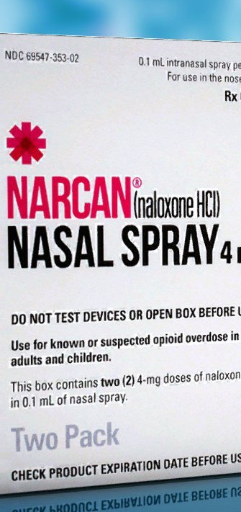
The Facts
109,000 deaths per year in the USA - AMA
Close to 1 million ER visits – AMA
26,500 overdoses reversed by lay people from 1996 to 2014 – CDC
93.5% of people given naloxone survived overdose – Emergency medical services data from Massachusetts
Not all overdoses are related to illegal use; can be due to dementia, children accessing the drugs, or mistakes by medical personnel or patients
Bystanders present in 2/3 of overdoses

Slide 9
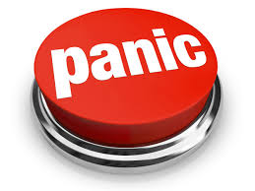
“Not such a great idea”
Untrained individual usage – risky?
Does it promote drug use?
Does it make the crisis worse?
Liability for the person giving the drug
Legal issues with companion drug users not calling 911 after use
Good Samaritan laws in most states to protect those who are overdosing and anyone assisting them in an emergency from arrest, charges or a combination of both.
Same discussion with needle exchange in the 80’s

Slide 10
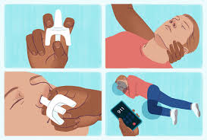
Criteria for Nasal Naloxone - ODG
Heroin or illicit synthetic opioid use (Fentanyl)
History of opioid misuse and recent release from incarceration or other controlled setting
Misuse of prescription opioids
Treatment for opioid use disorder, including medication-assisted treatment
Use of illicit drugs (e.g. cocaine) that may be contaminated with synthetic opioids

Slide 11
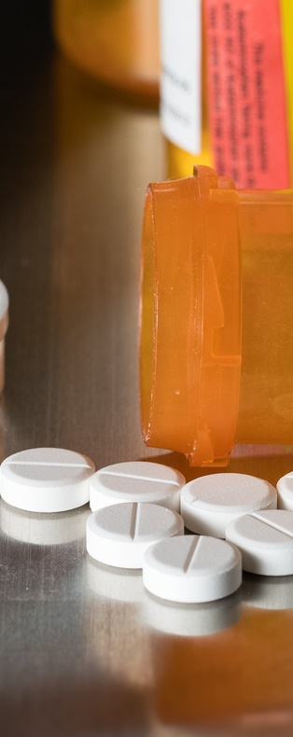
Criteria for Nasal Naloxone - ODG
Patient taking opioid therapy for chronic pain and 1 or more of the following:
Concomitant use of benzodiazepine
High-dose opioid therapy (>50 MED)
History of opioid overdose
History of substance use disorder
Patient at risk for returning to high dose to which no longer tolerant (release from prison or rehab)

Slide 12
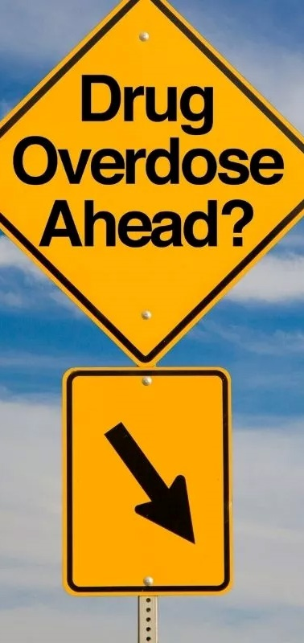
Signs of an overdose
Small, constricted “pinpoint pupils”
Falling asleep or losing consciousness
Slow, weak or no breathing
Choking or gurgling sounds
Limp body
Cold and/or clammy skin
Discolored skin – lips/nails

Slide 13
Protocol - CDC
Call 911 immediately
Administer Naloxone
Try to keep the person awake and breathing; if trained in CPR, might need to start
Lay the person on their side to prevent choking
Stay with the person until emergency assistance arrives
Repeat naloxone after 5 minutes if no improvement and no emergency personal arrived

Slide 14
Final Thoughts
Not a solution to the big problem
A question of ethics and morality?
Emergency personnel needs to be protected
Addiction is a disease
Death is final
What happens after the worst is avoided?

