Slide 1
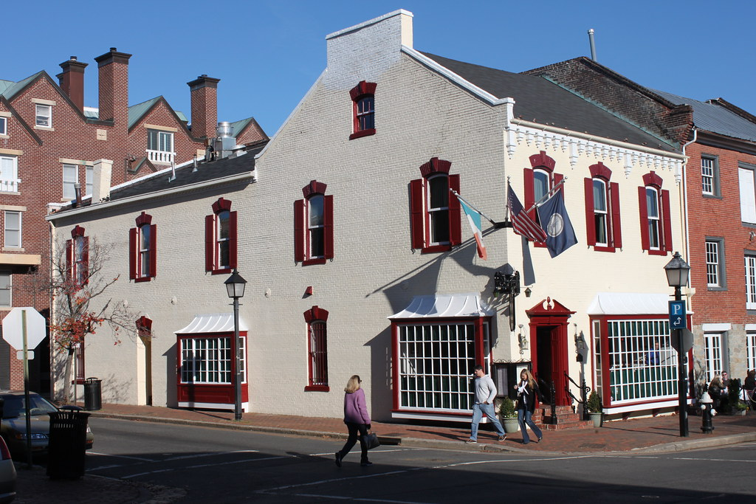
Emerging Topics for 2023 & Beyond
John Chino, ARM-P, ARM-E, CSRM

Slide 2
AGENDA
Today’s Topics
Prognostications from 2021 – How did I do?
The Insurance Market – it’s been hostile is it getting better?
Top 10 Trends for 2023 and Beyond
Cybersecurity & IT Disruptions
Aging Infrastructure
Social Inflation
The Great Resignation/Remote Work
Workers’ Compensation: Presumption Expansion and New & “More Mature” Workers.
Sexual Abuse Liability
Law Enforcement Liability
Climate Change
Pandemics (not just Covid)
Regulatory Risk

Slide 3
2022 Trends ? Not so much
I correctly predicted Civil Unrest would not be a trend.
I correctly predicted (but understated) “hyper-inflation” as a trend.
The order has changed…but Cyber continues to be the top “emerging” issue due to the interconnectivity of society and remote work.
Aging Infrastructure has “emerged” as a trend.
The Great Resignation creates multiple exposures and hazards.
The Insurance Market is trending worse than last year…

Slide 4
Not an Insurance Trend: Civil Unrest
Civil Unrest
The cost of the riots which occurred from May 26 through June 8 are estimated at $2 Billion in insurance claims.
This is the highest amount ever recorded going back to 1950 when the first civil disorder costs were tracked.

Slide 5
Temporary Trend: Hyper Inflation & the cost to rebuild
Architect’s Budget and the Actual Bids
The Pandemic has ravaged work crews and work sites
Logistics and supply chain issues have created huge cost increases for building materials especially wood products
Inflation fueled by fiscal stimulus
Many public agencies and school districts have shelved construction plans or reduced project sizes.
And your contractor is going to have a hard time meeting your insurance requirements!!

Slide 6
This is not a Crisis…it’s actually “good”.

Slide 7
Wait a second, maybe it is a Crisis? (Not really but it will still be painful)

Slide 8
Market Dynamics – Where we are now.
More Pressure on Underwriting
Prudent Underwriting Decisions
Underwriting Results Matter more than ever!
Pressure on Investments
Interest Rates
Investment Income
8

Slide 9
2023 Reinsurance Renewals – 1/1/23 Trending BAD!

Slide 10
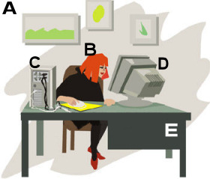
Trend #1: CYBER Underwriters Speak (and you’re not going to like what they have to say).
The risk exposure has changed so dramatically that we have to bring up those rates and we have to wait until those insureds have better controls in their network for us to bring those rates back down a bit.”
Pricing is part of the solution, but pricing alone won’t end the hard market, according to Paul Needle, senior vice president of cyber treaty reinsurance at Munich Re. Increased cyber maturity for insureds is what will have “an exponential effect” on losses, he added.
“No longer can we accept that they’re going to implement certain controls post-binding, it absolutely needs to be in place,” said Needle. “To me, the difference between this and any other hard market is the underlying change in the underlying process.”

Slide 11
Ransomware – trending towards a very bad Monday Morning

Slide 12
Cyber Threat Actors: We are #1!!!
Big Game Hunting – the practice of choosing your target based on how much they can pay.
Trend: Average Ransom payment is up 82% from 2021 at $570,000.
Trend: Combining Extortion Techniques!
Insurance Industry Response – a completely new approach:
Cutting Limits – especially limits for ransomware
Tighter Underwriting Controls
Insurers “packaging” solutions with the policy

Slide 13
Big Game Hunters want YOU
From a top-down risk perspective, the result is an increase in risk if your client works in certain fields. The industries subject to ransomware attacks the most in 2021³ (in descending order) were:
Government
Education
Healthcare
Technology
Services
Manufacturing
Retail
Utility
Finance

Slide 14
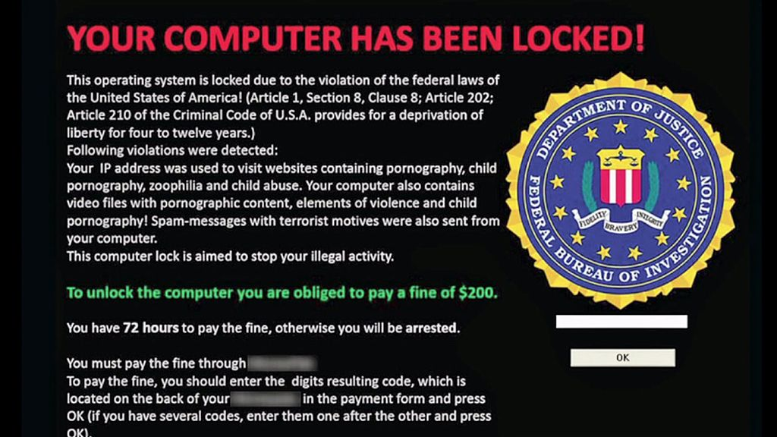
CYBER Nagging! (get used to it)
Do you have Multi factor Authentication (MFA) for all remote devices?
Do you have an “air gap” or a segmented backup with unique credentials? Test it!
Do you have Endpoint Protection?
“Cyber Security is the area for conflict in the 21st Century”
James Lewis, CSIS
Future Trend: Alternative Funding such as Captives and ILS will replace traditional insurance

Slide 15
Trend: Fighting Back
Federal Response
StopRansomware.gov, a new website facilitating access to advice and resources to assist U.S. firms in combatting the threat of ransomware
Rewards of up to $10M for information on Threat Actors
State Response
State of Arizona, Department of Homeland Security providing free of charge to every public agency:
MFA
Endpoint Protection

Slide 16
Aging Infrastructure

Slide 17
The Water Crisis in Mississippi's largest city is a harbinger of worse
In the US, 21M Americans drank water from systems that do not meet safety standards (2015 last time a study was made).
Investment in Water systems has been declining since 70’s
Most pipes were installed in the 70’s and 80’s and have not been upgraded
The Bipartisan Infrastructure Law will “shower” $55Bn on water infrastructure

Slide 18
I Quit!

Slide 19
No one is getting younger but 10,000 Americans a day turn 65
In April 2021, a record 4.0 million Americans quit their jobs. In June 2021, approximately 3.9 million American workers quit their jobs.
Resignations are consistently the most prevalent in the South, where 2.9% of the workforce voluntarily left their jobs in June, followed by the Midwest (2.8%) and the West (2.6%). The Northeast is the most stable region, with 2.0% of workers quitting in June.

Slide 20
Trend or Not?? EPLI is much more Expensive
New Losses Since COVID:
Wrongful Termination dropped by 14% as a total of all losses.
Discrimination & Harassment: Racial jumped 8% as a total of all losses.

Slide 21
Trend #3: Social Inflation and Nuclear Verdicts
Nuclear Verdict: any award that is significantly disproportionate to what would be expected.
Nuclear Verdict: a jury award in which the penalty exceeds $10M

Slide 22
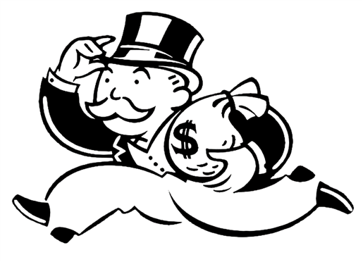
What is Social Inflation?
The increase in insurance losses due to social and political factors
Desensitization re: the “value of money”
More liberal treatment of claims by WC boards & Legislators
Funded by Investors
Influenced by circumstances entirely independent of the specific facts of any individual case
Difficult to predict
Prevalence and degree
Liability insurance losses have increased at exponential rates since 2021 and there is no relief in sight.

Slide 23
Judicial Hellholes – 2021/2022
#1) CALIFORNIA (again)
2) NEW YORK
3) GEORGIA SUPREME COURT
4) PHILADELPHIA COURT OF COMMON PLEAS AND THE SUPREME COURT OF PENNSYLVANIA
5) COOK, MADISON AND ST. CLAIR COUNTIES, ILLINOIS
6) LOUISIANA
7) CITY OF ST. LOUIS, MISSOURI
8) SOUTH CAROLINA ASBESTOS LITIGATION

Slide 24
Social Inflation – still inflating and not very social….
 | First | Second | Third
2018 | Florida | California | St. Louis, Missouri
2019 | California | Florida | New York City
2020 | Philadelphia Court of Common Pleas | California | New York City
2021 | Pennsylvania SC | New York | California
2022 | California | New York | Georgia SC
Things have gone from bad to Oh My Lord! Are you serious? Really??
Settlements and Verdicts are 5 to 10 times greater than just 12 months ago and there is no sign things will get better.

Slide 25
3* Trends for WC
Low Unemployment leads to inexperienced workers and over worked employees
Mega Claims: Claims greater than $3M
Medical Inflation is “off the charts”.
*Over 35 is the new “aging workforce”

Slide 26
Workers’ Comp & Goldilocks Which employees are “just right”?
Spiers authored a report on the subject which stated “studies and initial financial metrics provide strong empirical evidence that injuries to an aging workforce are real, significant and will continue to be a driving factor in increased employee injury costs over the next 10 to 20 years.” Workers 55 and older are 21% of claims but 31% of cost.
You need to take special care with new employees. One workers’ compensation insurance underwriter analyzed 5 years of claims and found that 28 percent of workplace injuries resulting in claims happened in the first year of employment.
An inexperienced worker’s first month on the job is the riskiest. Another insurer found a worker’s injury rate is four to six times higher in the first month on a new job.

Slide 27
Expansion of Presumption Laws

Slide 28
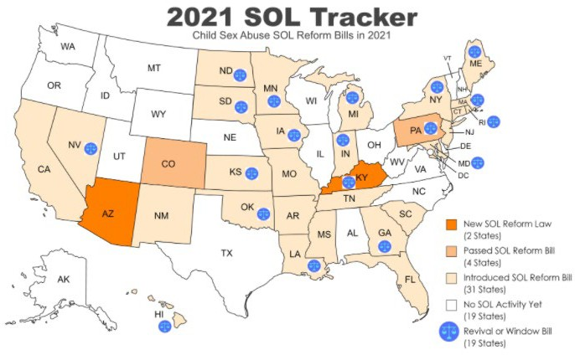
Reviver Legislation and Sex Abuse – 2021
Source: Child USA https://childusa.org/2020sol/

Slide 29
State Laws are old news…
President Biden signed a bill that will eliminate the statute of limitations for people who were sexually abused as minors to file civil claims.
The Eliminating Limits to Justice for Child Sex Abuse Victims Act was passed by the House by voice vote after passing the Senate by unanimous consent in March.
Previously, minors who survived such abuse were able to file federal claims until they reached the age of 28 or until a decade after the violation or injury was discovered.

Slide 30
Insurance Industry Response
Retreat entirely
Claims Made Coverage
Lower Limits, Higher Deductibles & Raise Prices
“Sunset Clauses”
Knowledge of the event equals an exclusion
Aggregate Limits (One time limit)
Per Victim Attachment – Sexual Abuse often involves 2 to 50+ victims.
Mandatory Loss Control
John Chino Prediction for 2022 and Beyond:
Occurrence Coverage is Dead
And Scholastic Risk will be available via Captives owned by Insurance Pools
2023 and Beyond:
Risk Management will be stepped up on a collaborative basis not previously seen

Slide 31
COVID –Business Interruption (BI) and WC 2020 Results
As of November 2020, P&C insurers had paid a total of $419.7 million for business interruption
losses—less than a third of the $1.3 billion in case incurred losses and a small fraction of the
estimated COVID-19-related economic losses sustained by U.S. businesses.
Workers’ Compensation Insurers reported receiving over 210,000 claims, the vast majority of which (over 85 percent) were closed without payment by insurers

Slide 32
WC & COVID

Slide 33
Some good news….

Slide 34
I Predict: Cat Bonds will be the Savior for Pandemic risk
World Bank created a Cat Bond for the Ebola Pandemic in 2017.
$320 Million in Bonds and $105 Million in Swaps
Written for a 5 year period
The trigger is a minimum number of deaths in certain developing countries and must be exponential
The Ebola pandemic failed to meet the trigger but Covid did and $196 Million was paid to some countries.

Slide 35
Trend #7: Insurers are not keen on Law Enforcement risk
Civil Unrest
Public Perception
Hiring, training, operating
Changes in law
Colorado
New Mexico
Qualified Immunity

Slide 36
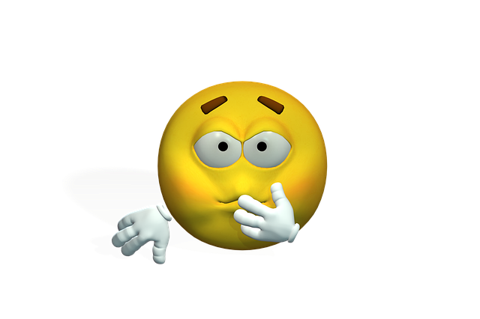
Law Enforcement “fixes” that Insurers find abhorrent
State Legislators are working overtime to fix law enforcement
Colorado Senate Bill 217
Eliminates Qualified Immunity
Officers to face up to $25k in personal damages
House Bill 1250
Deadly force as a “last resort”
New Mexico HB4
Allows New Mexicans to launch lawsuits against governmental entities in State Court if they believe their civil rights have been violated.
Eliminates Qualified Immunity

Slide 37
The Defund Movement quickly flamed out and became the Refund Movement but departments are woefully understaffed.
Understaffing at the root of all problems
Most everyone blames the current situation on understaffing, which is said to be at 50 percent of capacity.

Slide 38
Climate Change and Increasing Losses for the Industry

Slide 39
Insurance is embedded in the issue in many ways
Insurance is not only critical to the rebuilding of damaged areas but also key to mitigation:
Mitigation investments reduce risk
HSB remote sensor technology to detect leaks
Alabama law that when roof is repaired its more resilient
Swiss Re partnered with Iceye Oy for satellite imagery of disasters
EigenRisk for live data on 40+ “cats”
Buy your own fire engine…

Slide 40
Climate Change will it lead to liability issues? YES…get ahead of it, now.
Litigation on a range of environmental, social and governance issues is on the rise.
“Greenwashing claims” – when a company overstates its green or ESG credentials
ESG are now fundamentally driven by Government
US SEC now has a climate and ESG taskforce
US Federal Reserve is focusing on the impact on firms financials
$35 Trillion in assets are monitored using a sustainability lens
Trend: increased losses for Directors & Officers, Errors and Omissions and Employment Practices Liability

Slide 41
Trend #10: Regulation or ESG
ESG: Environmental/Governance/Social Integration
Environmental Stewardship
Climate Change
Diversity and Inclusion
Racial justice
Workplace Conduct
Data Privacy
Business Ethics
Investments
Investors
INSURANCE INDUSTRY
ESG Risks of Clients They Insure

