Slide 1
Rockets & Exploding Bombs A Career in Risk Management

Slide 2
So How do “I” get “There?”

Slide 3
Focus on the Important Stuff First It is Not ALL Important!! SELL what is! It is NOT all equally Important SELL!!

Slide 4
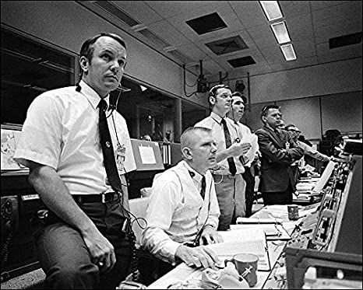
Relationships and Communication
Phone
E mail
In person

Slide 5
What you Say to Yourself Matters “Be Thankful More Often”
VIDEO

Slide 6
Validation
VIDEO

Slide 7
Have a Sense of Urgency
VIDEO

Slide 14
Put in Time and Effort to Be Better at Your Craft
Put the time in. It is NOT an 8 to 5 job
Take those opportunities for training
Politics are real - - - - - regardless of the facts!
Never say no - - - say Yes - - - - but - - -
Take time for you

Slide 15
Workers’ Compensation
Designated providers (at least first visit)
All inclusive light duty program
The communication Diamond
Frequent flyer review
Vendor relationships
Inclusive communication

Slide 16
Employee
Claims Examiner
Employer
Supervisor
Risk Management
Treating Physician

Slide 17
GL and Auto Claims
Prompt reporting (30 minutes) 24 hours
Be accessible
Good report form/ structure
Early intervention
Know the witnesses EARLY

Slide 18
Subrogation
Centralized
Great Communication
Follow up

Slide 19
Failures

Slide 20
Sometimes you will Fail
After 20 years in the private sector
10 years into employment in Goodyear
The City of Flagstaff

Slide 21
Failure + Positive Attitude = Success
VIDEO

Slide 22
Hugh McAlease

Slide 23
Know when the Tide is Changing

Slide 24
VIDEO

Slide 25
Read the Room

Slide 26
I should REALLY listen to the voice in my head!!

Slide 27
It’s just a BAD DAY It is Not a Bad Life!!

Slide 28
Greatest Successes
“Saving our Assets” training programs
Who is the Risk Manager?
It’s in the numbers
Friends along the way
Hire for positive attitude and aptitude
“You Can’t send a Duck to Eagle School”

Slide 29
Mentorship
VIDEO

Slide 30
Mentorship
Staff
Fellow Employees
Family
Friends
New to their Risk Career

Slide 31
Maintaining a Successful Risk Program
Accountability
Relationships
The Right Attitude
Consistency
Who to Hire?

Slide 32
Rocket Fuel Thoughts
Life is not Fair!!! Get over it and MOVE ON!
You can fail at anything so why not do what you love. FIND YOUR JOY
DON’T GIVE UP to easy, you will never know how close to success you were
Take Risks

Slide 33
Rockets and Exploding Bombs
VIDEO

Slide 34
VIDEO

Slide 35
The Legacy of a Career

